Slide 1
2020-21 NFHS Field hockey Rules PowerPoint
Rules Changes
Major Editorial Changes
Points of Emphasis

Slide 2
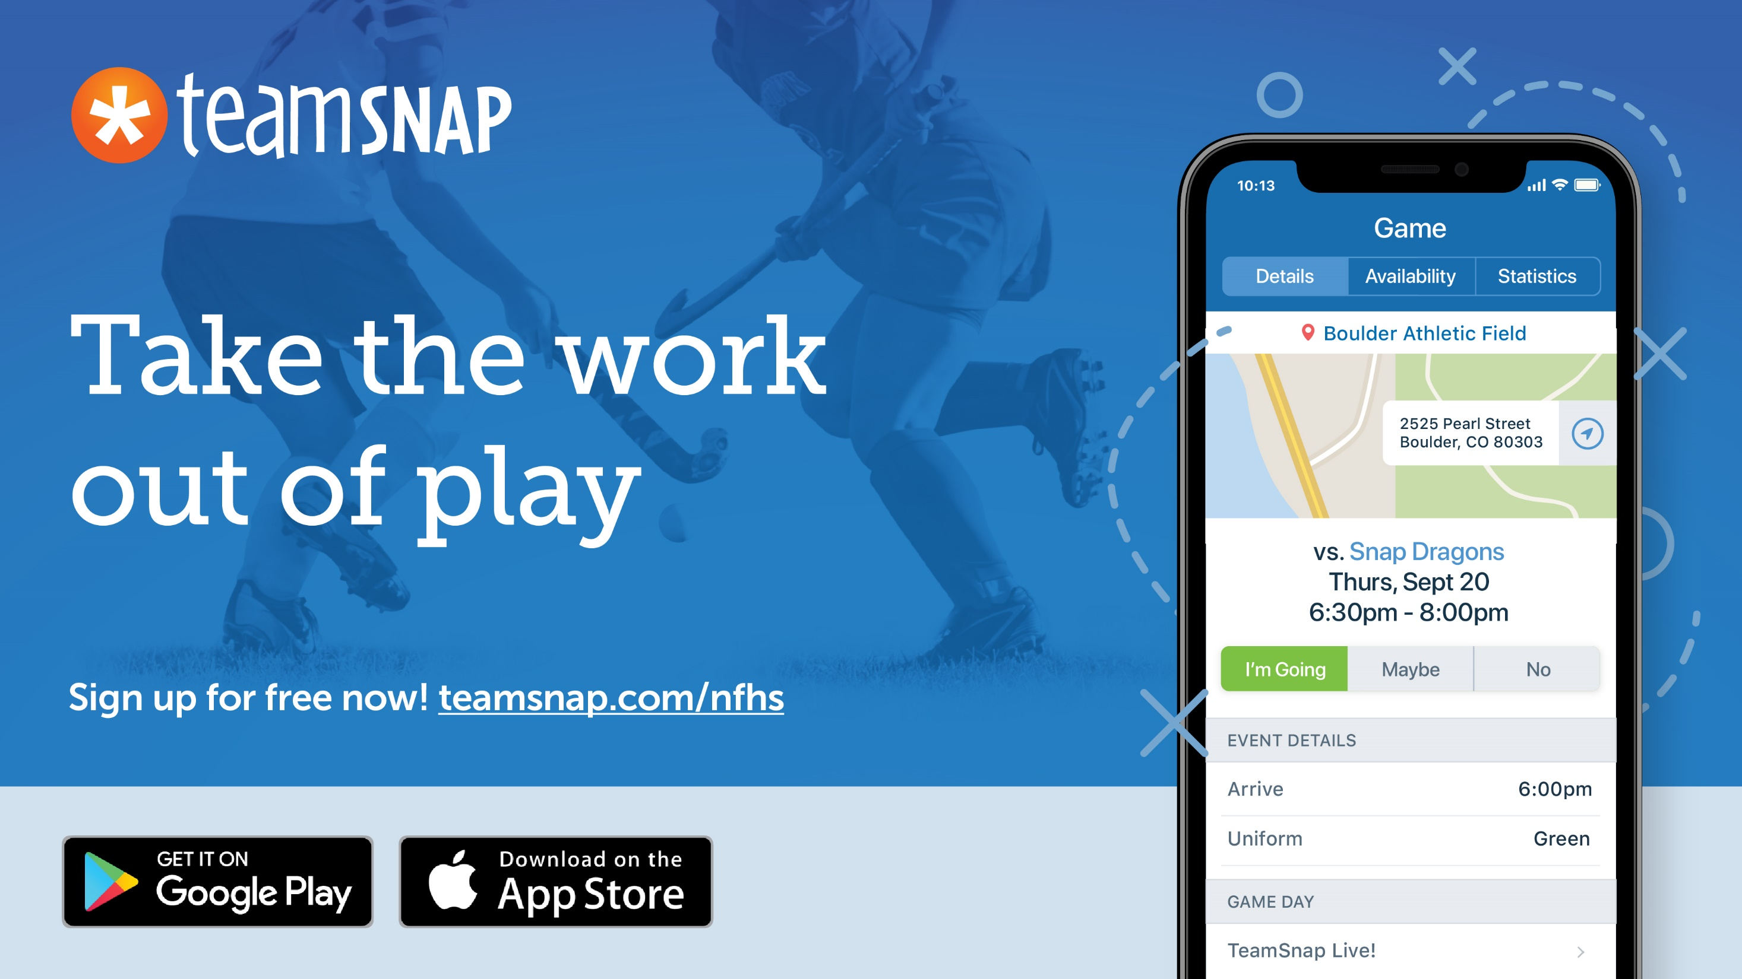
Sponsor Slide
remove this text and place artwork centered here

Slide 3
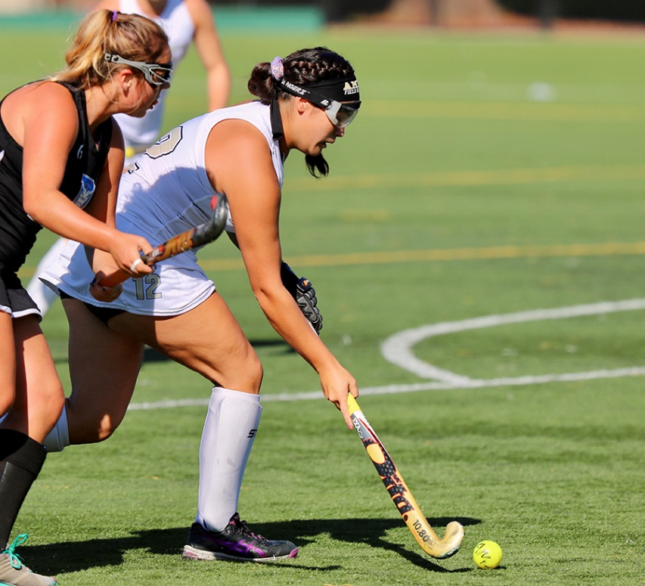
National Federation of State High School Associations
NFHS (located in Indianapolis, IN – Est. 1920):
National leadership organization for high school sports and fine arts activities;
National authority on interscholastic activity programs.
Conducts national meetings;
Sanctions interstate events;
Produces national publication for high school administrators;
National source for interscholastic coach training and national information center.
Notes:
The NFHS is the national leadership organization for high school sports and fine arts activities;
We serve as the National authority on interscholastic sports and activities; conduct national meetings; sanctions interstate events; produces national publication for high school administrators;
National source for interscholastic coach training and national information center.
VISION - It is the vision of the NFHS to help prepare tomorrow’s leaders for the next level of life through the many program offerings in education-based athletics and activities.
The National Federation of State High School Associations (NFHS) is the national leader for education-based high school athletics and activities,
which prepare tomorrow’s leaders for the next level of life through innovative programs, healthy participation, achievement, and development of positive relationships.
MISSION - A significant responsibility of the NFHS is the commitment to writing quality playing rules.
The National Federation of State High School Associations (NFHS) serves its members by providing leadership for the administration of education-based high school athletics and activities
through the writing of playing rules that emphasize health and safety, educational programs that develop leaders, and administrative support to increase participation opportunities and promote sportsmanship.

Slide 4
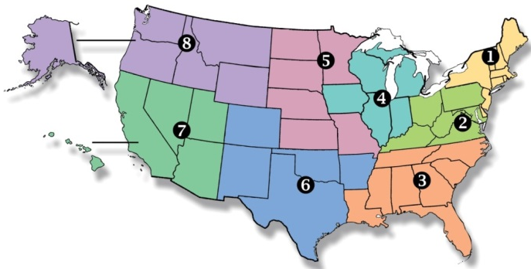
National Federation of State High School Associations
NFHS (located in Indianapolis, IN – Est. 1920):
National leader and advocate for high school athletics and performing arts programs.
Serves 51 state associations, 19,500 high schools and 12 million student participants.
Writes playing rules for 17 high school sports for boys and girls.
Offers online education courses for high school coaches, officials, parents, students and others.
Ensures that students have opportunity to enjoy healthy participation, achievement and good sportsmanship in education-based athletics.
Notes:
NFHS Membership includes 50-member state associations plus the District of Columbia.
Our membership is split into 8 different sections which are depicted in this map you see here.
The NFHS reaches more almost 20,000 high schools and 12 million participants throughout the 8 NFHS sections across the U.S.

Slide 5
NFHS Rules Review Committee
The NFHS Rules Review Committee is chaired by the chief operating officer and composed of all rules editors. After each committee concludes its deliberations and has adopted its recommended changes for the subsequent year, such revisions will be evaluated by the Rules Review Committee.
Davis Whitfield
Chief Operating Officer
Lindsey Atkinson
Girls Lacrosse and Volleyball
Bob Colgate
Football and Sports
Medicine
Sandy Searcy
Softball, Swimming & Diving and Water Polo
Elliot Hopkins
Baseball and Wrestling
Julie Cochran
Cross Country, Gymnastics, Field Hockey and
Track & Field
James Weaver
Boys Lacrosse
and Spirit
Theresia Wynns
Basketball and Soccer
Dan Schuster
Ice Hockey

Slide 6
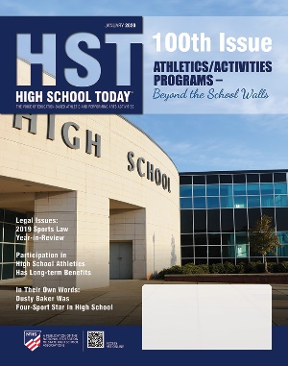
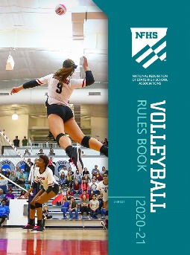
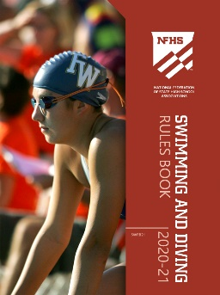
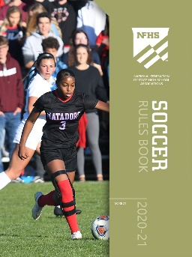
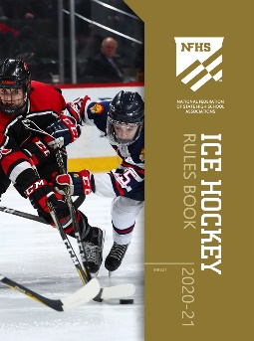
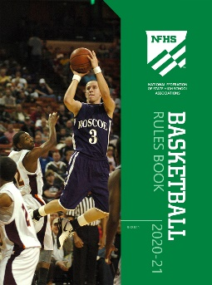
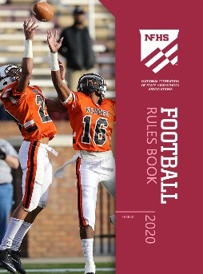
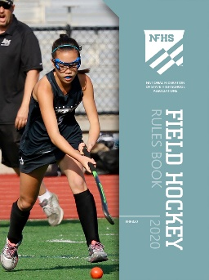
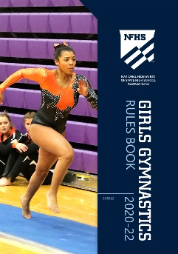
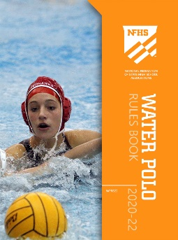
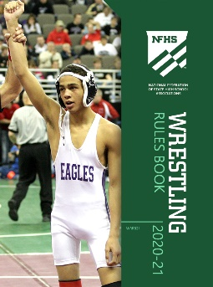
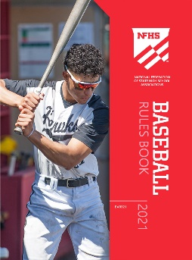
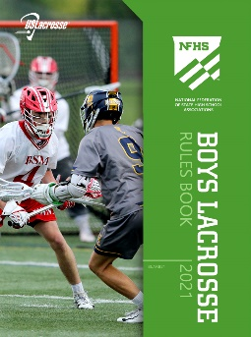
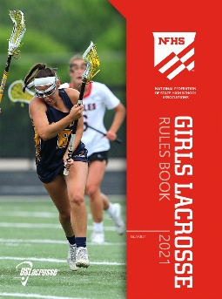
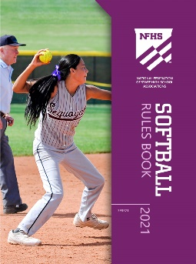
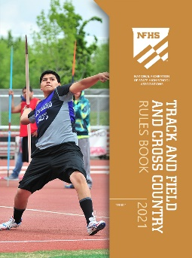
National Federation of State High School Associations
The NFHS writes playing rules for 17 sports for boys and girls at the high school level.
Publishes 4 million pieces of materials annually.
Notes:
The NFHS writes rules for 17 sports, publishes High School Today along with several other key publications totaling over 4 million pieces annually.

Slide 7
NFHS Rules Book as e-Books
E-books features:
Searchable
Highlight areas of interest
Make notes
Easy navigation
Adjustable viewing size
Immediate availability
Notes:
In addition to the printed rules book, the Track and Field and Cross Country Rule books is also available as an E-book for a cost of $6.99.
To purchase the rules and case E-book; go to each sport specific page on the NFHS.org site where you will find information about purchasing and/or downloading not only rule books but other sport specific publications.

Slide 8
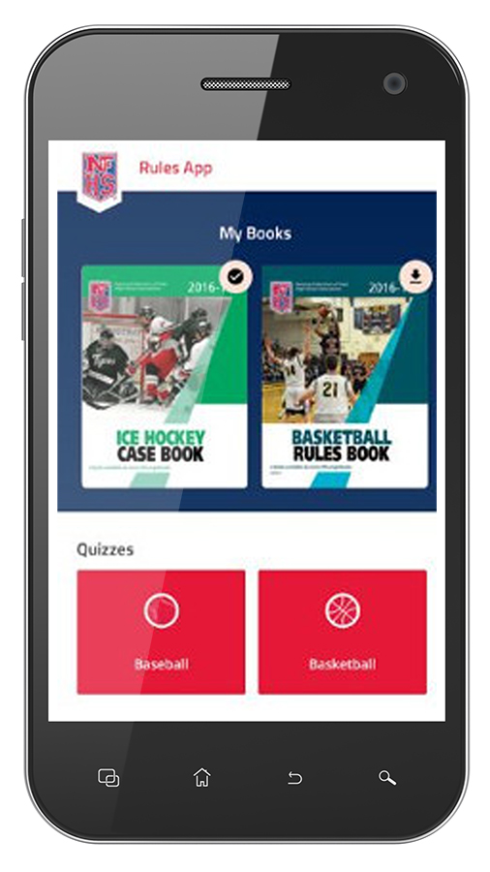
NEW NFHS Rules App
Rules App features:
Searchable
Highlight notes
Bookmarks
Quizzes for all sports
Easy navigation
Immediate availability
Free to paid members of the NFHS Coaches and Officials Associations
www.nfhs.org/erules for more information
Notes:
A Rules app for all NFHS rules books and case books is available on iTunes and Google Play. The app is free to download. Each book subscription is $6.99;
Rules books and case books will be cross-linked and Searchable. NFHS Coaches and Officials Association paid individual members get all books for free, and 100% states members get books for free in sports designated by their state.

Slide 9
2020 nfhs field hockey RULES CHANGES
Rules Changes

Slide 10
The field
ART. 1 . . . The field shall be a smooth rectangular area. The dimensions, lines, goals and markers shall be as illustrated on the accompanying diagram. To minimize risk for all participants and ensure a more consistent and uniform playing surface, the grass should be cut to a maximum height of 1½ inches. A regulation size field is 100 yards long by 60 yards wide. Where space limitations mandate a smaller field, 90 yards long by 50 yards wide may be used. On a reduced or enlarged size field, the 25-yard lines, striking circles and penalty
Notes:
Or enlarged field was added to help clarify markings on fields that are used for multiple sports.

Slide 11
SECTION 5 PLAYER UNIFORM
Rule 1-5-1 thru 8 Player Uniform
ART. 1 . . . All uniforms shall adhere to the following:
a. Members of each team shall be dressed uniformly, except the goalkeeper. The uniform top shall have clearly visible numbers on the front and back.
b. The home team shall wear single solid white uniform tops front and back on the torso, and the visiting team shall wear single solid black or dark-colored uniform tops front and back on the torso.
1. Players are permitted to wear a single-color undershirt, short or long-sleeved. If worn, the undershirts for the home team shall be white and for the visiting team shall match the color of the jersey or be black or a dark color. All players on the same team who choose to wear an undershirt must wear the same color.
2. The “torso” is the portion of the top from an imaginary horizontal line at the base of the neckline extending to each armhole/sleeve, down to the bottom hem of the top and from side seam to side seam.
c. Uniform bottoms shall be like-colored.
1. Multiple styles of uniform bottoms may be worn by teammates and may include: shorts, skirts, kilts, or pants provided the shin guards are visible. (1-6-2)
2. Any undergarment that extends below the team uniform shall be the same color.
d. The school’s name, nickname, logo, mascot and/or team player’s name are permitted on the uniform top and/or bottom.
1. Lettering must be placed horizontally and may be arched. Names may also be on multiple lines.
2. There are no restrictions in the area of the jersey/top from an imaginary horizontal line at the base of the neckline extending to each armhole/sleeve, up to the shoulder seam.
Notes:
Rationale: Re-organization of the uniform rule to remove redundant language as well as added language about uniform bottoms for clarity.
Undershirt old Art 6 2019 book
Uniform Bottoms are new as there was no rule in previous book as to what could be worn on the bottom.

Slide 12
SECTION 5 PLAYER UNIFORM
Art 1 continued
e. Neckline and Armhole/Sleeve Trim Requirements
1. Trim shall not exceed 1 inch around the neck and arm openings.
2. Side inserts must be centered vertically below the armpit.
3. The width of the side inserts, including trim, must be a maximum of 4 inches (2 inches on each side of the seam).
4. The style/design of the side insert may be of any color or design. Side inserts must be the same width for all team jerseys.
f. The home team shall wear solid knee-length white socks/sock guards (not rolled down) and the visiting team shall wear solid knee-length contrasting dark-colored socks/sock guards (not rolled down).
g. A single partial/whole manufacturer’s logo/trademark/reference, no more than 2 ¼ square or 2¼ inches in any dimension, inches is permitted on each piece of the uniform provided placement does not interfere with the visibility of the player’s number.
h. One American flag, not to exceed 2 inches by 3 inches, may be worn or occupy space on each item of uniform apparel. By state association adoption, to allow for special occasions, commemorative or memorial patches, not to exceed 4 square inches, may be worn on the uniform without compromising its integrity.
Notes:
Socks was Art 3 in 2019 Rules Book

Slide 13
SECTION 5 PLAYER UNIFORM
ART. 2 . . .The number shall be:
Clearly visible;
A solid color contrasting to any surrounding colors;
No more than two digits (00-99);
NOTE: A team may not use both 0 and 00. Duplicate numbers are not permitted on the same team.
At least 3 inches in height on the front of the uniform top;
At least 6 inches in height on the back of the uniform top;
If a visible number is worn on the uniform bottom, it shall be the same number as on the uniform top.
ART. 3 . . . In the case of similar team uniforms, the team not wearing proper uniform tops shall wear contrasting pinnies with visible numbers.
ART. 4 . . . Individual players may wear mittens/gloves, knitted hats and soft headgear.
ART. 5 . . . Jewelry shall not be worn except for religious or medical medals. A religious medal must be taped and worn under the uniform. A medical-alert bracelet must be taped and may be visible.
ART. 6 . . . . Hair control devices may be worn if made of soft material.
ART. 7 . . . When an illegally uniformed team is unable to correct the situation or cannot verify state association approval of the uniform, the game shall be played. The official must, however, notify the state association following the game.
PENALTY A field player wearing an illegal uniform shall be removed from the game at the first stoppage of play following the discovery of the violation. The removed player may re-enter if she has complied with the rules, or she may be replaced, in a manner consistent with the substitution rules. Misconduct penalties will be assessed to the head coach, using the card progression.
Notes:
Reorganization of number rule in Art 1 of 2019 book
Art 7 gives officials direction when dealing with uniform violations that are playable.

Slide 14
SECTION 6 PLAYER EQUIPMENT
Rule 1-6-1 Player Equipment
ART. 1. . . All field players shall wear mouth protectors. A tooth and mouth protector (intraoral) shall include occlusal (protecting and separating the biting surfaces) and labial (protecting the teeth and supporting structures) portions and shall cover the posterior teeth with adequate thickness. It is recommended that the protector be:
a. Properly fitted, protecting the anterior (leading) dental arch, and
b. Constructed from a model made from an impression of the individual’s teeth, or;
c. Constructed and fitted to the individual by impressing the teeth into the tooth and mouth protector itself.
Notes:
Rationale: Allows the use of mouth protectors that also cover the lips and brings the language in line with other NFHS rules books.
Also language was removed from this section that discussed the rules review committee and the NFHS reviewing non-traditional playing equipment.

Slide 15
SECTION 8 GOALKEEPER EQUIPMENT
Rule 1-8-1a Goalkeeper Equipment
ART. 1. . . The goalkeeper shall wear:
a. A uniform top of a color or colors contrasting to the color of the uniform tops of field players of both teams, and with a visible number on the front and back, opposing goalkeepers may wear the same color.

Slide 16
HEAD COACH RESPONSIBILITIES
1-9-1b Head Coach Responsibilities Penalty (NEW)
PENALTY: After a coach certifies that his/her team is properly and legally equipped, and the official later discovers that this is not the case, the coach shall be assessed the appropriate misconduct penalty, using the card progression.
Notes:
Rationale: Clarifies penalty for illegal uniform or equipment after the game has begun.

Slide 17
OFFICIALS
2-1-6 Officials
ART. 6 . . . The officials shall use cards for misconduct violations. An official’s time-out shall be taken. The table-side official should check with the scorer to make sure that the player’s number, the reason for the penalty, and the time and length of the penalty are recorded correctly in the official scorebook before play is resumed.
Notes:
Rationale: Clarifies the procedure for officials when issuing a misconduct violation.

Slide 18
PROCEDURES
3-2-4 Procedures
ART. 4 . . . 25-yard free hit is a method for an attacker to put the ball in play if a a player from the defending team unintentionally causes the ball to go across the end line. The attacking team shall be awarded a 25-yard free hit. Play is re-started with the ball on the 25-yard line that is in line with where it crossed the end line. All procedures for taking a free hit apply. All players shall be 5 yards away from the ball. The ball may not be played into the circle until it has traveled at least 5 yards (not necessarily in a single direction) or has been touched by a player of the defending team.
Notes:
Rationale: Clarifies that the ball must travel at least 5 yards before being played into the circle. Additionally, redundant language is removed.

Slide 19
SECTION 4 OTHER
Rule 3-4 Other (NEW)
ART. 1. . . Flagrant foul is any act (physical or verbal) which is extremely offensive and/or could cause bodily injury or harm to any player. The offender shall be immediately disqualified.
ART. 2. . . Open space is no one being within playing distance of the ball.
ART. 3. . . Playing distance is the distance within which a player is capable of reaching the ball to play it.
Notes:
Rationale: Reorganizes and adds definitions to the rules book.

Slide 20
PROCEDURES
Rule 3-2 Procedures
ART. 2. . . Free hit is a means of putting the ball in play by any player following a foul by an opponent. A player may use a hit, flick, scoop, push or self-pass.
ART. 12 . . . Self-pass is a method for taking a free hit, center pass, side-in or 25-yard free hit where the player may touch the ball more than once or dribble the ball in any direction.
Notes:
Rationale: Clarifies the definition of the self-pass and when it may be used. It also removed redundant language.

Slide 21
TECHNIQUES
Rule 3-3-9 Techniques (NEW)
ART 9 . . . Shadowing is the act of being within playing distance of an opponent and following their movement on the field without impeding their progress.
Notes:
Rationale: Adds definition to the rules book.

Slide 22
Length OF PERIODS
Rule 4-1-1 Length of Periods
Art. 1. . . The game shall consist of four quarters of 15 minutes, an interval of 2 minutes between quarter 1 and 2 and between quarter 3 and 4. There shall be a halftime between quarters 2 and 3 of no more than 10 minutes after which the teams shall change ends of the field. Games involving players below the varsity level may be of shorter duration.
Notes:
Rationale: Aligns with several other rules codes. This is intended to allow for teams to maximize their play for the entire match. Set stoppage times will offer breaks for rest, hydration and strategizing. This change should be relatively easy for both the timers and umpires to administer.
5-1-1 and 5-2-2 also affected

Slide 23
STARTING AND STOPPING THE CLOCK
Rule 4-2-3 Starting and Stopping the Clock
ART. 2 . . . The game clock shall be stopped by the official’s signal for:
a. Injury to a player or an official;
b. Goalkeeper substitution;
c. Penalty strokes;
d. Carding or disqualification of a player;
e. A goal;
NOTE: By state association adoption, the clock may continue to run after goals when one team is ahead by a specified number of goals, or alternative game ending procedures may be established after having completed the second quarter.
PENATLY : Failure of a team to be ready to play after a goal is scored, or any other stoppage of the game clock shall be considered misconduct by the coach and penalized accordingly.
Notes:
Rationale: With the change to four quarters teams have guaranteed breaks for rest, hydration and coaching opportunities. The removal of team timeouts will help keep the game fluid.

Slide 24
SUBSTITUTION
Rule 4-4-5 Substitution
ART. 5 . . . All substitutions must take place through the team substitution area, with the player coming off the field before her substitute may go onto the field.
Notes:
Rationale: Clarifies that all substitutions must go through the team substitution area with the player coming off before the substitute may go in.

Slide 25
PLAYER MISCONDUCT AND PENALTIES
8-2-1 PENALTIES Player Misconduct and Penalties
PENALTIES:
1. In all cases of misconduct during play, an official’s time-out shall be taken to issue the card. The player must leave the field immediately and the game is restarted by assessing the appropriate penalty with no further interruption. The penalty time shall start with the restart of play. The time of the suspension/disqualification shall be recorded in the scorebook. A team shall play short for the duration of the suspension or disqualification.
a. For a green card, the suspension time is 2 minutes.
b. For a yellow card, the suspension time is 5 or 10 minutes.
c. For a red card, the offender is disqualified for the remainder of the game.
When a goalkeeper is suspended or disqualified, the coach shall remove one field player for the suspension or disqualification period, and the offending goalkeeper shall be replaced by another fully outfitted goalkeeper. The field player removed by the coach, may properly substitute with another field player provided that her team continues to play short during the goalkeeper's suspension or disqualification. Players and goalkeepers who received a green or yellow card, shall serve their suspension at the scorer's table on the same side as their team bench. Players and goalkeepers who receive a red card are the responsibility of the coach and shall be removed to their bench or another appropriate place.

Slide 26
PLAYER MISCONDUCT AND PENALTIES
2. If the situation warrants, the official may issue a red card on a first violation. If a red card is issued, then this is considered a flagrant foul. The offender shall be disqualified.
3. For any simultaneous misconduct fouls, the offenders shall be suspended or disqualified, and both teams shall play short.
4. For misconduct by a player(s) during any stoppage of the game clock, the player(s) shall be carded. The player(s) shall be removed from the game and the team shall play short. The penalty time shall start with the restart of play.
Notes:
Rationale: Clarifies the penalties for suspensions and disqualifications.
Others rules affected
5-2-1 if ball out of bounds.

Slide 27
PENALTY CORNER
Rule 10-3 Penalty Corner – Criteria for Completion
ART. 3 . . . Extended Play Only: If a penalty corner is awarded at the end of the first three quarters, the game shall continue in order to complete the penalty corner. If the penalty corner is awarded at the end of the game, the game shall continue in order to complete the penalty corner unless the scoring opportunity of the goal would not influence the outcome of the game. If time expires at the end of the game after the insertion from the end line, play shall continue until the penalty corner is completed.
Notes:
Rationale: Brings the criteria for completing a penalty corner in extended play in alignment with regulation play.

Slide 28
COACHES’ CONDUCT
Rule 12-1-2a Coaches’ Conduct
ART. 2. . . Coaches and nonparticipating team personnel shall not:
a. Use abusive language;
b. Taunt or bait anyone involved in the game;
c. Move along the sideline in a distracting manner;
Notes:
Rationale: Removed repetitive language.

Slide 29
COACHES’ CONDUCT
Rule 12-1-Penalties Coaches’ Conduct
PENALTIES:
1. In all cases of misconduct during play, a time-out shall be taken to issue the card. When possible, officials should wait until the next stoppage of play to call time-out and issue a card to the offender(s) and the head coach.
a. A green card is a warning; no player is removed from the field, the team does not play short.
b. For a yellow card, the head coach of the offending team shall remove one field player from the game for 5 minutes of elapsed playing time. The designated field player may properly substitute with another field player provided that the team plays short.
c. For a red card the offender(s) and the head coach are disqualified and are removed from the team area. The offending team shall remove one field player from the game and the team plays short for the remainder of the game. The designated field player may properly substitute with another field player provided that the team plays short.
d. For any flagrant foul, any identified offender(s) and head coach shall be removed from the team area and a penalty stroke shall be awarded the opponent and the team shall play short.

Slide 30
Coaches’ conduct
NOTE: When flagrant misconduct occurs during any intermission, a red card is issued, and a penalty stroke is taken prior to the beginning of the next quarter.
e. In the case of a coach being removed from the field and an assistant coach or other authorized school personnel is not available, the team shall forfeit the game.
2. If the situation warrants, the official may issue a yellow or red card on a first misconduct violation.
3. To restart play:
a. If a foul was called prior to stopping the clock, the game is restarted by assessing the penalty for that foul.
b. If the ball went out of bounds the game shall be restarted by awarding the side-in, 16-yard hit, or 25-yard hit.
c. If no foul was called prior to stopping the clock, play shall be restarted with a bully at or near where play on the ball ended.
Notes:
Rationale: Clarifies penalty intent and adds definitions of cards to rule on coaches conduct.

Slide 31
2020 nfhs Field Hockey Editorial CHANGES
Editorial Changes

Slide 32
THE FIELD AND MARKINGS
1-2-4l The Field and Markings
ART. 4 . . . In addition to the boundary lines, the following lines and marks shall be placed in accordance with the accompanying diagram:
l. SCORERS’ TABLE – The scorers’ table and team benches shall be placed on the same side of the field. The scorers’ table shall be placed slightly in front of the team line.
Notes:
Rationale: This table is not the officials' table. The officials are out on the field. Changing the name to "Scorer's table" might help schools provide a score keeper at the games.

Slide 33
PLAYER EQUIPMENT
Rule 1-6-5 Player Equipment
ART. 5. . . All field players shall wear eye protection that meets the ASTM standard for field hockey (F2713) at the time of manufacture.
Notes:
Rationale: Adds the ASTM standard to the rule instead of appearing solely in the note.

Slide 34
PLAYER EQUIPMENT
Rule 1-6-7 Player Equipment
ART. 7. . . Required equipment shall not be modified from its original manufactured state and shall be worn/used as intended by the manufacturer.
Notes:
Rationale: Mirrors R 1-6 Penalties:1.

Slide 35
GOALKEEPER EQUIPMENT
Rule 1-8-1 Goalkeeper Equipment
a. A uniform top of a color or colors contrasting to the color of the uniform tops of both teams, and with a visible number on the front and back;
g. Field hockey goalie pads, not to exceed 12 inches in width per pad (frontal view);
h. Field hockey goalie shoes or kickers;
b. A full face/cage mask-helmet which covers the entire head including the back of the head (cage must be rounded at all points); mask helmets shall not have a hard, visor-type protrusion which extends beyond the cage.
e. A chest protector specifically manufactured for field hockey goalkeepers. The chest protector must be worn under the uniform jersey;
f. Field hockey goalie gloves with separate fingers (no webbing) that do not exceed 8 inches in width when lying flat; or foam hand protectors which are no more than 9 inches wide when laid flat, face up, and no more than 14 inches long when measured from the base to the extremity of the hand protector. Hand protectors shall not be altered;
d. A wrap-around type throat protector.
c. A tooth and mouth protector, which may be attached to the facemask/helmet. A tooth and mouth protector (intraoral) shall include occlusal (protecting and separating the biting surfaces) and a labial (protecting the teeth and supporting structures) portions and shall cover the posterior teeth with ad- equate thickness. It is recommended the protector be properly fitted and 1) constructed from a model made from an impression of the individual’s teeth or 2) constructed and fitted to the individual by impressing the teeth into the tooth and mouth protector itself.
Notes:
Rationale: The top down order, of required equipment, makes checking for compliance easier.

Slide 36
officials
Rule 2-1-4c Officials
ART. 4 . . . Prior to the game, the officials shall:
c. Meet with captain(s) and head coach from each team, and proceed with the following:
Introductions;
2. Coin toss for choice of goal or possession of ball;
3. Review of ground conditions;
4. Review sportsmanship expectations.
5. Verify with each coach that all players’ uniforms and equipment are legal.
Notes:
Rationale: Coaches/players should not be asking how rules will be interpreted but may need reminder of important rule changes, especially early in the season.

Slide 37
PENALTY CORNER
Rule 10-3-2
ART. 2 . . . If play is stopped because of an injury, inadvertent whistle or any other reason during the taking of a penalty corner and a bully would otherwise be awarded, the penalty corner must be retaken.
Notes:
A new article was created for stoppage in place for injury or inadvertent whistle. This was letter g in 2019 book but moved to article as article one simple deals with when a penalty corner is complete.

Slide 38
2020 Nfhs Field hockey points of emphasis
Points of Emphasis

Slide 39
Providing an official scorer and timer
Rule 2-2 outlines the duties of the scorers and timers for field hockey.
The home team shall supply the official timer and scorer.
They are to remain at the scorer’s table for the entire game, including intermissions between quarters.
The home team should supply an audible device as well as a game clock and stopwatch.
NFHS rules recommend they wear officials pinnies at the table.

Slide 40
tackling
The NFHS rules book defines tackling as a technique executed by a player in an attempt
to gain possession or cause the opponent to lose possession of the ball.
To properly execute a tackle, the player must be in the proper position to avoid a foul.
The player shall not use the stick dangerously, nor deliberately make body or stick contact to gain any advantage when tackling.
Remember that a player can’t hit, hook or hold an opponent’s stick with her stick. There should be clear intent to play the ball by the tackling player and the timing of the movement must be exact.

Slide 41
5-yards
The opponent (and attack players inside the attacking 25) shall be 5 yards from the selfstart/ free hit.
If an opponent is within 5 yards of the ball, she may shadow the opponent but must not
interfere with the taking of the free hit/self–start and must not play nor attempt to play the
ball. The NFHS rules book defines shadowing as the act of being within playing distance of
an opponent and following their movement on the field without impeding their progress. If
this player is not playing the ball, attempting to play the ball or influencing play, she has
not violated the 5-yard rule. If the player does impede progress or influence play, she shall
receive a warning and another free hit may be awarded. For repetitive violations by a player,
the official should use the proper card progression. Be aware the player taking the self-pass
does not have to delay her start.

Slide 42
Issuing cards
Officials must always consider violations for repetitive, non-dangerous fouls, deliberate
actions, misconduct or dangerous play. When possible, the official should use preventive
officiating.
Card progression is an important tool in game management as well as ensuring player
safety and fairness during the game. At times a verbal caution can serve as a warning to both teams from an official. However, when one player or one team commits repetitive fouls and is in the card progression, it is not appropriate game management to include both teams in this same card progression. Both teams have their own card progression and should not be included in the opponents’ card progression.

Slide 43
NFHS OFFICIALS Education

Slide 44
Notes:
OFFICIALS EDUCATION
Every opportunity should be taken to improve upon officiating. Clinics, course work, observations, video review, association meetings should all be considered when attempting to improve one’s skills in officiating. The NFHS has provided opportunities for officials and prospective officials to take courses and to review video to support learning and developing officiating skills.
Sport-Specific Officiating courses are offered in several sports. They are ideal for new officials and those in the first few years of officiating. These courses introduce officials to the mechanics and techniques used in the sport and provide specific information on an area within that sport. Individuals can complete a course within 30-45 minutes. The cost of these courses is $10.00 to NFHS Officials Association members and $20 for non-members.
“Interscholastic Officiating” is a general course on sports officiating and it is free to members and cost $20 for non-members. This course provides an introduction to skills and concepts used as an official. Several topics are covered such as: basics of becoming and staying an official, science of officiating, art of officiating, how to combine these skills for successful officiating.
Video clips are made available to NFHS Officials Association members. The video is clipped on specific topics and provides the rules references as well as dialogue on the topic.
The courses and videos are offered at www.NFHSLearn.com .
Courses Available:
Officiating Football
Officiating Volleyball – Ball Handling
Officiating Volleyball – Alignment
Officiating Basketball
Officiating Basketball – Three-Person Mechanics
Soccer – Fouls and Misconduct
Soccer - Offside
Swimming and Diving
Officiating Wrestling
Umpiring Softball
Future Courses to be Considered:
Umpiring Baseball
Field Hockey
Track and Field
Umpiring Softball – Mechanics
Communication Among Officials and Coaches

Slide 45
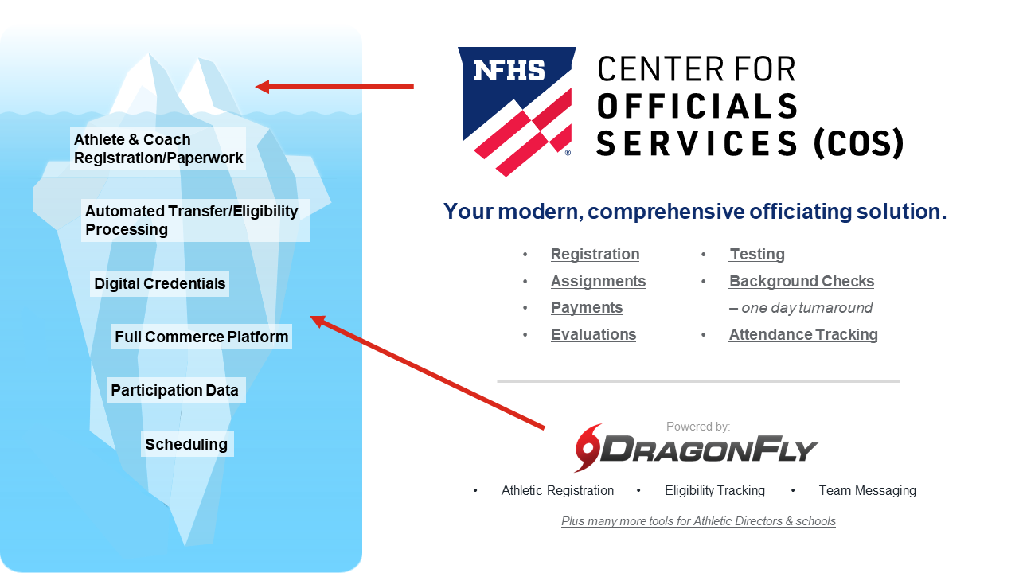
NFHS Center for Officials Services (COS)
Notes:
Your Complete Solution for Officials Management and More:
Registration
Assignment
Payment
Testing
Background Checks
For More Information on the NFHS – Center for Officials Services (COS) Contact:
Davis Whitfield, NFHS, dwhitfield@nfhs.org
Karissa Niehoff, NFHS, kniehoff@nfhs.org
Also If You’re Interested in Eligibility and Monitoring Requirements Contact the Folks at Dragonfly:
Kirk Miller, Dragonfly, kirk@dragonflyathletics.com
Brandon Wallace, Dragonfly, brandon@dragonflyathletics.com

Slide 46
NFHS Learning Center

Slide 47
Notes:
The NFHS Learning Center, accessed at NFHSLearn.com has over 70 online professional development courses for the entire interscholastic community, including coaches, administrators, officials, parents, students, and individuals within performing arts programs. The mission and purpose of the NFHS Learning Center is focused on growing professional development opportunities. Those opportunities include courses, but now also incorporate additional videos such as “The Parent Seat” and “Beyond The Scoreboard,” which are short videos created to show to parents at Parent Meetings or show during events. The NFHS Learning Center has delivered over 10,000,000 courses and looks to continue to educate and be a valuable resource for the entire interscholastic community. Learn more at NFHSLearn.com!

Slide 48
NFHS Network

Slide 49
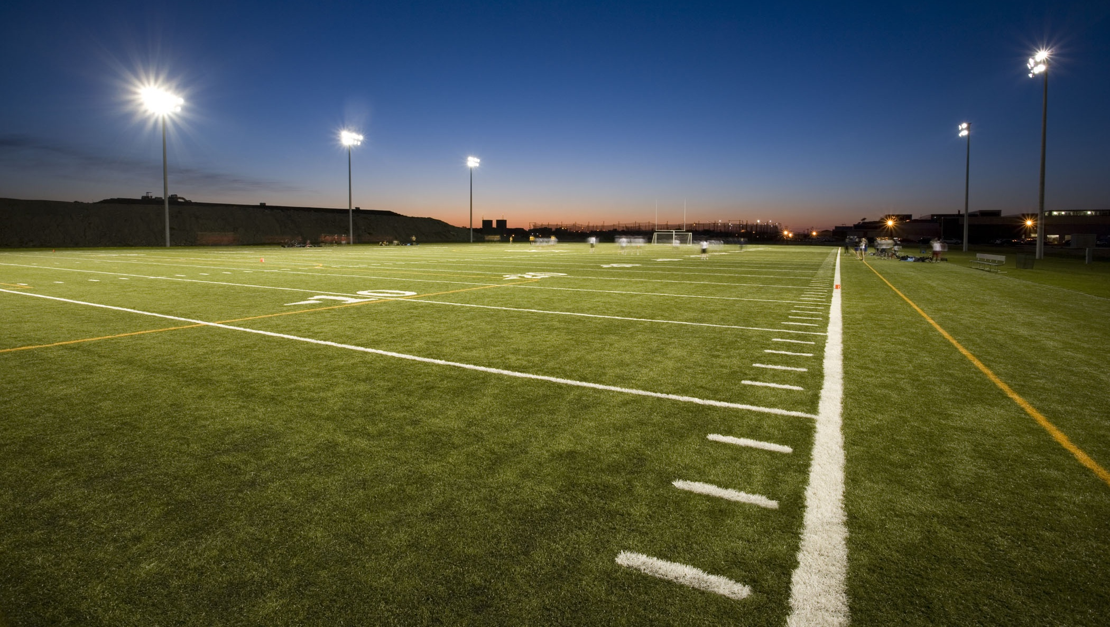
NFHS Network
By 2025, every high school sporting event in America will be streamed live.
The NFHS Network will be THE DESTINATION for fans to view these broadcasts.
27 Different Sports and Activities
www.NFHSnetwork.com
Notes:
The NFHS Network is the leader in streaming Live and On Demand high school sports.
Partnered with the National Federation of State High School Associations, 45 high school state athletic/activities associations, and PlayOn! Sports, the NFHS Network is a joint venture created to provide fans with the ability to stream high school sports on any device, from wherever they are.
All NFHS Network events are available to watch online at www.NFHSnetwork.com and through the NFHS Network Live App for iOS and Android. Follow us on Facebook, Twitter, Instagram, and YouTube.
Watching high school sports and events has never been easier.
The NFHS Network’s goal to broadcast live all 2 million high school sporting events by 2025.
The NFHS Network covers 27 different regular season and postseason sports, as well as other high school activities, celebrating the accomplishments of students-athletes, student broadcasters, and high schools across the country.

Slide 50
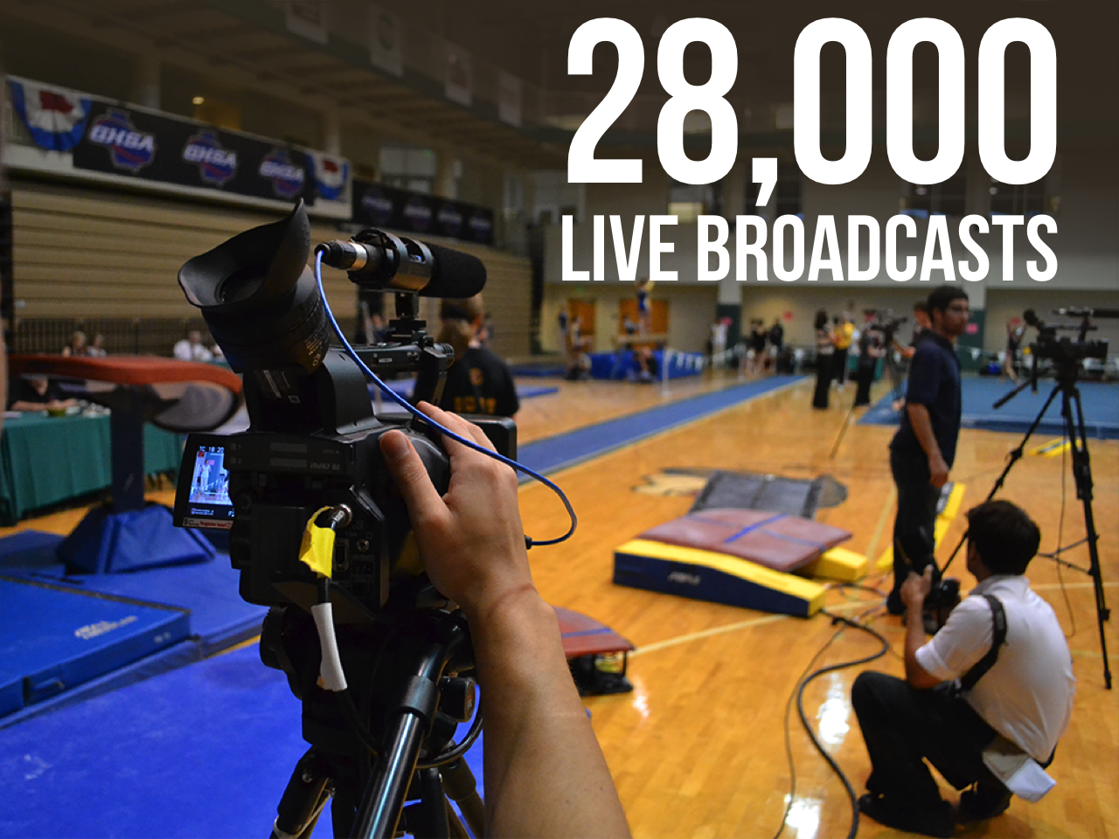
Notes:
The NFHS Network will broadcast over 150,000 live events this year. If your school is not a member of the NFHS Network School Broadcast Program, please contact us at Mark.Koski@NFHSnetwork.com

Slide 51
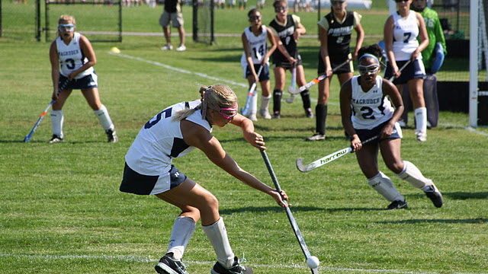
QUESTIONS?

Slide 52
Thank You
National Federation of State High School Associations PO Box 690 | Indianapolis, IN 46206 Phone: 317-972-6900 | Fax: 317.822.5700 www.nfhs.org | www.nfhslearn.com | www.nfhsnetwork.com

