Slide 1
2014 NFHS Field Hockey Rules Interpretation PowerPoint
B. Elliot Hopkins, MLD, CAA
Director of Sports, Sanctioning and Educational Services
Notes:
Thank you for participating in this annual interpretation meeting. While the game of field hockey is in reasonable shape, we continue to work toward improving the game and hopefully putting young people in safe conditions and in situations that they are able to find success in some aspect of the of the game. Ultimately, our goal is for them to be safe, have fun and gain some valuable life lessons from participation.
Areas in this PowerPoint that are underlined designate that the text was newly added to the rules this year. Bold notations mean the language is either a title, heading or penalty. Deletions and modifications are aptly identified as well. Where appropriate, notes and comments will be found under some of the PowerPoint slides. Not every rule change or editorial change warrants an explanation over and above the stated rationale. Thank you again for your attendance, participation and dedication to interscholastic athletics. Have a fantastic field hockey season!

Slide 2
Welcome to our new corporate partner – Big Teams

Slide 3
RULE 1-7-4
ART. 4. . . Goalkeepers may not play outside the 25-yard area they are defending except when they are taking a penalty stroke.
Rationale: The usefulness of playing inside the whole half has been diminished with other previous rule changes. Goalkeepers rarely come outside their circle much less above the 25-yard line. This rule change validates a practice that has been discontinued for a number of years.

Slide 4
RULE 2-1-1
ART. 1. . . The game should…of the field. Both officials are responsible for ensuring that the official time is correct. The game officials maintain…of regulation play.
Rationale: With the advent of playing the game on different types of fields with large scoreboards and timing mechanisms, both officials are responsible for making sure the official time is correct.

Slide 5
RULE 2-1-2g
ART. 2. . . The official’s uniform shall consist of:
a.- f. Remains the same.
g. A watch suitable for timing the game.
Rationale: In support of the new (2-1-1) rule change, officials shall have a watch suitable for monitoring official time.

Slide 6
RULE 2-2-4
ART. 4. . . At the end…half has expired. When a visible scoreboard is used as the game clock, it shall be the official clock and shall remain on until the clock runs down to zero. If the visible clock is not the official clock, it may be stopped prior to the end of the half/game.
Rationale: Confusion occurs when the scoreboard clock is visible but the official clock is kept on the field. Determining the official clock prior to the game will assist in minimizing any unintentional misinformation.

Slide 7
RULE 5-2-1b1
ART. 1. . . Following any stoppage of the game clock by the officials, play shall be restarted as follows:
a. Remains the same.
b. Remains the same.
1) The bully shall take place at or near where play on the ball ended at least 16 yards from the end line, 5 yards from the sideline and 5 yards from the circle.
Rationale: Restructured how to restart play after the game officials stopped the game clock.

Slide 8
RULE 5-2-1b5
ART. 1. . . Following any stoppage of the game clock by the officials, play shall be restarted as follows:
a. Remains the same.
b. Remains the same.
1) – 4) Remains the same.
5)When play is suspended…the end line, 5 yards outside the circle, at least 5 yards…the ball ended.
Rationale: Clarified the location of where the bully is to be taken.

Slide 9
RULE 8-1-1h
ART. 1. . . Fouls include the following:
a.- g. Remains the same.
h. Players must not intentionally raise the ball from a hit except for a shot on goal;
Rationale: This is a risk minimization rule. Previously none of the rules prohibited a player from “chipping” the ball high into the air in open play or from a free hit while not taking a shot on goal.

Slide 10
RULE 9-1-2
ART. 2. . . If the defense is awarded a free hit within 16 yards of the end line, the hit may be taken anywhere in line with the violation up to 16 yards from the inner edge of the end line. Opposing players must be at least 5 yards away from the spot where the hit is taken. If the defense is awarded a free hit within 16 yards of the end line or in the circle, the hit maybe taken anywhere in line with the violation up to 16 yards from the inner edge of the end line. Opposing players must be at least 5 yards away from the spot where taken.

Slide 11
RULE 9-1-2 (cont.)
Rationale: Article 2 clarifies the location of the defense taking the free hit. Since the ball will always be restarted in line with the foul and parallel to the sideline, everyone involved knows where to start the free hit and where to expect the free hit to be taken and that is why Rule 9-1-3 was deleted.

Slide 12
RULE 11-2-10
ART. 10. . . Any unnecessary delay by either the stroker or goalkeeper shall not be permitted. Delay by either team shall be treated as misconduct. A second offense by the same team during the same penalty stroke shall result in the stroke being ended. Continued offenses by the same team during the same penalty stroke shall result in:

Slide 13
RULE 11-2-10 (cont.)
If the second offense is by:
The attack team, no goal shall be awarded; If by the attacking team, no goal shall be awarded and the penalty stroke is ended;
The defending team, the use of card progression would be appropriate. If by the defending team, the use of the card progression would be appropriate.
Rationale: The penalty for continued offenses by the same team is detailed in more specific language for the attacking and defending team.

Slide 14
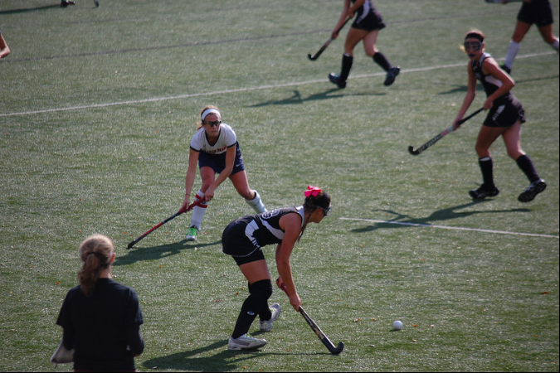
Major Editorial Changes

Slide 15
RULE 1-6-1
ART.1. . . All field players…adequate thickness. It is recommended the protector be:
a. Properly fitted, protecting the anterior (leading dental arch) and
b. Constructed from a model made from an impression of the individual’s teeth or
c. Constructed and fitted to the individual by impressing the teeth into the tooth and mouth protector itself.
Rationale: Editorial.

Slide 16
RULE 2-1-5c
ART 5 . . . The official nearer the officials’ table shall sound the whistle to start and end each half of play, and to restart the game following a goal. ,time-out or other suspension of play. Either official may sound the whistle to : (a) suspend the game; (b) signal time-outs; (c) restart play following time-out or other suspension of play;

Slide 17
RULE 2-1-5c (cont.)
(d) indicate when the ball has gone out of play; (e) indicate a goal has been scored and report the number of the player who scored to the scorer prior to the center pass; (f) assess a penalty; and (g) start and end a penalty stroke.
Rationale: Editorial.

Slide 18
RULE 3-1-7
ART. 7 . . .Suspended player is one who has been issued a green card (2-minute suspension), yellow card and removed to the team bench area for five or 10 minutes of playing time. is one who has received a green or yellow card and shall serve their suspension at the scorer’s table on the same side as their team bench. Suspended players may be coached during their suspension period.
Rationale: Editorial.

Slide 19
RULE 3-2-9 Note
ART. 9 . . .16-yard hit is a means…or self-pass. NOTE: The ball must move at least one yard on the free hit, long hit, center pass, side-in and 16-yard hit before another player of the same team is allowed to play the ball.
Rationale: Editorial.

Slide 20
RULE 7-2-3
ART. 3 . . . In taking a side-in, the ball shall be placed motionless on the sideline where it went out of bounds. *The ball be driven, pushed or self-passed without delay. The ball shall be put into play by using the free hit procedure without delay. If the striker hits at the ball but fails to move it from it’s location or misses the ball, she shall retake the hit, provided she did not foul.
Rationale: Editorial and *Correction.

Slide 21
RULE 8-1-1r
r. Goalkeeper striking and /or kicking in an intimidating or dangerous manner, playing the ball without the stick in her hand; or placing the ball after catching an aerial ball;
Rationale: Editorial.

Slide 22
RULE 8-1-1 PENALTY # 4
4. In the event of simultaneous fouls by opposing players:
A bully shall be taken on the spot where the fouls or misconduct occurred, at least 5 yards from either sideline and at least 16 yards from the end line.
5 4. If the offending team commits a foul before the awarded penalty is taken on a free hit or 16-yard hit, the penalty may be progressed up to 10 yards, upgraded and/or dealt with as misconduct.
Rationale: Editorial.

Slide 23
RULE 9-2-1d
d. The ball is moved using a drive, flick, scoop, push or self-pass.
Rationale: Editorial.

Slide 24
RULE 9-2-3
ART. 3 . . . For a free hit awarded to the attack below the 25-yard line the ball may not be played into the circle unless it has amassed a dribbling distance of 5 yards or has been touched by a player of either team other than the player taking the free hit.
Rationale: Deleted/Editorial. Rule 9-2-3 was a duplication of Rule 9-2-1f.

Slide 25
RULE 10-2-7
ART. 7 . . . If the first shot at goal is a hit (as opposed to a push, flick or scoop), the ball must be on a path or trajectory to cross the goal line no higher than 18 inches unless it touches the stick or body of a defender or the stick of an attacker as it travels toward goal or had traveled more than five yards from the circle prior to the shot. If the first shot at goal is a hit and the ball is, or will be too high crossing the goal line it must be penalized immediately.

Slide 26
RULE 10-2-7
The ball must cross the goal-line, or be on a path which would have resulted in it crossing the goal-line, no higher than 18 inches before any deflection, for a goal to be scored. If the first shot at goal is a hit and the ball is, or will be too high crossing the goal-line, it must be penalized immediately. This height restriction on a first hit at goal no longer applies if the ball has first traveled more than 5 yards outside the circle.
Rationale: Editorial.

Slide 27
RULE 11-2-8f
f. An attacker penetrates the 25-yard area prior to the stroke being taken;
Rationale: Editorial.

Slide 28
RULE 11-2-8i
i. If the stroke is taken before the whistle and a goal is not scored. If a goal is not scored on a penalty stroke, the defenders shall put the ball in play with a free hit at a spot 16 yards in front of the center of the goal just outside the circle.
Rationale: Editorial.

Slide 29
RULE 11-2-9b
b. A defender penetrates the 25-yard line prior to the stroke being taken.
Rationale: Editorial.

Slide 30
RULE 11-2-10
ART. 10 . . . Any unnecessary delay by either the stroker or goalkeeper shall not be permitted. Delay by either team shall be treated as misconduct. A second offense by the same team during the same penalty stroke shall result in the stroke being ended. Continued offenses by the same team during the same penalty stroke shall result in: If the second offense is by:

Slide 31
RULE 11-2-10 (cont.)
The attack team, no goal shall be awarded; If by the attacking team, no goal shall be awarded and the penalty stroke is ended;
The defending team, the use of card progression would be appropriate. If by the defending team, the use of the card progression would be appropriate with the stroke still in effect.
Rationale: Editorial.

Slide 32
RULE 12-1-1g
Delete. g) Meet with players during injury time-outs for the purpose of coaching;
Renumber rest of sub-articles (h-j).
Rationale: Editorial.

Slide 33
RULE 12-1-1 PENALTIES # 1.
1. First offense, a green card shall be issued to the offender and the head coach. The warning shall be recorded in the scorebook.
Rationale: Editorial.

Slide 34
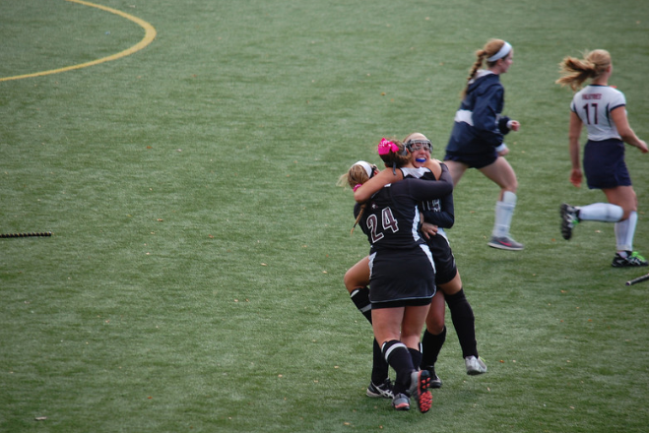
2014 Points of Emphasis
Notes:
The NFHS Field Hockey Rules Committee and the NFHS Board of Directors believes there are areas of the game of interscholastic field hockey that need to be addressed and given special attention. These areas of concern are often cyclical, some areas need more attention than others, and that is why they might appear in the rules book for consecutive editions.
These concerns are identified as “Points of Emphasis.” For the 2014 high school field hockey season, attention is being called to: use of cards, officials’ professionalism and coach's responsibilities. When a topic is included in the Points of Emphasis, these topics are important enough to reinforce or they are not being given the proper attention. While many of these topics have the same titles from last season, they have been updated to reflect additional concerns from the committee.

Slide 35
Proper Use of Equipment – Shinguards
The standardization of the performance of protective eyewear was the first step in assuring that the players are wearing the best products available for their size and skill level. There has been a recent trend that required shinguards made of plastic, foam rubber or fiberglass that should cover the front of the leg from the ankle to just below the knee is being substituted by small youth size soccer shinguards or by cardboard-shaped shin guards.

Slide 36
Proper Use of Equipment – Shinguards (cont.)
This practice has led to an increase of shin injuries (contusions). It is incumbent upon the coaches and players to use the required equipment and not try to circumvent the rule.
Manufacturers spend hundreds of hours and thousands of dollars researching and testing products before they are released to the public.

Slide 37
Proper Use of Equipment – Shinguards (cont.)
They ensure that their products will perform at the highest level possible if it is worn properly. The NFHS makes a significant investment in time and resources to consider appropriate equipment for high school field hockey, for the sole purpose of minimizing risk.

Slide 38
Field Markings
The lines of a field hockey field have been designed for a distinct separation of various areas on the field for players, coaches, fans and officials. These areas are designated for risk minimization for all involved. It is imperative that the field be marked exactly as the rules book designates.

Slide 39
Field Markings (cont.)
No one wants an improperly lined field that puts the players in positions that increase their risk of getting injured. It would be prudent for coaches to work with the custodial or maintenance staff prior to the start of the season to review the correct field markings.

Slide 40
Sideline Encroachment
It is important not to allow sideline encroachment during a contest. There are many groups involved in a field hockey game and their roles are interconnected. The players, substitutes, bench personnel, officials, ball shaggers, table staff of scorer and timekeeper all have key roles in the game and need to be able to do their respective jobs unencumbered of clutter and needless bodies blocking their view or field access.

Slide 41
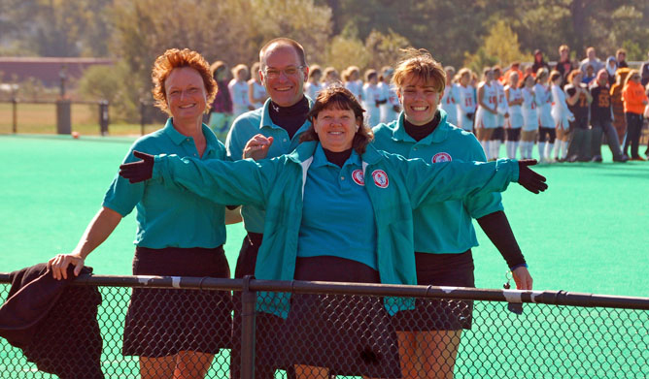
Officials’ Guide

Slide 42
SETTING THE TONE I.B.9.
I. PRINCIPLES AND TECHNIQUES
A. AIMS remains the same.
B. Setting the tone:
1-8 remains the same.
9. Assure the official clock is correct.
Rationale: Editorial.

Slide 43
Tie-Breaking Procedures A. 1.
1. The officials shall meet with the team captains for a coin toss. The home visiting team captain shall call the coin in the air. In subsequent tie-breaking procedures requiring a coin toss, the call of the toss shall be alternated between teams always be the visiting team.
Rationale: Clarification that the visiting team is extended the courtesy to call the coin toss for tie-breaking procedures, making it consistent with all levels of field hockey.

Slide 44
Tie-Breaking Procedures C. 2.
If the overtime period…by the procedure. If a player was disqualified during the regulation game causing the team to play short, that team must play short throughout the overtime. If a player(s) was suspended (green card, yellow card), the team shall play short until the suspension time is completed. If a player receives…game is completed.
Rationale: Editorial. The green card carries a 2 minute suspension penalty.

Slide 45
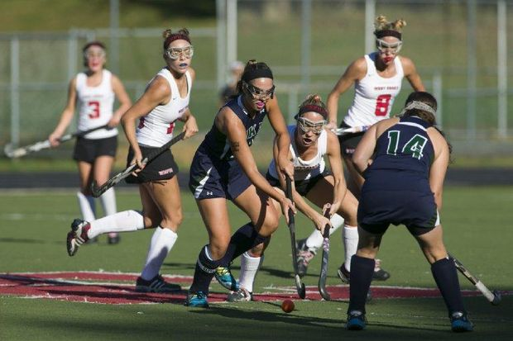
Corrections

Slide 46
Rule 1-7-7
ART. 7. . . If a goalkeeper…as defined in Rule 8-1-2e 8-2-1e and Penalty 1. If she cannot comply with the equipment requirements, her team shall forfeit the game.
Rationale: Corrected rule reference.

Slide 47
RULE 2-2-4
ART. 4. . . At the end of each half, the timer shall sound an audible device to indicate that time in the half has expired. The umpire’s whistle shall signal the official end of the half. When a visible scoreboard…end of the half/game.
Rationale: Inadvertently omitted.

Slide 48
RULE 5-2-1b
b. If no foul was called prior to stopping the clock, play shall be restarted with a bully. at or near where play on the ball ended.
Rationale: Clarification.

Slide 49
Situations and Rulings 5.2.1 Situation F Ruling and Comment
RULING: should be Correct Procedure.
COMMENT: When play is suspended and the ball is in the circle, a bully shall be taken at least 16 yards from the end line, at least 5 yards from the sideline and at least 5 yards outside the circle and in line with the spot where play on the ball ended.
Rationale: The ruling was corrected. The comment was misprinted.

Slide 50
Rule 8-1-1 PENALTY #5
5. For deliberate fouls between the 25-yard lines, an appropriate card shall be issued to the offender.
Rationale: Should not be shaded. It is not a new rule change. Rule 8-1-1 Penalty #4 should be recognized as an editorial change.

Slide 51
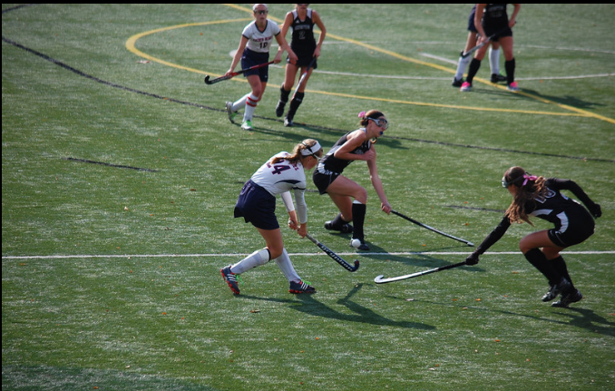
NFHS Sports Medicine

Slide 52
NFHS Sports Medicine
The 2012-13 season has continued to have one of the lowest injury rates.
Field Hockey injury rates have remained stable over the previous four year period.
For the 2012-13 season:
Strain/sprains injuries (35.8%)
Head/face injuries (22.8%) remained the most common injured body site
Hip/thigh/upper leg injuries (19.5%)
Concussions (20%)
No eye injuries were reported.
2013-14 injury data will be released August 31st.

Slide 53
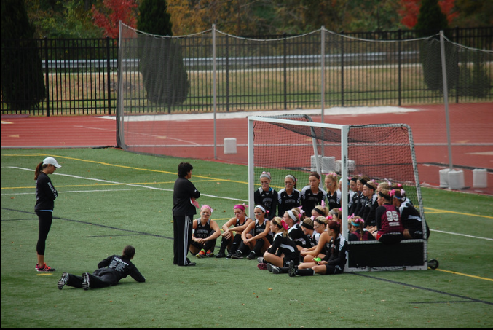
NFHS Coaches Certification and Education Program Courses

Slide 54
Courses Currently Available at www.nfhslearn.com
Core Courses
Fundamentals of Coaching
First Aid for Coaches
Sport-Specific Courses
Soccer | Wrestling | Volleyball | Football
Basketball | Cheer & Dance | Spirit Safety Field Hockey | Softball | Track and Field
Elective Courses
Teaching Sports Skills
Teaching & Modeling Behavior
Coaching Sports in Middle School
Engaging Effectively with Parents
NCAA Eligibility
Free Courses
Concussion in Sports – What You Need to Know
The Role of the Parent in Sport
Notes:
The NFHS Coach Certification Program and all its courses can be accessed at www.nfhslearn.com. The courses are segmented into four categories: Core courses, Sport-Specific courses, Elective courses and Free courses.
Core courses are typically the courses that are used to fulfill state coaching requirements. Core courses include Fundamentals of Coaching, which informs the coach on his/her role as a coach at the interscholastic level. The other core course is First Aid for Coaches, which is a first aid course developed by the American Red Cross.
Sport-Specific courses highlight the methods to teach the skills and tactics of the sport. The NFHS partners with national organizations to bring coaches the content experts in every sport.
Elective courses go further into detail on content that was introduced in Fundamentals of Coaching.
Free courses are elective courses and are identical to other NFHSLearn courses, but are available at no cost!
Coaches can Get Certified! as an Accredited Interscholastic Coach with the NFHS by taking Fundamentals of Coaching, First Aid for Coaches OR its equivalent and a sport-specific course OR Teaching Sports Skills. Get Certified! Today!
Sport-Specific courses scheduled to be developed in 2012: Baseball, Ice Hockey, Swimming and Diving

Slide 55
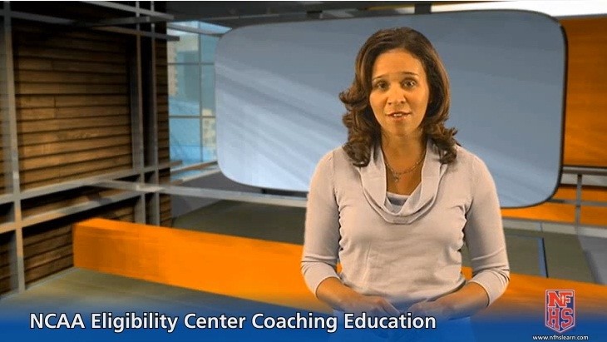
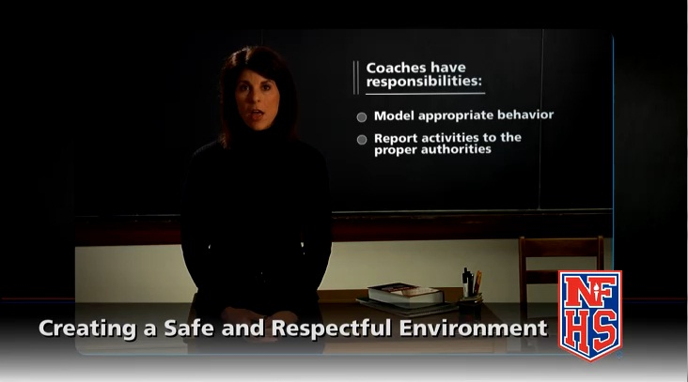
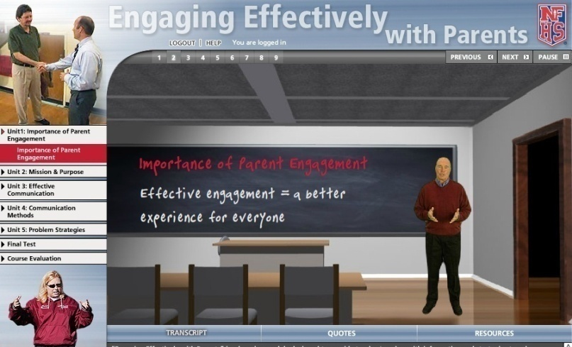
Free!
$20
$20
All NFHS courses can be accessed at www.nfhslearn.com
Notes:
Just a reminder, there are several new and/or updated coaching courses located at nfhslearn.com.
Check them out!

Slide 56
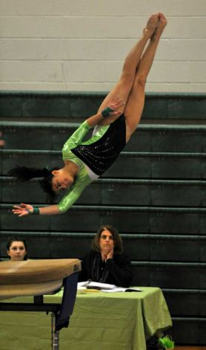
Interscholastic Officiating
Introduction to skills and concepts used as an official
Ideal for new officials or those in first few years of officiating
30-45 minutes to complete
Topics include: basics of becoming and staying an official, science of officiating, art of officiating, how to combine these skills for successful officiating
Course is FREE to any NFHS Officials Association member
Non-members course is $20
Contact NFHS Officials Department for details (317.972.6900)
www.nfhsofficials.com

Slide 57
2014 NFHS Field Hockey Rules Book as E-Book
Electronic Versions of the NFHS Field Hockey Rules is now available for purchase as an e-book.
Apple users can visit iTunes for available books.
Apple, Android and Kindle users can buy e-books from Amazon.com and view them through the Kindle app.
Price: $5.99 each
Visit www.nfhs.org/ebooks
for more information.

Slide 58
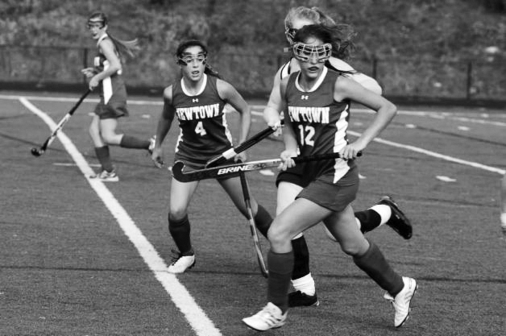
Thank You
Have a great season

