Slide 1
2020-22 NFHS Water Polo
Rules PowerPoint
Rules Changes
Major Editorial Changes
Points of Emphasis

Slide 2
National federation of state high school associations (NFHS)

Slide 3
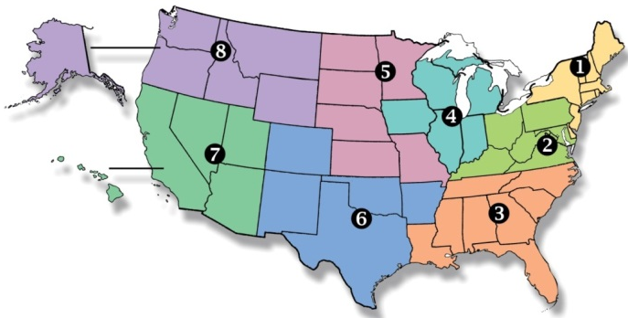
National Federation of
State High School Associations
NFHS (located in Indianapolis, IN – Est. 1920):
  National leader and advocate for
  high school athletics and
  performing arts programs.
  Serves 51 state associations, 19,500
  high schools and 12 million student
  participants.
  Writes playing rules for 17 high school
  sports for boys and girls.
  Offers online education courses for high school coaches,
  officials, parents, students and others.
  Ensures that students have opportunity to enjoy healthy participation, achievement and good sportsmanship in education-based athletics.
Notes:
The NFHS is the national leader and advocate for high school athletics and performing arts programs. Services of the NFHS reach more than 19,000 high schools and 12 million participants throughout the 8 NFHS sections across the U.S.
A significant responsibility of the NFHS is the commitment to writing quality playing rules for 17 high school sports for boys and girls, in addition to providing educational resources for high school coaches, officials, parents and students.
It is the vision of the NFHS to help prepare tomorrow’s leaders for the next level of life through the many program offerings in education-based athletics and activities.

Slide 4






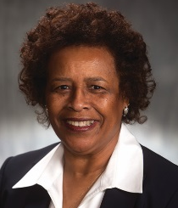

NFHS Rules Review Committee
The NFHS Rules Review Committee is chaired by the chief operating officer and composed of all rules editors. After each committee concludes its deliberations and has adopted its recommended changes for the subsequent year, such revisions will be evaluated by the Rules Review Committee.
Davis Whitfield
Chief Operating Officer
Lindsey Atkinson
Girls Lacrosse and Volleyball
Bob Colgate
Football and Sports
Medicine
Sandy Searcy
Softball, Swimming & Diving, and Water Polo
Elliot Hopkins
Baseball and Wrestling
Julie Cochran
Cross Country, Gymnastics, Field Hockey and
Track & Field
James Weaver
Boys Lacrosse and
Spirit
Theresia Wynns
Basketball and Soccer
Dan Schuster
Ice Hockey
Notes:
All committee recommended rules changes are vetted through the NFHS Rules Review Committee before advancing to the NFHS Board of Directors for final action. The committee is comprised of all NFHS Director of Sports and chaired by the NFHS Chief Operating Officer.

Slide 5

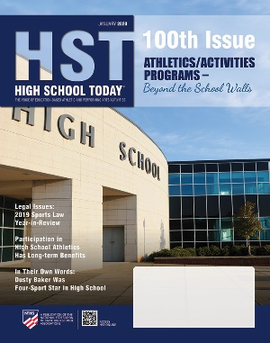
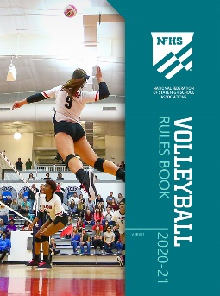
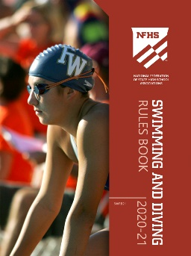

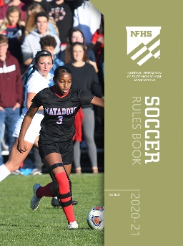
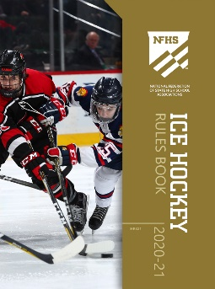
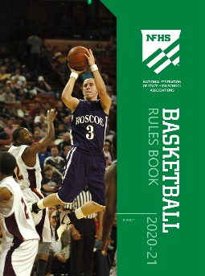

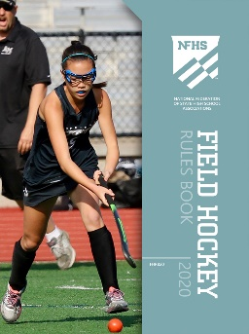
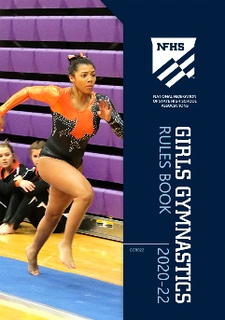
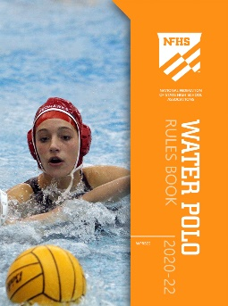

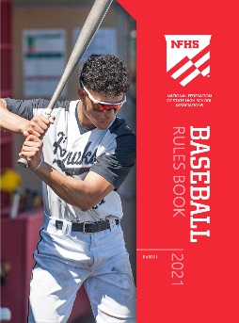
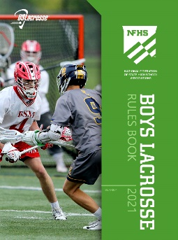
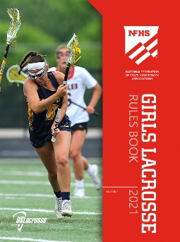
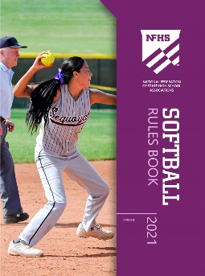
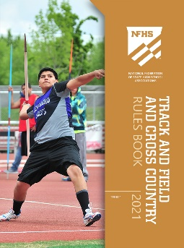
National Federation of
State High School Associations
The NFHS writes playing rules for 17 sports
for boys and girls at the high school level.
  Publishes 4 million pieces of materials annually.
Notes:
The NFHS writes playing rules for 17 sports, publishes High School Today (HST) along with several other key publications totaling over 4 million pieces annually.

Slide 6

NFHS Rules Book as e-Books
E-books features:
  Searchable
  Highlight areas of interest
  Make notes
  Easy navigation
  Adjustable viewing size
  Immediate availability
Notes:
The NFHS Rules and Case Book e-books are available for $6.99 each.

Slide 7
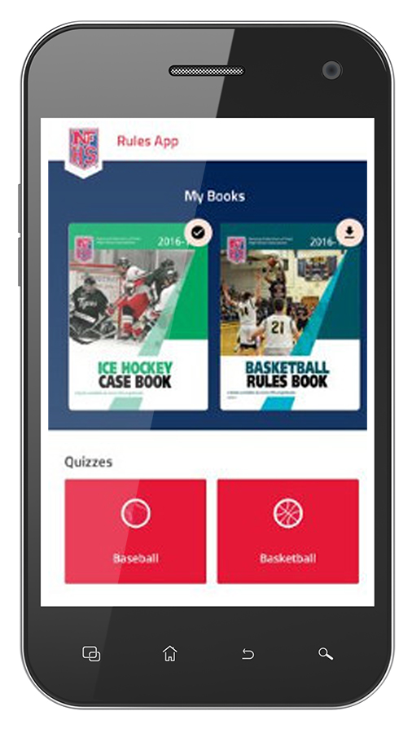
NEW NFHS Rules App
Rules App features:
  Searchable
  Highlight notes
  Bookmarks
  Quizzes for all sports
  Easy navigation
  Immediate availability
  Free to paid members of the NFHS Coaches
  and Officials Associations
  www.nfhs.org/erules for more information
Notes:
Rules app for all NFHS rules books and case books are available on iTunes and Google Play. Rules books and case books are cross-linked and enabled for searchable content.
App is free to download.
Each book subscription is $6.99.
NFHS Coaches and Officials Association paid members get all books for free.
100% states members get books for free in sports designated by their state.

Slide 8
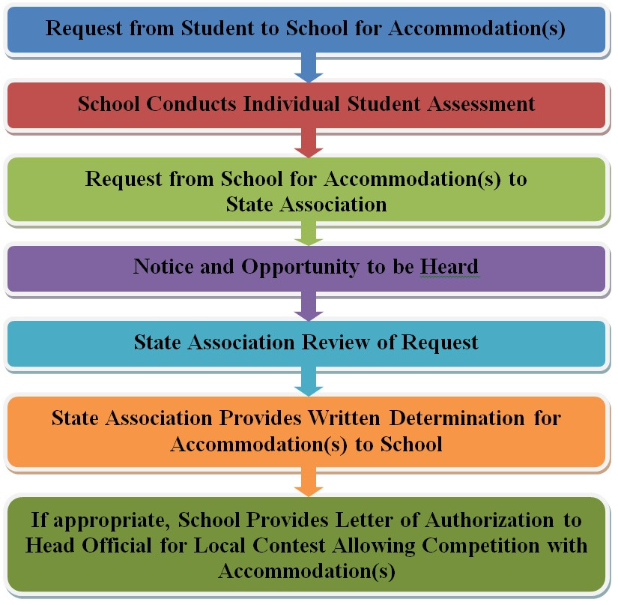
Guidelines for Schools and state associations for consideration of accommodations
Notes:
To assist state associations in working with schools for the inclusion of students with disabilities, the following guide prepared by the NFHS Task Force on the Inclusion of Students with Disabilities is being provided for your review.
Following these guidelines will assist in the individual student assessment by the student and the school.
When requesting a possible accommodation, coaches should work with their school and the state association as early as possible in the sport season.
Contest officials shall defer decisions on rule accommodations to the respective state association.
This information serves as a guide. Each state association may develop its own process.

Slide 9
2020 nfhs water polo
RULES CHANGES

Slide 10
Markers
1-6-1, 1-6-2, 4-21-1, 4-21-2, 4-21-3, 4-21-4
The 5-meter line has been moved to a 6-meter line in these referenced rules. Note: The 5-meter reference still applies to penalty throws.
NOTE: The penalty shot shall be taken 5 meters from goal line.
Notes:
Rules 1-6-1, 1-6-2, 4-21-1, 4-21-2, 4-21-3, 4-21-4: The 5-meter line has been moved to a 6-meter line in these referenced rules. However, the 5-meter line still applies to penalty throws.
Rationale: Introducing a 6-meter line increases the front court which allows offensive players more room to work. It also provides the center forward more room to receive the ball.

Slide 11
Other Equipment
1-21, 1-26
Players are now permitted to wear a soft padded cap but it must meet the requirements of rules 1-20 through 1-24, and 2-4.
A player may only wear a swim cap under the water polo cap; the color of the swim cap shall match the color of the water polo cap as closely as possible. The swim cap worn by a goalkeeper shall be red or a color which matches the color of the water polo cap of the goalkeeper as closely as possible (red or dark for the home goalkeeper or red or white for the visiting goalkeeper).
Notes:
Rules 2-21, 1-26: Players are now permitted to wear a soft padded cap but it must meet the requirements of rules 1-20 through 1-24, and 2-4.
A player may only wear a swim cap under the water polo cap; the color of the swim cap shall match the color of the water polo cap as closely as possible. The swim cap worn by a goalkeeper shall be red or a color which matches the color of the water polo cap of the goalkeeper as closely as possible (red or dark for the home goalkeeper or red or white for the visiting goalkeeper).
Rationale: Headgear is required by NFHS rules in some sports and is permissive in others. Coaches, athletes and parents/guardians should review the manufacturers’ warnings about proper usage and performance limits of such products.

Slide 12
30-second shot clock timer - Duties
3-18-2, 3-18-3g
The manner in the way free throws must be taken has been more clearly defined.
The term “water polo move” has been eliminated from the rules book.
Notes:
Rules 3-18-2, 3-18-3g: The manner in the way free throws must be taken has been more clearly defined.
Rationale: With players now able to put the ball into play and shoot, it becomes vital for the defender to know when they are able to attack. By mandating that the ball is clearly and visibly put into play, it is clear to everyone, including the timekeeper, when the ball is in play.

Slide 13
30-second shot clock timer - Duties
3-20-2a
The scorekeeper shall be provided with players and officials full names at least 15 minutes before the start of the contest.
The date, place and starting and ending time of the game, names of officials, names of teams, full player names and corresponding cap numbers in numerical order for all players (the team roster with full player names for each team with cap numbers designated must be in the secretary’s hands a minimum 15 minutes prior to the start of the game);
Notes:
Rule 3-20-2a: The scorekeeper shall be provided with players and officials full names at least 15 minutes before the start of the contest.
The date, place and starting and ending time of the game, names of officials, names of teams, full player names and corresponding cap numbers in numerical order for all players (the team roster with full player names for each team with cap numbers designated must be in the secretary’s hands a minimum 15 minutes prior to the start of the game);
Rationale:
Games often begin with no names on the official scoresheet and frequently only first or last names are listed. This change clarifies that full names written on the scoresheet are required prior to the start of the game.

Slide 14
Interval Time
4-14, 7-12-2, 7-13-4, 7-14-4
Any time the ball is removed from the water by the referee is now considered interval time:
time between periods;
during a time-out;
before the restart after a goal;
before a penalty throw is taken; or
any time the ball is removed from the water by the referee.
Notes:
Rules 4-14, 7-12-2, 7-13-4, 7-14-4: Any time the ball is removed from the water by the referee is now considered interval time.
Rationale: When the referee removes the ball from the water the game stops, which is an interval moment.

Slide 15
Interval Time
4-14, 7-12-2, 7-13-4, 7-14-4
If a player of either team commits a minor act of misconduct during interval time (the time between periods, during a timeout, before the restart after a goal, before a penalty throw is taken, or when the ball is taken out of the water by the referee), he/she is excluded for 20 seconds on the first offense.
If a double flagrant misconduct foul occurs during a time-out, after a goal, or when the ball is taken out of the water by the referee both players are excluded for the remainder of the game with their substitutions in the re-entry areas.
Notes:
Rules 4-14, 7-12-2, 7-13-4, 7-14-4:
If a player of either team commits a minor act of misconduct during interval time (the time between periods, during a timeout, before the restart after a goal, before a penalty throw is taken, or when the ball is taken out of the water by the referee), he/she is excluded for 20 seconds on the first offense.
If a double flagrant misconduct foul occurs during a time-out, after a goal, or when the ball is taken out of the water by the referee both players are excluded for the remainder of the game with their substitutions in the re-entry areas.
Rationale: When the referee removes the ball from the water the game stops, which is an interval moment.

Slide 16
Goals - GOALKEEPER PRIVILEGES
4-20
The goalkeeper may now move beyond the half
distance line, shoot from anywhere and may take
a penalty shot or participate in a shootout as the
goalkeeper and/or shooter.
Notes:
Rule 4-20: The goalkeeper may now move beyond the half distance line, shoot from anywhere and may take a penalty shot or participate in a shootout as the goalkeeper and/or shooter.
Rationale: This change provides more scoring options for teams.

Slide 17
Goals – How Scored
4-21-1
Clarifies that at least two players must intentionally touch the ball after a free throw or restart of play inside 6 meters.
Notes:
Rule 4-21-1: Clarifies that at least two players must intentionally touch the ball after a free throw or restart of play inside 6 meters.
Rationale: If the foul is inside of 6 meters, the player must pass the ball to another player before a goal can be scored. Also, by allowing a direct shot on goal from a corner throw the player becomes an immediate threat that the defender must account for. This opens up the center forward position which was usually double teamed since the player taking the corner throw wasn’t able to shoot and makes the 2-meter area more accessible.

Slide 18
Goals – How Scored
4-21-2
If both the foul and the ball is outside of 6 meters a player may put the ball into play and then shoot.
The change also allows players to put the ball into play and score from a corner throw.
Notes:
Rule 4-21-2: If both the foul and the ball is outside of 6 meters a player may put the ball into play and then shoot. The change also allows players to put the ball into play and score from a corner throw.
Rationale: This creates a faster and simpler game as well as encourages more action and scoring.

Slide 19
Goals – How Scored
4-21-2
A goal can be scored from anywhere after visibly putting the ball into play after the following:
a. a foul outside of 6 meters with the ball located outside of 6 meters;
b. a corner throw;
c. goal throw;
d. at the start or restart of play outside of 6 meters;
e. the ball leaving the side of play outside of 6 meters;
f. after a goal;
g. after a time-out;
h. after the referee returns the ball back to the pool outside of 6-meters or to a player
taking a corner throw.
NOTE: If the ball was removed from inside of 6-meters, the player cannot shoot after
putting the ball into play (exception: corner throw).
Notes:
Rule 4-21-2: A goal can be scored from anywhere after visibly putting the ball into play after the following:
a. a foul outside of 6 meters with the ball located outside of 6 meters;
b. a corner throw;
c. a goal throw;
d. at the start or restart of play outside of 6 meters;
e. the ball leaving the side of play outside of 6 meters;
f. after a goal;
g. after a time-out;
h. after the referee returns the ball back to the pool outside of 6-meters or to a player taking a corner throw.
NOTE: If the ball was removed from inside of 6-meters, the player cannot shoot after putting the ball into play (exception: corner throw).
Rationale:
This change allows players to put the ball into play outside of 6 meters or from a corner throw. This creates a faster and simpler game as well as creating more action and scoring. Additionally, a goal can be scored at the start of a quarter or restart of play outside of 6 meters, including neutral throws outside of 6 meters.

Slide 20
Goals – how scored
4-21-3
The signal for awarding a free throw outside but within one meter of the 6-meter line has been altered.
If a free throw is awarded for a foul outside, but within one meter of the 6-meter line, the referee administering the free throw will point with one arm horizontal to the body in the direction of the attacking team and, with the other arm, shall raise a hand up vertically to indicate that the player is eligible to shoot.
Notes:
Rule 4-21-3: 4-21-3: The signal for awarding a free throw outside but within one meter of the 6-meter line has been altered.
If a free throw is awarded for a foul outside, but within one meter of the 6-meter line, the referee administering the free throw will point with one arm horizontal to the body in the direction of the attacking team and, with the other arm, shall raise a hand up vertically to indicate that the player is eligible to shoot.
Rationale: By changing the signal to a raise hand, the award of a free throw becomes clear to everyone on the pool deck.

Slide 21
Goals – how scored
4-21-4
If, at the award of a foul outside 6 meters, the ball is inside of 6 meters, a goal may not be scored directly or after the ball is put into play. *NOTE: Both must be outside of 6 meters.
In this case, at least two players (of either team, excluding the defending goalkeeper) must intentionally play or touch the ball before a goal can be scored.
Notes:
Rule 4-21-4: If, at the award of a foul outside 6 meters, the ball is inside of 6 meters, a goal may not be scored directly or after the ball is put into play. *NOTE: Both must be outside of 6 meters. In this case, at least two players (of either team, excluding the defending goalkeeper) must intentionally play or touch the ball before a goal can be scored.
Rationale: Both the foul and the ball must be outside the 6-meter line to shoot and score. If the ball is inside 6 meters, a free throw must be taken at the location of the ball.

Slide 22
Goals – How Scored
4-21-5, 4-24e, 5-4
The corner throw was removed from a list of situations in which a direct goal cannot be scored after a restart.
NOTE: Although a goal cannot be scored directly, the player restarting play from a corner throw or outside of 6 meters can visibly put the ball into play and then shoot and score or swim and then shoot and score.
Notes:
Rules 4-21-5, 4-24e, 5-4: The corner throw was removed from a list of situations in which a direct goal cannot be scored after a restart.
NOTE: Although a goal cannot be scored directly, the player restarting play from a corner throw or outside of 6 meters can visibly put the ball into play and then shoot and score or swim and then shoot and score.
Rationale: A player taking a corner throw may now shoot directly once the ball is put into play.

Slide 23
Corner Throws – How Taken
5-4
The corner throw shall be taken by a player of the attacking team from the 2-meter mark on the side nearest to which the ball crossed the goal line. The throw need not be taken by the nearest player but shall be taken without undue delay.
A player taking a corner throw may shoot directly or once put in play (a) fake and shoot, (b) swim and shoot without passing or (c) pass to another player.
Notes:
Rule 5-4: The corner throw shall be taken by a player of the attacking team from the 2-meter mark on the side nearest to which the ball crossed the goal line. The throw need not be taken by the nearest player but shall be taken without undue delay. A player taking a corner throw may shoot directly or once put in play (a) fake and shoot, (b) swim and shoot without passing or (c) pass to another player.
Rationale: Allowing a direct shot on goal from a corner throw makes the player an immediate threat that the defender must account for.

Slide 24
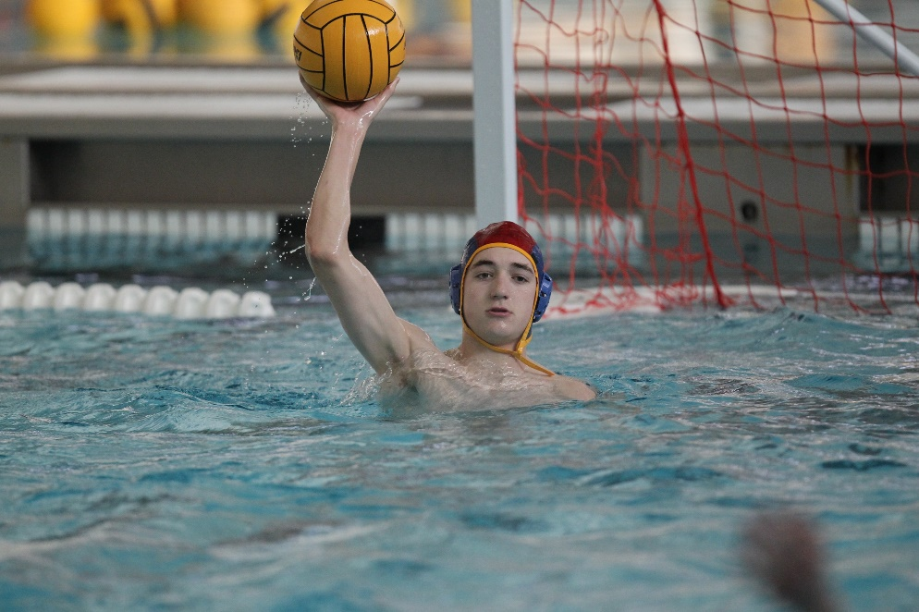
Free Throws – Where Taken
5-10-1
A free throw shall be taken at the
spot of the ball versus where the
foul occurred. This does not
apply if the ball is inside the
2-meter mark.
Notes:
Rule 5-10-1: A free throw shall be taken at the spot of the ball versus where the foul occurred. This does not apply if the ball is inside the 2-meter mark.
Rationale: This speeds up the game by playing the ball where it lies. However, if there is a foul within the 2-meter, the ball is always moved outside of the 2-meter area. Allowing a direct shot on goal from a corner throw makes the player an immediate threat that the defender must account for.

Slide 25
Free Throws – Where Taken
5-13
Free throws (putting the ball in play) must be taken clearly and visibly. This includes, but is not limited to
passing the ball to another player;
dropping the ball from a raised hand into the water;
throwing the ball in the air;
tossing or placing the ball before swimming, or;
transferring the ball from one hand to another above the water.
The referee administering the free throw must indicate “ball in play” by dropping an arm from horizontal to vertical position when the player taking the free throw clearly and visibly puts the ball into play.
Notes:
Rule 5-10-1: A free throw shall be taken at the spot of the ball versus where the foul occurred. This does not apply if the ball is inside the 2-meter mark.
Rational; Putting the ball into play (or making a ball “live”) is defined as a player, who is clearly in a position most readily to take the free throw, having clear separation with the ball and hand above the water. The ball becomes live upon the release. Methods of putting the ball into play are: (1) passing the ball, (2) dropping the ball onto the water from a raised hand, (3) popping the ball up out of the hand, (4) tossing or placing the ball before swimming, and
transferring the ball from one hand to another above the water. Other actions such as faking, spinning the ball in the hand, and transferring the ball from one hand to another on the surface of the water no longer constitutes putting the ball in play. The rule change was made in order to support new methods of scoring from outside of 6 meters and from corner throws. Coaches are encouraged to teach players how to put the ball in play and when a ball becomes “live” in accordance with this change. This rule change will also provide clarity as to when the ball is put into play.

Slide 26
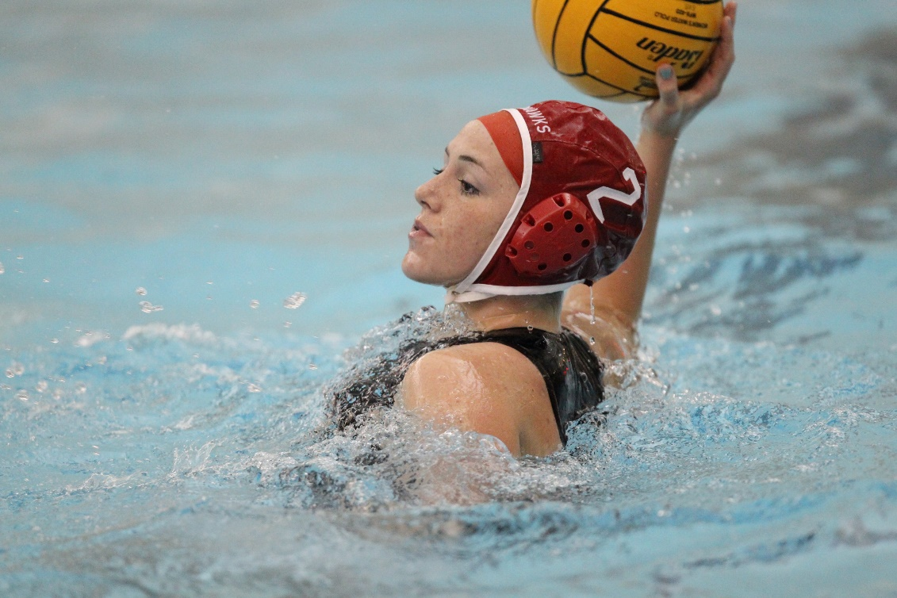
Exclusion Fouls – Re-entry
7-3-6
                A backup goalkeeper may now be
                substituted for an excluded
                goalkeeper.
Notes:
Rule 7-3-6: A backup goalkeeper may now be substituted for an excluded goalkeeper.
Rationale: Previously, if a goalkeeper was excluded, a back-up goalkeeper was not allowed to be substituted into the game during the man advantage. With this rule change, a back-up goalkeeper can enter the game during the man advantage by substituting for a field player. In other words, it is the player, not the position, that is excluded.

Slide 27
Enforcement
7-1, 7-3-13, 7-4
A player may leave the field of play at any time under the sideline.
If a player voluntarily leaves the field of play under the sideline or goal line other than their own re-entry area, they shall be permitted to re-enter the field of play from the re-entry area nearest to that player’s goal line or from anywhere after one of the following:
a. a goal scored;
b. a time-out;
c. end of the period.
Notes:
Rules 7-1, 7-3-13, 7-4: A player may leave the field of play at any time under the sideline.
If a player voluntarily leaves the field of play under the sideline or goal line other than their own re-entry area, they shall be permitted to re-enter the field of play from the re-entry area nearest to that player’s goal line or from anywhere after one of the following:
a. a goal scored;
b. a time-out;
c. end of the period.
Rationale: The rule change allows the player to leave any time under the sideline. The violation occurs when the player re-enters illegally.
A violation occurs when the player re-enters illegally. Verbiage awarding an exclusion foul for the player to leave the field of play without the permission of the referee has been deleted.

Slide 28
Tactical Foul (Direct Shot)
7-22
A player that has earned a foul outside of 6 meters is not able to shoot if a defender tactically knocks the ball into the 6-area area.
It shall be an exclusion foul if a player on defense commits an ordinary foul outside of 6 meters and does one of the following as a “tactical foul” to prevent the player from shooting a direct shot:
a. Knocks the ball inside 6 meters;
b. Knocks the ball further away from the goal;
c. Throws the ball away;
*NOTE: The above are examples; tactical fouls are not limited to a-c.
Notes:
Rule 7-22: A player that has earned a foul outside of 6 meters is not be able to shoot if a defender tactically knocks the ball into the 6-area area.
Rationale: A player should not be able to shoot or put the ball in play and then shoot if a defender tactically fouls and knocks the ball into the 6-meter area. This rule change will discourage a defender from fouling with a few seconds left in the game and then throwing the ball to the other side of the pool. This rule allows referees to restore the advantage that was taken away from the offense.

Slide 29
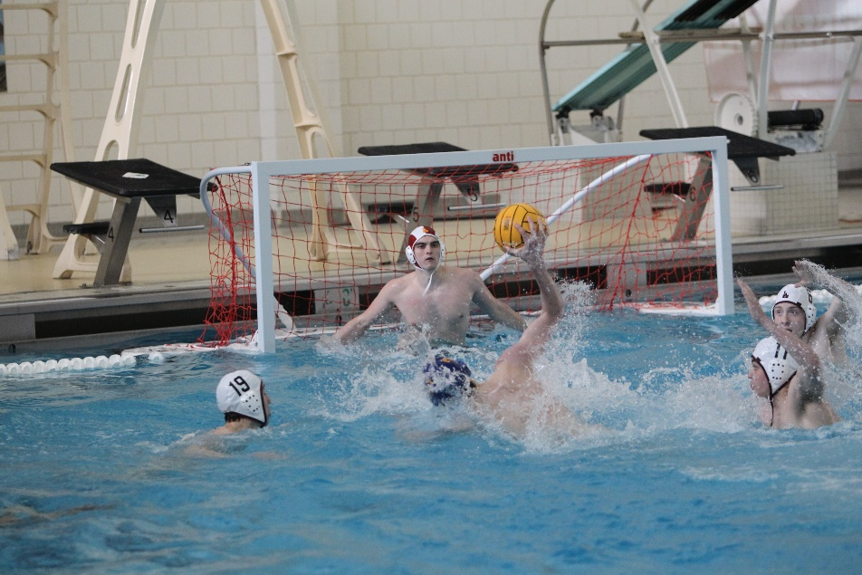
ATTACKING PLAYER FROM BEHIND WITHIN 6 METERS 8-9
It shall be a penalty foul for a defending player to foul or impede an attacking player from behind within the 6-meter area in a probable goal situation.
Notes:
Rule 8-9: It shall be a penalty foul for a defending player to foul or impede an attacking player from behind within the 6-meter area in a probable goal situation.
Rationale: This change follows current national trends of the sport. It simplifies the game for all stakeholders and makes it easier for spectators to understand while promoting more scoring.

Slide 30
2020-22 nfhs water polo
Major editorial CHANGES

Slide 31
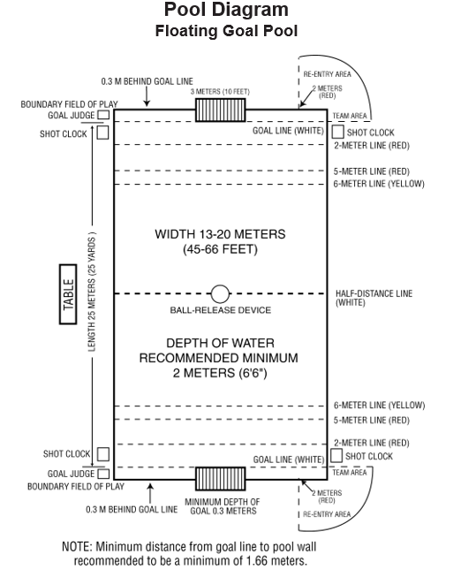
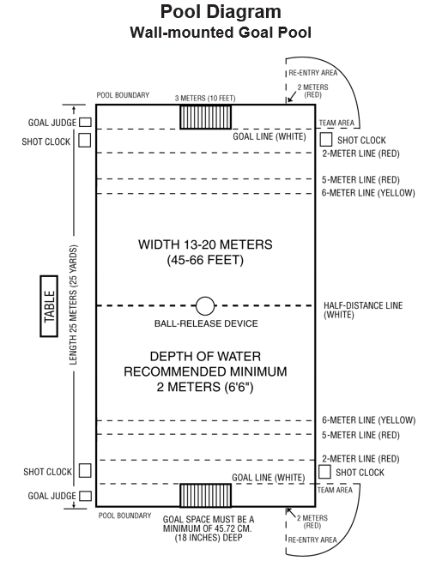
Pool Diagrams
Notes:
Change have made to the pool diagrams that reflect rule changes to the 6-meter line . However, the 5-meter line still applies to penalty throws. The diagrams have been moved to the beginning of the rules book.
Introducing a 6-meter line increases the front court which allows offensive players more room to work. It also provides the center forward more room to receive the ball.
Changes to Rule 1-6-1 are reflected in these diagrams:
ART. 1 . . . Distinctive marks shall be provided on both sides of the field of play to denote the following:
white marks – goal line and half-distance line;
red marks – 2 meters from goal line;
yellow marks – 6 meters from goal line;
red marks shall be placed 5 meters from goal lines to indicate the point from which a penalty shot must be taken.

Slide 32
Appendix c, Figure DD
Fig. DD When a free throw is for a foul outside but within one meter of the 6-meter line, the referee administering the free throw will point with one arm horizontal to the body in the direction of the attacking team and, with the other arm, shall raise a hand up vertically to indicate that the player is eligible to shoot.
Notes:
If a free throw is awarded for a foul outside, but within one meter of the 6-meter line, the referee administering the free throw will point with one arm horizontal to the body in the direction of the attacking team and, with the other arm, shall raise a hand up vertically to indicate that the player is eligible to shoot.

Slide 33


Officials signal
Notes:
By changing the signal to a raise hand, the award of a free throw becomes clear to everyone on the pool deck.

Slide 34
2020-22 nfhs water polo points of emphasis

Slide 35
Putting the ball in play
Methods of putting the ball in play:
passing the ball;
dropping the ball on to the water from raised hand;
popping the ball out of hand;
tossing or placing ball before swimming or transferring the ball from one hand to another above the water.
Notes:
Putting the Ball Into Play
Putting the ball into play (or making a ball “live”) is defined as a player, who is clearly in a position most readily to take the free throw, having clear separation with the ball and hand above the water. The ball becomes live upon the release. Methods of putting the ball into play are: (1) passing the ball, (2) dropping the ball onto the water from a raised hand, (3) popping the ball up out of the hand, (4) tossing or placing the ball before swimming, and
transferring the ball from one hand to another above the water. Other actions such as faking, spinning the ball in the hand, and transferring the ball from one hand to another on the surface of the water no longer constitutes putting the ball in play. The rule change was made in order to support new methods of scoring from outside of 6 meters and from corner throws. Coaches are encouraged to teach players how to put the ball in play and when a ball becomes “live” in accordance with this change. This rule change will also provide clarity as to when the ball is put into play.

Slide 36
New methods of scoring
Outside 6-meters
  Players may score via direct shot outside of 6 meters;
  Put ball into play then move anywhere in the field to shoot;
Corner throw
  Take a direct shot
  Put the ball into play then move anywhere in the field to shoot;
By increasing methods and options for scoring there will be greater offensive spacing and improved game flow.
Notes:
New Methods of Scoring
The NFHS has adopted several changes that will enhance a team’s opportunity to score a goal.
Scoring outside of 6 meters:
The player may now score by:
An immediate direct shot after being fouled outside of 6 meters (this method of scoring is no longer allowed at 5 meters);
Putting the ball into play (making themselves “live”) then moving anywhere in the field of play to shoot.
For a foul to be determined outside of 6 meters both the ball and the player must be completely outside the 6-meter line. As part of these changes, the 6
-meter line (yellow) has been established as a visible marking to the course and the 5-meter line (red) will now be only used for penalty shots.
Scoring on a corner throw - Once a corner throw has been awarded, a player may score by:
Taking an immediate direct shot after being awarded a corner throw;
Putting the ball into play (making themselves “live”) then shoot or swim any where in the field of play and shoot.
By increasing methods and options for scoring there will be greater offensive spacing and improved game flow. These changes will also open up the center forward position and make the 2-meter area more accessible within the flow of the game.

Slide 37
Player advantage inside of 6 meters
A player inside of 6 meters who is in a probable goal scenario will be awarded a penalty shot regardless of whether they are holding the ball.
In a probable goal scenario the award of penalty shot all three factors must be in play:
Player is inside 6-meter area;
Player has established position;
Player is fouled or impeded from behind.
Notes:
Player Advantage Inside 6 Meters
A player inside of 6 meters who has established a position of advantage in a “probable goal” scenario who is then fouled or impeded from behind, will be awarded a penalty shot regardless of whether or not they are holding the ball. The referee must first allow the player to complete the action before awarding the penalty. It is important to understand that the release of the ball by the offensive player is not a factor in the official awarding a penalty shot. It is also important to understand that this is in a “probable goal” scenario. Thus, all three factors should be present in order for an official to reward a penalty shot: The player is
(1) inside the 6-meter area, (2) has established position and is (3) fouled or impeded from behind. This rule change will promote freedom of movement and reduce player risk within the high impact moments of the game.

Slide 38
Leaving the field of play
Players, without leaving the water, may leave the field of play anywhere under sideline or goal line without penalty, but must re-enter from the re-entry area nearest their goal line unless stoppage has occurred such as a goal, time-out, or end of the period.
This is a risk minimization initiative. A player who is injured must be able to leave the field of play if necessary.
Notes:
Leaving the Field of Play
Players, without leaving the water, may leave the field of play anywhere under the sideline or goal line. However, the player or the substitute must re-enter the field of play from the re-entry area nearest their goal line unless a stoppage has occurred such as a goal, time-out, or end of the period. This change has been added to reduce risk to players. A player who is injured must be able to immediately remove him/herself from the field of play if necessary. It is important to understand and instruct that a violation occurs only when a player leaves the water or re-enters the game illegally.

Slide 39
Goalkeeper privileges
A goalkeeper:
  may move past half court;
  may take part of a shootout;
  may take a penalty shot.
If a goalkeeper is excluded another goalie may be substituted for existing player during exclusion time. The exclusion is on the player, not the position.
Notes:
Goalkeeper Privileges
A goalkeeper may now move past half court and can become part of the offense. The goalkeeper may now take part in a shootout as a shooter or take a penalty shot. If a goalie is excluded another goalie may be substituted for an existing field player during the exclusion time. An exclusion is on the player, not the position. By allowing the goalkeeper to participate offensively it provides more scoring options for teams and encourages more tactical adjustments in different game scenarios.

Slide 40
NFHS OFFICIALS Education

Slide 41

SPORTS-SPECIFIC Officiating COURSES www.nfhslearn.com
Introduction to mechanics and techniques used in each sport
Ideal for new officials or those in first few years of officiating
30-45 minutes to complete
Topics vary based on the needs of the officials in the sport
NFHS Officials Association members cost is $10
Non-members – course is $20
API available to state associations to collect results

Slide 42
NFHS OFFICIALS EDUCATION
SPORT-SPECIFIC COURSES
Courses Available
  Officiating Football
  Soccer – Fouls and Misconduct
  Swimming and Diving
  Officiating Wrestling
  Officiating Basketball
  Umpiring Softball
  Officiating Volleyball – Ball Handling
Future Courses
  Officiating Baseball
  Basketball – Three-Person Mechanics
  Field Hockey
  Track and Field
  Volleyball – Overlapping
  Softball – Mechanics
  Communication Among Officials and Coaches
  Soccer - Offside

Slide 43
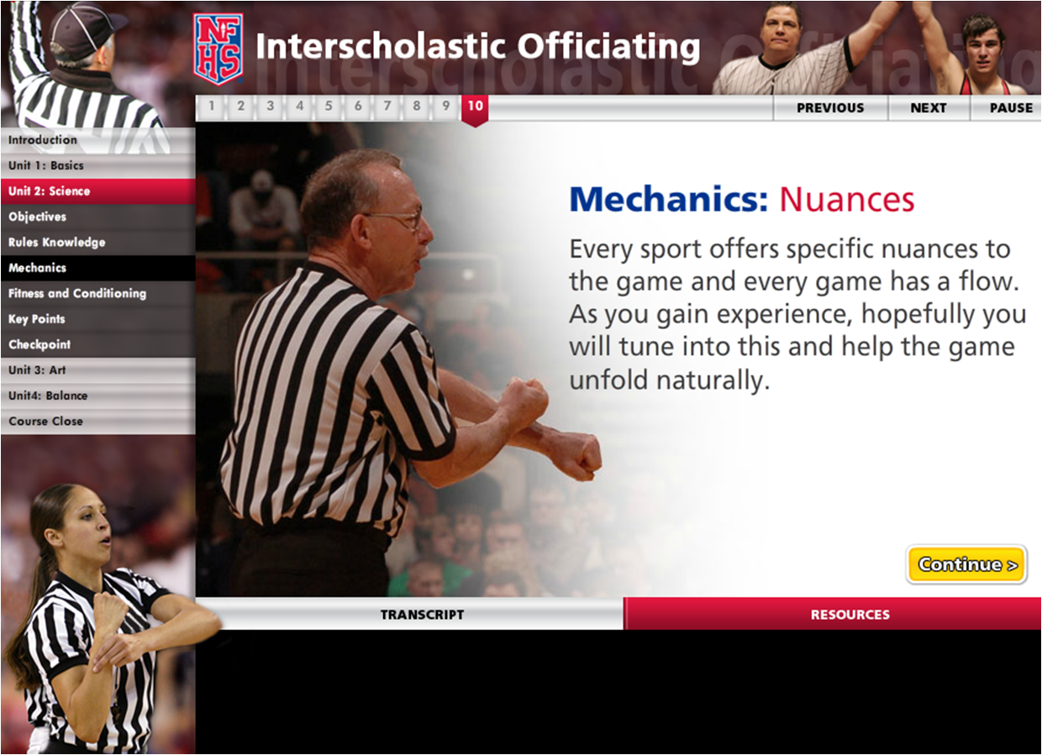
Interscholastic Officiating www.nfhslearn.com
Introduction to skills and concepts used as an official
Ideal for new officials or those in first few years
of officiating
30-45 minutes to complete
Topics include: basics of becoming and staying an official, science of officiating, art of officiating, how to combine these skills for successful officiating
Course is FREE to any NFHS Officials Association member
Non-members course is $20
API available to state associations to collect results

Slide 44
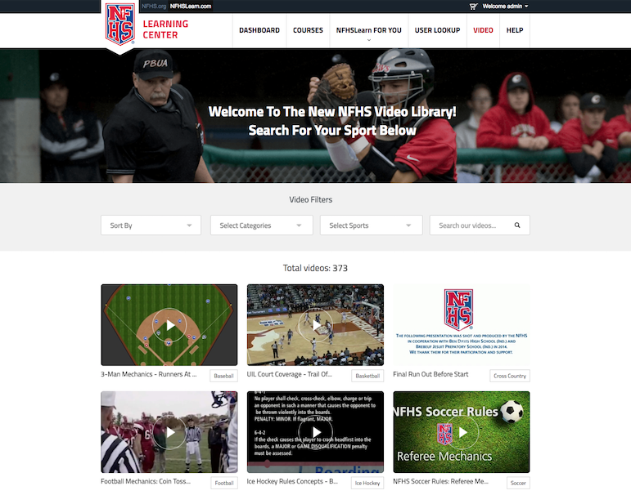

Slide 45
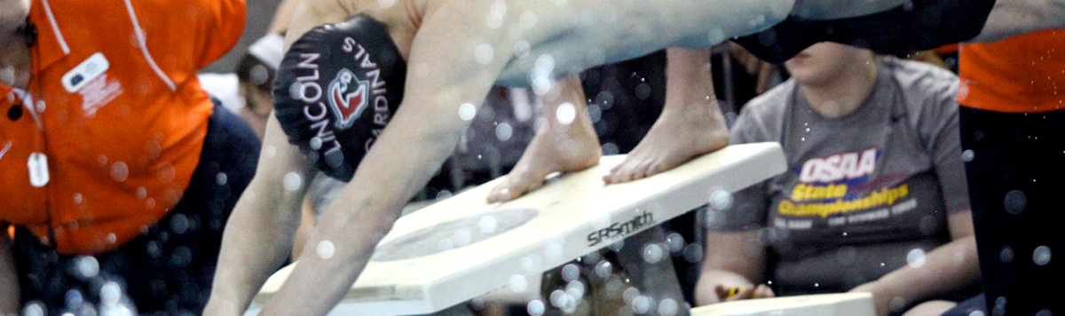



Officiating Swimming & Diving
Course Objectives
Units
Understand the roles of professionalism, rules knowledge, and communication and how they help ensure a fair meet.
Know how to consistently identify swimming violations in each type of event.
Learn the elements of a proper dive and how to score dives appropriately.
Elements of Professional Development
Officiating Swimming
Officiating Diving
Judging Practicum
Unlimited access to course for 1 year from the date of purchase
Approved by NFHS for 3 course clock hours
Notes:
Officiating Swimming and Diving is a course developed by the NFHS in conjunction with the National Interscholastic Swim Coaches Association (NISCA) and USA Diving. This course defines the elements of professional development and the fundamentals of officiating strokes and turns. The course also explores officiating and judging diving and provides a judging practicum that includes feedback of submitted scores. Officials may select either the swimming track, the diving track, or both, depending on rules required by their state association.
More:
- Unlimited access to course & resources for one year from date of purchase
- Use as an elective to fulfill AIC or CIC certification requirements

Slide 46
NFHS Learning Center

Slide 47

Notes:
The NFHS Learning Center, accessed at NFHSLearn.com has over 70 online professional development courses for the entire interscholastic community, including coaches, administrators, officials, parents, students, and individuals within performing arts programs. The mission and purpose of the NFHS Learning Center is focused on growing professional development opportunities. Those opportunities include courses, but now also incorporate additional videos such as “The Parent Seat” and “Beyond The Scoreboard,” which are short videos created to show to parents at Parent Meetings or show during events. The NFHS Learning Center has delivered over 10,000,000 courses and looks to continue to educate and be a valuable resource for the entire interscholastic community. Learn more at NFHSLearn.com!

Slide 48
NFHS Network

Slide 49
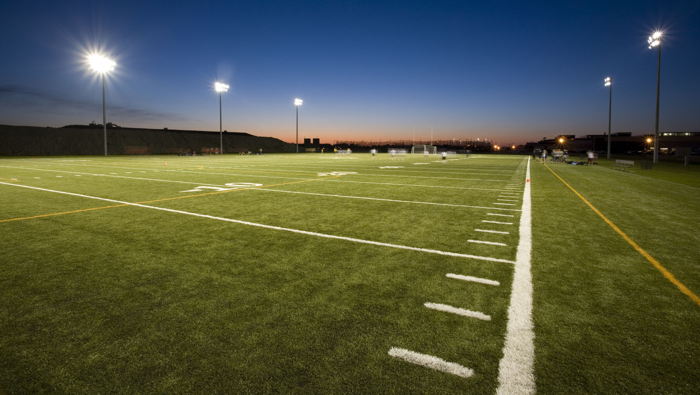

NFHS Network
By 2025, every high school sporting event in America will be streamed live.
The NFHS Network will be
THE DESTINATION for fans
to view these broadcasts.
27 Different Sports and Activities
www.NFHSnetwork.com
Notes:
The NFHS Network is the leader in streaming Live and On Demand high school sports.
Partnered with the National Federation of State High School Associations, 45 high school state athletic/activities associations, and PlayOn! Sports, the NFHS Network is a joint venture created to provide fans with the ability to stream high school sports on any device, from wherever they are.
All NFHS Network events are available to watch online at www.NFHSnetwork.com and through the NFHS Network Live App for iOS and Android. Follow us on Facebook, Twitter, Instagram, and YouTube.
Watching high school sports and events has never been easier.
The NFHS Network’s goal to broadcast live all 2 million high school sporting events by 2025.
The NFHS Network covers 27 different regular season and postseason sports, as well as other high school activities, celebrating the accomplishments of students-athletes, student broadcasters, and high schools across the country.

Slide 50
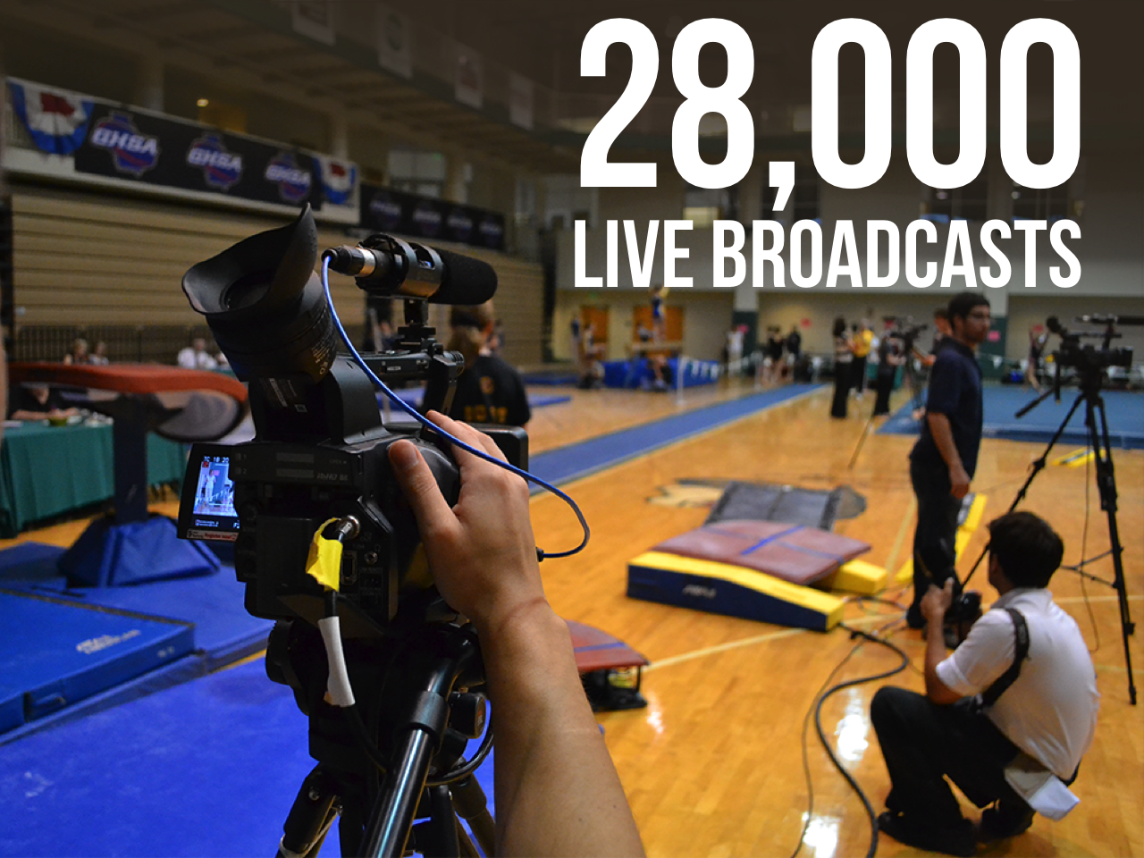
Notes:
The NFHS Network will broadcast over 150,000 live events this year. If your school is not a member of the NFHS Network School Broadcast Program, please contact us at Mark.Koski@NFHSnetwork.com

Slide 51
2020-22 nfhs water polo resources

Slide 52
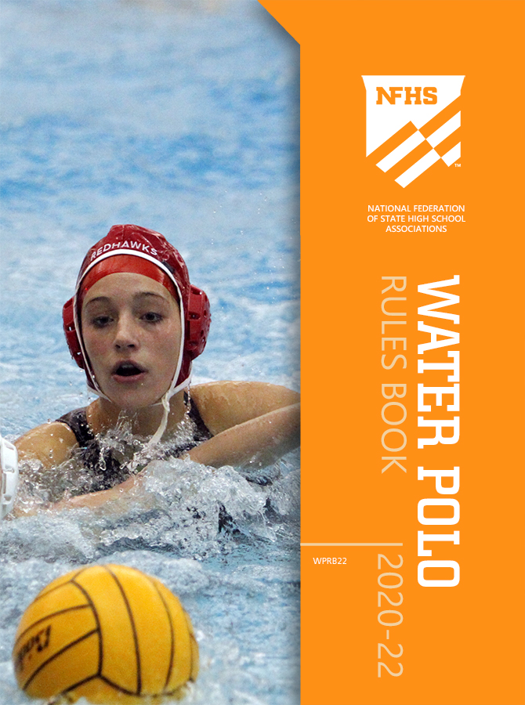
NFHS water polo publications
The Rules Book and other water polo materials can be ordered online at www.nfhs.com, or by calling 1-800-776-3462.

Slide 53
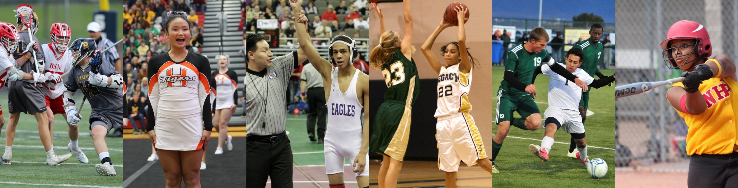
Thank You
National Federation of State High School Associations
PO Box 690 | Indianapolis, IN 46206
Phone: 317-972-6900 | Fax: 317.822.5700
www.nfhs.org | www.nfhslearn.com | www.nfhsnetwork.com

