Slide 1
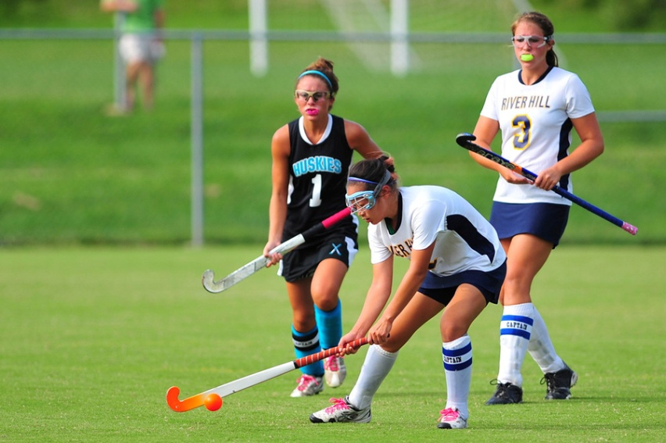
2013-14 NFHS Field Hockey Rules Interpretation PowerPoint
Notes:
Thank you for participating in this annual interpretation meeting. While the game of field hockey is in reasonable shape, we continue to work toward improving the game and hopefully putting young people in safe conditions and in situations that they are able to find success in some aspect of the game. Ultimately, our goal is for them to be safe, have fun and gain some valuable life lessons from participation.
Areas in this PowerPoint that are underlined designate that the text was newly added to the rules this year. Bold notations mean the language is either a title, heading or penalty. Deletions and modifications are aptly identified as well. Where appropriate, notes and comments will be found under some of the PowerPoint slides. Not every rule change or editorial change warrants an explanation over and above the stated rationale. Thank you again for your attendance, participation and dedication to interscholastic athletics. Have a fantastic field hockey season!

Slide 2
Rule 1-3-4
Modify: The ball shall be spherical with a plastic seamless outer surface. It may be of any solid color that contrasts with the playing surface. The ball shall…..in either format:
Rationale: The description of the ball is archaic and not in touch with the current manufactured product used in high school field hockey.

Slide 3
Rule 1-6-10
Modify: ART. 10... Use of video monitoring, replay equipment or personal wireless communication devices during the game by coaches is permitted. Players are not allowed to use personal wireless communication devices during the game.
Rationale: Recommended rule change from the NFHS Rules Review Committee to standardize the rules regarding electronic communication devices in all NFHS rules books.

Slide 4
Rule 1-8-1c
Modify: ART 1 … Head coaches are responsible for:
a. no change;
b. no change;
c. Ensuring that their players follow the substitution rules.
Rationale: The head coach is the appropriate person, for ensuring that substitutions of players on their team are carried out properly.

Slide 5
Rule 2-2-4
Modify: ART. 4...During the final…end of each half. At the end of each half the timer shall sound an audible device to indicate that time in the half has run out. Note: The near umpire's whistle shall signal the official end of the half. Where a visible scoreboard is available, it should remain on until the clock runs down to zero.
Rationale: This brings the procedure for ending the half or game in line with other levels of the sport. Further, it avoids opportunity for error when the umpire cannot hear the timer's count down.

Slide 6
Rule 3-3-9
Modify ART 9...Self-pass is a legal stroke for putting the ball into play for a free hit, 16-yard hit, center pass and side-in. The self-pass requires that there is a clear separation between the initial touch and any subsequent play on the ball. is a legal technique for putting the ball into play for a free hit, 16-yard hit, center pass, long hit and side-in.
Rationale: This would bring the self pass in-line with other levels of the game, but also eliminate the “clear separation between the initial touch & any subsequent play on the ball.”

Slide 7
Rule 4-4 Penalties 1-3 and Note
Modified: Delete Penalties 1, 3, 4, 5 and Note.
PENALTIES:
2. For violations by the team without the ball, the coach shall be notified with no other penalty assessed.
1. For subsequent violations by either team, misconduct penalties will be assessed to the head coach of the offending team, using the card progression.

Slide 8
Rule 4-4 Penalties 1-3 and Note (cont.)
Rationale: In the past,there was a clarification of penalties with a clear separation between fouls that happened on the field in the course of play, and misconduct (behavior). The rules book was not clear regarding wrongful substitutions. If a substitution is done incorrectly,it is a misconduct issue, not a foul, and so there should be no change of possession of ball.

Slide 9
Rule 4-4-6
Modify: ART 6… A suspended player returning to the game must follow the substitution rules.
Renumber old 4-4-6 to new 4-4-7.
Rationale: Clarification.

Slide 10
Rule 8-2-2a Penalties
Modify: a. First offense, a green card is issued as a warning to the offender. The warning shall be recorded in the scorebook. a green card is issued and the player must leave the field of play for two minutes of elapsed playing time (suspension) to the scorer’s table and the team shall play short one player for the duration of the penalty time. Time out shall be taken to issue the card, the player must leave the field immediately and the game is restarted with no further interruption. The penalty time shall start with the restart of play. The suspension shall be recorded in the scorebook.
Notes:
Great tool for first time fouls that aren’t quite thought of as a caution (yellow card), but deserve something more than another hard whistle. To clarify, the suspended player will set at the scorer’s table on the side of their team bench so they can still receive coaching during the suspension time. Substitution rule would apply if the 2 minutes expires after the awarding of a penalty corner.

Slide 11
Rule 8-2-2a Penalties (cont.)
Rationale: Bring the green card in-line with other levels, but more importantly, it would send a stronger message after a hard whistle, but not as stringent as a yellow card.

Slide 12
Rule 8-2-3e Penalties
Modify: New. e. Players who have received a green card or a yellow card shall serve their suspension at the scorer's table on the same side as their team bench. Players who receive a red card suspension are the responsibility of the coach and shall be removed to their bench or another appropriate place.

Slide 13
Rule 8-2-3e Penalties (cont.)
Rationale: Assist the umpires and coaches to manage suspensions and avoid players returning too early or not getting back into the game in a timely manner. Additionally, placing the player on the same side as their team bench is logical for coaches to control their players.

Slide 14
8-2 Penalty Note
Modify: Delete. PENALTY #5. NOTE: If the penalty stroke is successful, play is restarted with a center pass by the team that did not score. If no goal is scored, the defenders shall be awarded a free hit 16 yards in front of the center of the goal outside the circle. When flagrant misconduct occurs during halftime intermission, a red card is issued and a penalty stroke is awarded. The team not having possession at the start of the game shall have possession to start the second half.

Slide 15
8-2 Penalty Note (cont)
Rationale: Clarifies how to proceed after the penalty stroke has been completed and where returning players may re-enter the game following a suspension period.

Slide 16
Rule 9-2-1e, f, and g
Modify: d. no change. e. The ball must not be raised intentionally directly from the free hit. The ball may be raised immediately using a push, flick or scoop action but may not be raised intentionally using a hit. This action must be conducted safely.
Delete f. and g.
Renumber the remaining articles.

Slide 17
Rule 9-2-1e, f, and g (cont.)
Rationale: By having the option to raise the ball immediately, opposing players will not have the opportunity to get closer than five yards; a raised ball on the free hit should be safer.
Notes:
By changing this rule, the next playing of the ball is no longer required to be two distinct actions. In the past, the interpretation of the "two distinct actions" has caused much controversy. By changing this rule, the ball does not have to move one yard before the player may play the ball again.

Slide 18
10-2 Penalties
Delete current Penalties 1-3. Modify:...PENALTIES: Any player entering the circle before the ball is struck shall be sent to the centerline.
1. For any offense of this rule by a defender other than the goalkeeper, the offending player(s) shall be required to go beyond the center line and cannot be replaced by another defender.

Slide 19
10-2 Penalties (cont.)
2. For any offense of this rule by a defending goalkeeper, the defending team defends the penalty corner with one fewer player.
3. For any offense of this rule by an attacker who enters the circle before the ball is played, the offending player(s) shall be required to go beyond the center line.

Slide 20
10-2 Penalties (cont.)
4. The player who pushes the ball from the back line must not feint at playing the ball. For an offense of this rule, the offending player shall be replaced by another attacker and must go to the center line.
5. Umpires must ensure that the penalty corner is set properly before allowing the insertion (a foot accidentally placed on the line and not correct by the umpire in advance of the insertion will not constitute sending a player to the center line).

Slide 21
10-2 Penalties (cont.)
6. For any necessity to restart a penalty corner due to an early break into the circle or a feint by the inserter, someone must go to the center line.
7. When multiple players break into the circle prior to the insertion, one and only one player entered the circle first. The umpire must make a decision and send only one player, the player who entered the circle first, to the center line.

Slide 22
10-2 Penalties (cont.)
8. When a player is sent to the center line, she may come back into the half of the field in which the penalty corner is taking place after the ball has been inserted.
9. All the above penalties apply only for the original and retaken penalty corner; a subsequent penalty corner may be defended by not more than five (5) players.

Slide 23
10-2 Penalties (cont.)
10. The umpire in charge of administering the penalty corner is solely responsible for all decisions on the attackers or defenders breaking into the circle too soon and feints by the inserter.
Rationale: This action will enhance the start of the penalty corner and more efficiently address the situation where the defense and or the attack break the line prior to the contact of the penalty corner.

Slide 24
Rule 10-2-7
New. ART.7.. ...If the first shot at goal is a hit, the ball must be on a path or trajectory to cross the goalline no higher than 18 inches unless it touches the stick or body of a defender or the stick of an attacker as it travels toward goal or had traveled more than five yards from the circle prior to the shot. If the first shot at goal is a hit and the ball is, or will be too high crossing the goal line it must be penalized immediately.

Slide 25
Rule 10-2-7 (cont.)
Rationale: Clarifies the height requirements when the first shot on goal is a hit or drive. It also confirms that the play must be blown dead as soon as it is recognized that it will not cross the goal line at 18 inches or less. This is not a hold whistle situation.

Slide 26
Rule 10-2-10
Modify: ART 10...Substitution may occur immediately following the initial hit from the end line. A suspended player returning to the game when a penalty corner has been awarded, may only do so after the ball has been put into play by the inserter.
Rationale: Clarifies that a returning suspended player on a penalty corner must wait until the ball is inserted into the game from the end line. The rule book had previously been silent on this issue.

Slide 27
Rule 11-2-6a-d
Modify: Delete. ART. 6...A goal is scored on the penalty stroke when:
a. The whole ball crosses completely over the goal line between the goal posts and under the crossbar;
b., c., and d, are deleted.
Rationale: Clarity and brings the rule in line with other levels.

Slide 28
Rule 11-2-8e
Modify: Delete. ART. 8...A penalty stroke is ended when:
a, b, c, d, f, g, h, i Remain unchanged.
e. The stroker takes the stroke prior to the whistle.
Rationale: Clarity and brings the rule in line with other levels of the sport.

Slide 29
Rule 11-2-9a
Modify: ART. 9...The penalty stroke may be retaken when:
a. The goalkeeper moves her feet prior to the stroke because of an unintentional movement by the stroker.
a. For any offense by the goalkeeper defending the stroke including moving either foot before the ball has been played; the penalty stroke is taken again.

Slide 30
Rule 11-2-9a (cont.)
If the goalkeeper defending the stroke prevents a goal being scored but moves either foot before the ball has been played, the goalkeeper must be verbally warned and for any subsequent offense the card progression shall be followed. If a goal is scored even though there has been an offense by the goalkeeper, the goal is awarded.

Slide 31
Rule 11-2-9a (cont.)
b. Is deleted.
c. Becomes the new "b". (see next rule change)
Rationale: Removes the “penalty goal." Keeps awarding a goal very clear and simple. A goal is scored if the whole ball crosses completely over the goal line between the goal posts and under the crossbar. Brings rule in line with other levels of the sport.

Slide 32
Rule 11-2-9c
Modify: c. If the stroke is taken before the whistle and a goal is scored, the penalty stroke is taken again.
Rationale: Clarity and brings the rule in line with other levels in the sport.

Slide 33
Rule 12 Penalty Note
Modify: New. NOTE: Carding a coach requires the official to call timeout. When possible, officials should wait until the next stoppage of play to issue the card. If a foul has not occurred, play will start with a bully.
Rationale: This clarifies how play restarts after a coach has been carded. It also gives guidance to officials regarding when to issue a card so that the team whose coach was not carded does not lose possession.

Slide 34
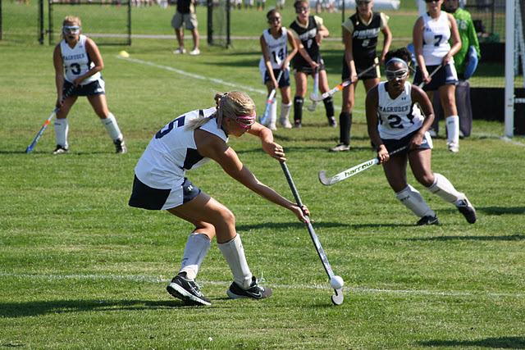
EDITORIAL CHANGES

Slide 35
Rule 1-5-1m
Modify: m. An American flag may be worn on or occupy a space anywhere on the team jersey provided it does not exceed 2 by 3 inches...of the number.
Rationale: Editorial.

Slide 36
Rule 1-5-4
Modify: ART 4. . .Individual players may wear mittens/gloves, knitted hats and soft-headgear as well as full-length, solid-colored warm-up pants/tights provided the knee-length socks/sock guards are visible.
Rationale: Editorial. Moved soft-headgear from 1-6-5b.

Slide 37
Rule 1-6-6
Modify: ART. 5... Hard and unyielding items...any additional padding. Each state association...circumstances. The accommodations should not fundamentally alter the sport, allow an otherwise illegal piece of equipment, create heighten risk to the athlete/others or place opponents at a disadvantage.
Rationale: Recommended editorial changes from the NFHS Rules Review Committee to standardize the rule changes in all NFHS rules books.

Slide 38
Rule 1-8
Modify: SECTION 8 HEAD COACHES' RESPONSIBILITIES .
Rationale: Editorial.

Slide 39
Rule 2-1-6
Clarified: …”When a yellow card is issued toa player, the offentder shall be removed to the team bench/scorer’s table area for five or ten minutes…
Rationale: Consistency with the same procedure as when a green card is issued.
Notes:
Will be added to the 2014 NFHS Field Hockey Rules Book.

Slide 40
Rule 3-1-7
Clarified: Art. 7. . . Suspended player is one who has been issued a green card (2-minute suspension), yellow card and removed to the team bench/scorer’s table area for five or 10 minutes of playing time.
Rationale: Consistency with the same procedure as described in Rule 2-1-6.

Slide 41
Rule 3-2-9
Clarified: Delete: Note: The ball must move at least one yard on the free hit, long hit, center pass, side-in and 16-yard hit before another player of the same team is allowed to play the ball.
Rationale: That requirement is no longer necessary since it was removed in Rule 9-2-1.

Slide 42
Rule 4-4-5 Note
Modify: NOTE: When a player's number changes because she has changed a uniform with an excessive amount of blood on it, the scorebook shall be changed, but no penalty is assessed. When a player's number changes because she has changed a uniform with blood on it, the scorebook shall be changed, and no penalty is assessed.
Rationale: Editorial.

Slide 43
Rule 8-1-1h
Modify: Delete. h. Failing to show separation between the initial touch and subsequent play on the ball when self-passing;
Renumber the rest of the sub-articles.
Rationale: Editorial. This deletion would add clarity to Rule 3-3-9. Eliminating the need for a self-pass to have clear separation between the initial touch and subsequent play on the ball.

Slide 44
Rule 8-2-1-2d PENALTY Note
Modify: Delete. NOTE: In all cases of misconduct, the appropriate penalty shall be assessed: (1) for a foul committed outside the circle, a free hit shall be awarded the opponent; (2) for a foul committed inside the circle by the defense, a penalty corner shall be awarded the attack; (3) for a foul committed inside the circle by the attack, a free hit shall be awarded the defense.
Rationale: Editorial. Not relevant.

Slide 45
Rule 11-2-9b
Modify: Delete. b. The goalkeeper takes a step in any direction or drops her stick after she and the stroker have indicated they are ready, the stroker's shot completely misses the goal cage. Renumber the remaining articles.
Rationale: Editorial. Clarity and brings the rule into line with higher levels.

Slide 46
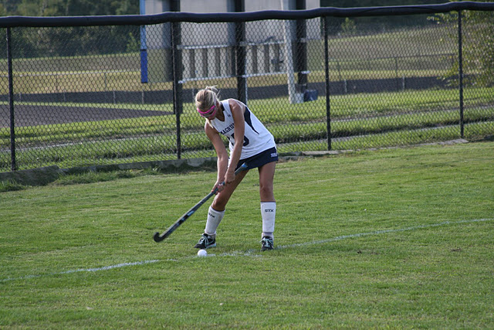
OFFICIALS’ GUIDE

Slide 47
Officials’ Guide Section V-A-5
Modify: The foul will be penalized...where the player is positioned. - when a player of either team plays an aerial ball with her stick above her shoulder, this is a foul and the penalty shall be applied where the player is positioned.
Rationale: Risk Minimization. Clarifies that playing an aerial ball with the stick above shoulder height is always a foul and it shall be penalized where that player is positioned at the time the ball was played.

Slide 48
Officials’ Guide Section VI-B-2
Modify: All opponents must always be at least 5 yards from the ball. between the two 25- yard lines.
Rationale: Clarification.

Slide 49
Officials’ Guide Section VIII-D-3b
Modify: b. If the shot is lifted and hits a non-marking defender positioned at least five yards away from the shot and between the shot and the goalkeeper, a penalty corner should be awarded.
Rationale: Clarifies that non-marking defenders are to be viewed differently than a defender who is legitimately marking an opponent. We want to discourage players from cluttering the path to goal and not marking an opponent. This is unsafe.

Slide 50
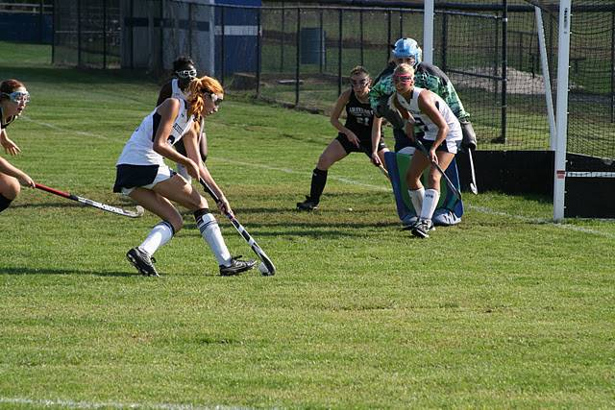
OFFICIALS’ SIGNALS

Slide 51
Official Signals
Modify: 13. Dangerous Play - Arms extended forward, lower than waist, palms down. Move the arms slowly up and down one time. Place one forearm diagonally across the chest.
Rationale: Consistent with other levels’ mechanics. Current NFHS signal for dangerous play is a calming motion and proposed change sends a stronger signal to player and coaches.

Slide 52
Official Signals
Modify: 16. Bully - Extend both arms in front of body, below the waist with palms touching, then move the arms and hands from one side to the other one time. Move hands alternately up and down in front of body with palms facing each other .
Rationale: Proposed change to bully gives a clearer indication of the mechanics of the action , current NFHS signal could be confused with the “no goal” signal.

Slide 53
Official Signals
Modify: New 22. 5-Yard Distance - Extend one arm straight up in the air showing an open hand with all fingers extended.
Rationale: New signal for 5-yard infringement would improve official to player communication.

Slide 54
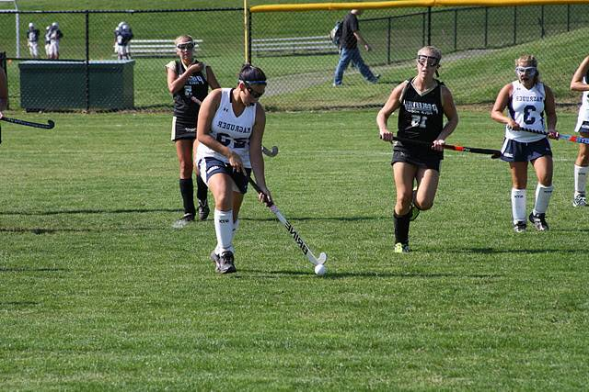
2013 POINTS OF EMPHASIS

Slide 55
Use of Cards
When used properly, cards are a teaching tool. By issuing a card, the official informs players, coaches and spectators that an infraction of the rules has occurred and is being addressed. A second similar offense by a teammate may result in the next upgraded card.

Slide 56
Proper Use of Equipment
With the standardization of the performance of protective eyewear, it is incumbent upon the coaches and players to properly use the equipment as it was intended. Combining various protective devices is potentially harmful and immediately voids any manufacturer’s warranty. By rule, required equipment shall not be modified and shall be worn as intended by the manufacturer. (1-6-7)

Slide 57
Proper Use of Equipment (cont.)
Manufacturer’s spend hundreds of hours and thousands of dollars researching and testing products before they are released to the public. They ensure that their products will perform at the highest level possible if it is worn properly. The NFHS makes a significant investment in time and resources to consider what is appropriate equipment for field hockey, for the sole purpose of minimizing risk.

Slide 58
Leaving Team Area
The lines of a field hockey field have been designed for a distinct separation of various areas on the field. These areas are designated for the safety of the players, coaches, officials, and fans. If everyone remains in their areas, this reduces the risk of anyone getting injured. There is no reason to leave the team area other than replacing someone who is injured, halftime, end of the game, substitution or being beckoned by the game official. This is another form of minimizing risk.

Slide 59
Sideline Encroachment
It is important not to allow sideline encroachment during a contest. There are many groups involved in a field hockey game and their roles are interconnected. The players, substitutes, bench personnel, officials, ball shaggers, and table staff that consists of scorer and timekeeper all have key roles in the game and need to be able to do their respective jobs unencumbered of clutter and needless bodies blocking their view or field access.

Slide 60
Proper Use of Mechanics
The typical high school official goes through extensive training so they can develop consistent, proper mechanics. They do this to ensure that the players have a positive experience and understand when a foul or misconduct occurs. Coaches rely on these mechanics to understand what was called so they in turn can educate their players. Fans appreciate crisp mechanics and clear signals so they can keep track of the action on the field and stay connected with the players.

Slide 61
Proper Use of Mechanics (cont.)
Good mechanics is also the key to communicating with the other official and table personnel. The safety of the players depends on good mechanics applied consistently by both officials. Eye contact, proper positioning, anticipation of play all contribute to the vital success of good game management.

Slide 62
Corrections

Slide 63
Rule 12-1-1 PEN 1
PENALTIES:
1. First offense, a green card shall be issued to the offender and the head coach. The warning shall be recorded in the scorebook.
Replace the current language in the 2013-14 NFHS Rules Book with the above verbiage.

Slide 64
11.2.9 Situation B
Red Team is awarded a penalty stroke. Following the verbal “ready “ response from both participants but prior to the official’s whistle to start the stroke, the attacker flicks the ball into the goal cage. No goal is awarded and the penalty stroke is retaken. RULING: Incorrect Correct procedure. COMMENT: If the stroke is taken before the whistle, this is a foul by the attacker and the penalty stroke is ended. If the stroke is taken before the whistle and a goal is scored, the penalty stroke is taken again.

Slide 65
NFHS Sports Medicine

Slide 66
NFHS Sports Medicine
The 2011-12 season has continued to have one of the lowest injury rates.
Field Hockey injury rates have remained stable over the previous four year period.
For the 2011-12 season:
Strain/sprains injuries (44%)
Head/face injuries (25.4%) remained the most common injured body site
Hip/thigh/upper leg injuries (20.9%)
Concussions (18.7%)
2012-13 injury data will be released August 31st.

Slide 67
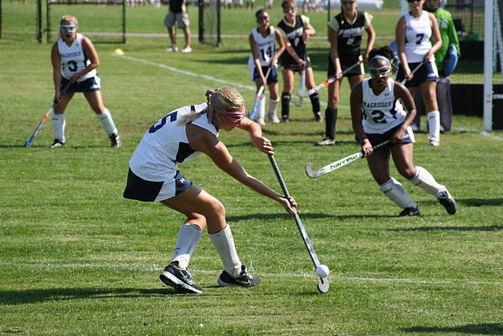
NFHS Coaches Certification and Education Program Courses

Slide 68
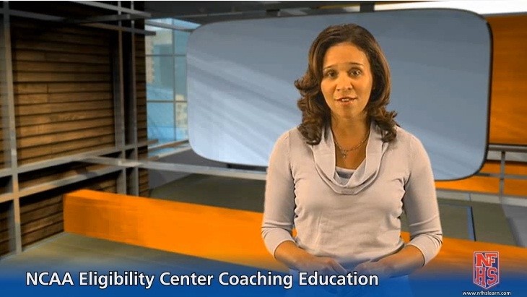
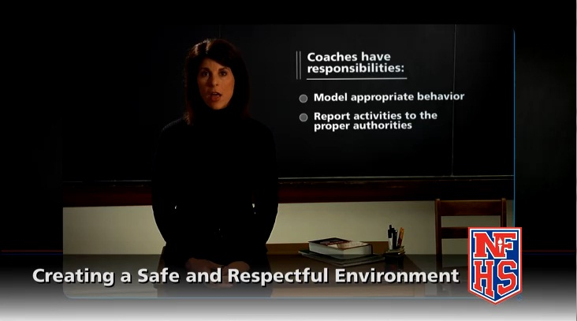
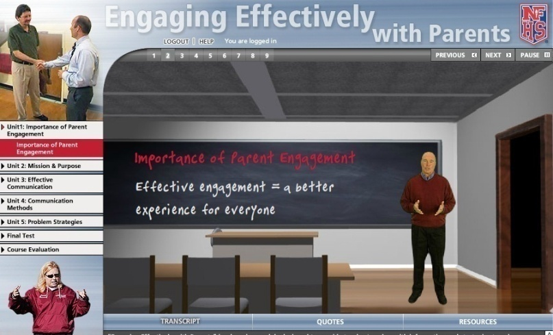
Free!
$20
$20
All NFHS courses can be accessed at www.nfhslearn.com
Notes:
Just a reminder, there are several new and/or updated coaching courses located at nfhslearn.com.
Check them out!

Slide 69
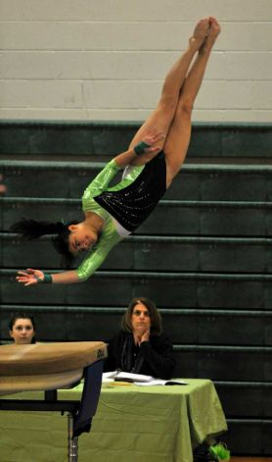
Interscholastic Officiating
Introduction to skills and concepts used as an official
Ideal for new officials or those in first few years of officiating
30-45 minutes to complete
Topics include: basics of becoming and staying an official, science of officiating, art of officiating, how to combine these skills for successful officiating
Course is FREE to any NFHS Officials Association member
Non-members course is $20
Contact NFHS Officials Department for details (317.972.6900)
www.nfhsofficials.com

Slide 70
THANK YOU
HAVE A GREAT
SEASON!

