Slide 1
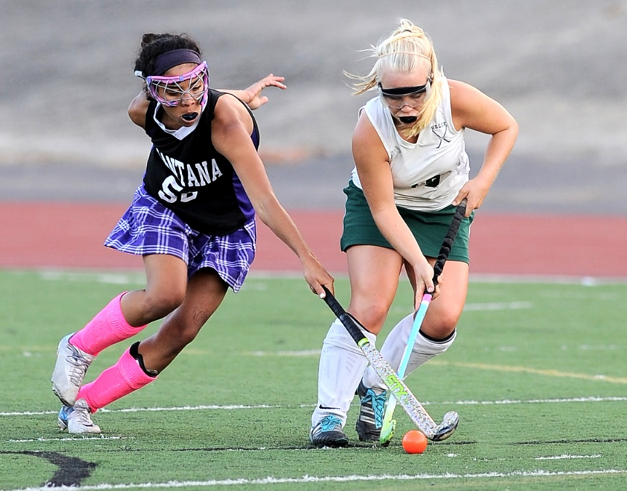
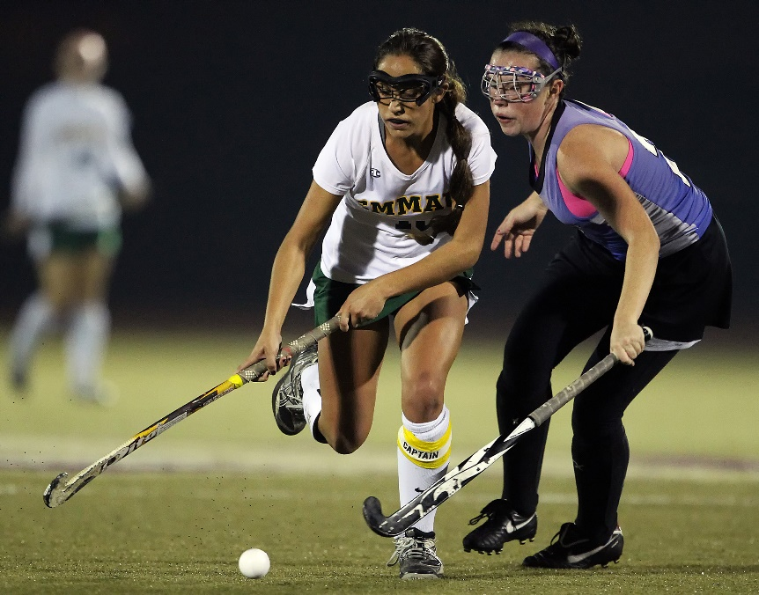
2016 NFHS FIELD HOCKEY rules PowerPoint
Notes:
Title Slide: 2016 NFHS Field Hockey PowerPoint

Slide 2

Notes:
Comment on Slide:
Big Teams is the Official Corporate Partner of NFHS Field Hockey for 2016.

Slide 3
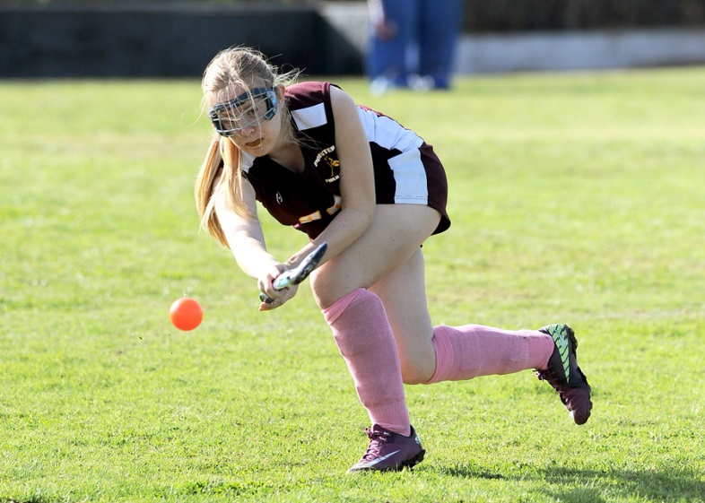
National federation of state high school associations (NFHS)

Slide 4
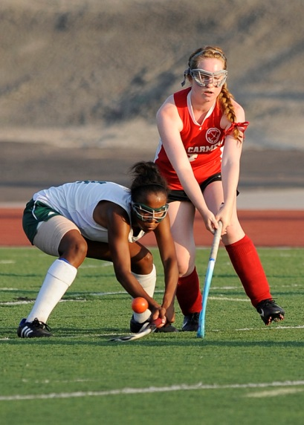
National Federation of
State High School Associations
NFHS (located in Indianapolis, IN – Est. 1920):
  National leadership organization for high school sports and fine arts activities;
  National authority on interscholastic
  activity programs.
  Conducts national meetings;
  Sanctions interstate events;
  Produces national publication for
  high school administrators;
  National source for interscholastic coach
  training and national information center.
Notes:
Comment on Slide:
Overview of the NFHS.

Slide 5
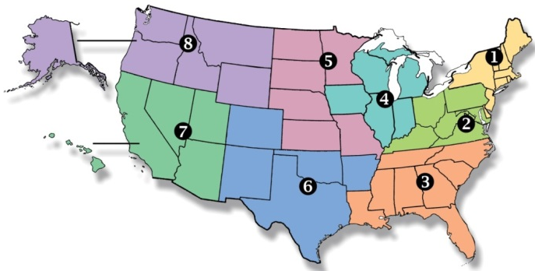
National Federation of
State High School Associations
Membership = 50 member state associations and D.C.
NFHS reaches more than 19,000 high schools and 12 million participants in high school activity programs, including more than 7.8 million in high school sports.
Notes:
Comment on Slide:
Overview of the NFHS.

Slide 6



NFHS Rules Review Committee
The NFHS Rules Review Committee is chaired by the chief operating officer and composed of all rules editors. After each committee concludes its deliberations and has adopted its recommended changes for the subsequent year, such revisions will be evaluated by the Rules Review Committee.
Davis Whitfield
Chief Operating Officer
Bob Colgate
Football and Sports
Medicine
Elliot Hopkins
Baseball and Wrestling
Mark Koski
Field Hockey
Becky Oakes
Cross Country, Gymnastics, Volleyball and
Track & Field
Dan Schuster
Ice Hockey
Sandy Searcy
Softball and Swimming & Diving
Theresia Wynns
Basketball and Soccer
Notes:
Comment on Slide:
Overview of NFHS Rules Review Committee.

Slide 7


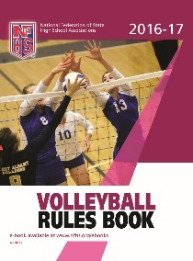
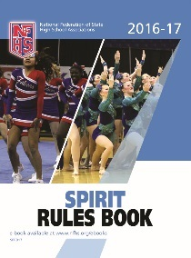



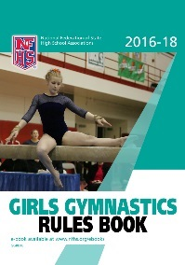
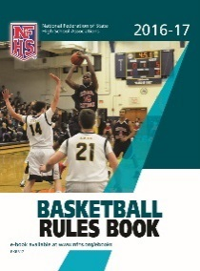





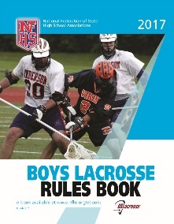
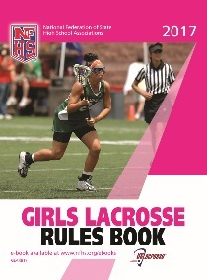


National Federation of
State High School Associations
The NFHS writes playing rules for 17 sports for boys and girls at the high school level.
  Publishes 4 million pieces of materials annually.
Notes:
Comment on Slide:
Overview of NFHS Rules Books and Publications.

Slide 8

NFHS Rules Book as e-Books
E-books features:
  Searchable
  Highlight areas of interest
  Make notes
  Desktop laptop availability
  Easy navigation
  Adjustable viewing size
  Immediate availability
Notes:
Comment on Slide:
Overview of NFHS Rules Book as E-Books.

Slide 9
2016 nfhs
Field hockey
RULES CHANGES

Slide 10

NFHS Field Hockey RULES
Page: 11
Each state high school association adopting these rules is the sole and exclusive source of binding rules interpretations for contests involving its member schools. Any person having questions about the interpretation of NFHS rules should contact the rules interpreter designated by his or her state
high school association.
The NFHS is the sole and exclusive source of model
interpretations of NFHS rules. State rules interpreters may contact the NFHS for model rules interpretations. No other model rules interpretations should be considered.
Notes:
Comment on Slide:
This statement appears at the bottom of the Table of Contents page in the 2016 NFHS Field Hockey Rules Book.

Slide 11
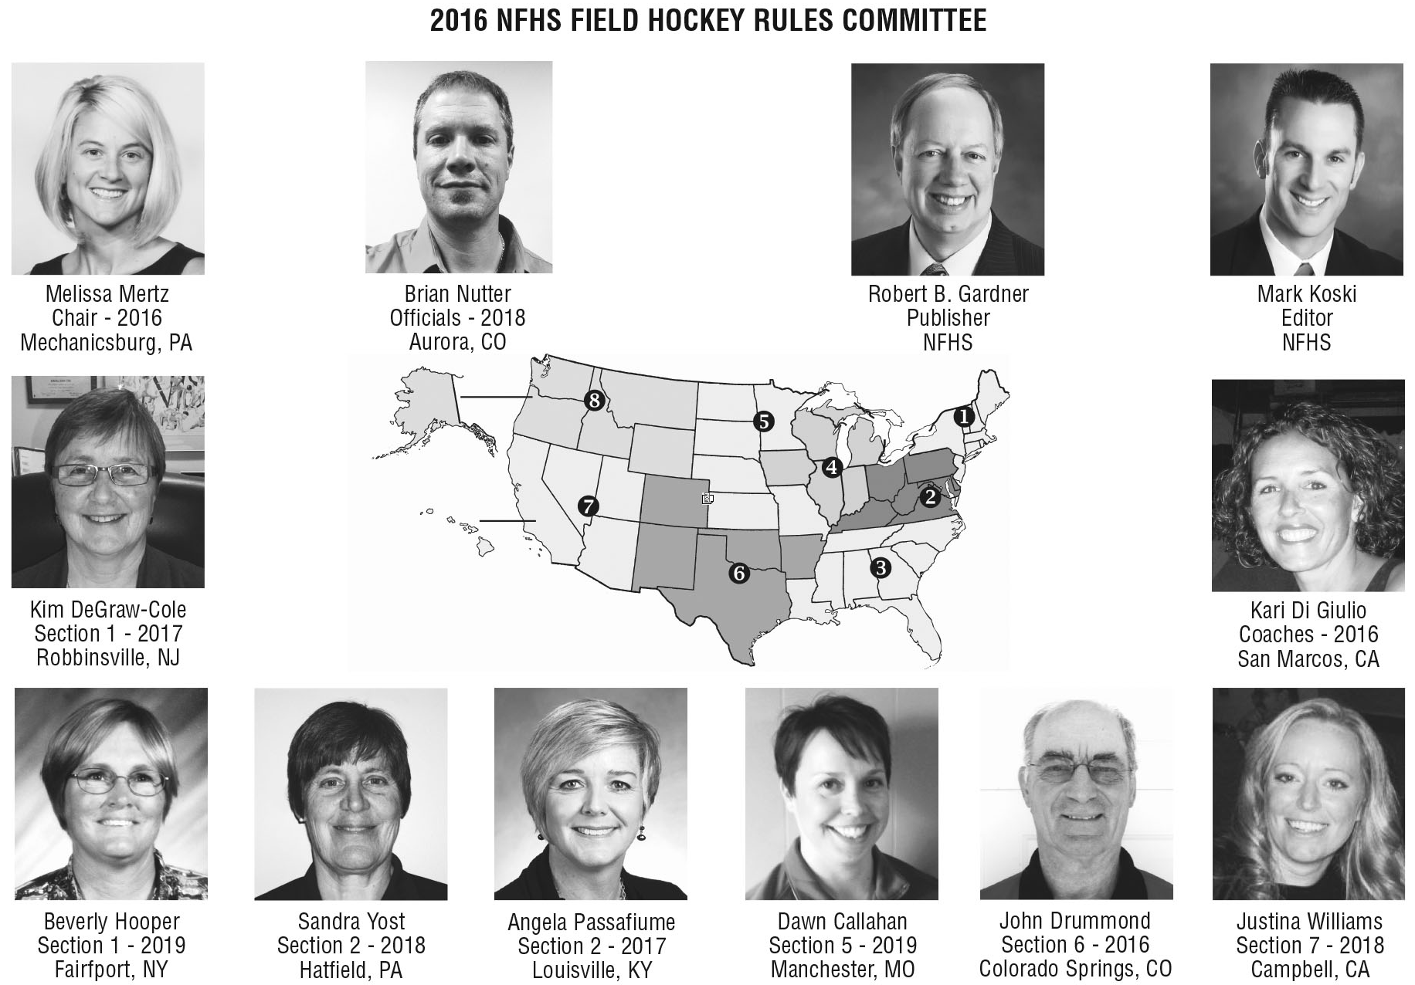
NFHS Field Hockey RULES committee
Page: 12
Notes:
Comment on Slide:
2016 NFHS Field Hockey Rules Committee

Slide 12
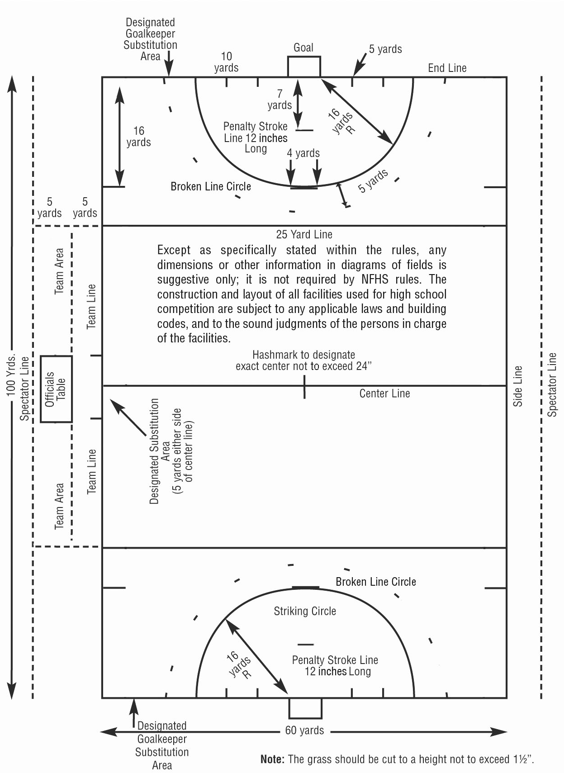
The field and markings
RULE 1-2
Page: 14
New procedure for Long Hit eliminates the need for this field marking. Long Hit Line will also be eliminated from Field Diagram.
Notes:
Comment on Slide:
Rule 1-2 - New procedure for Long Hit eliminates the need for this field marking. Long Hit Line will also be eliminated from Field Diagram.

Slide 13
Player uniform
RULE 1-5-3
Page: 19
The home team is required to wear single solid white uniform tops front and back on the torso. The home team should only wear white socks to match the uniform top. There is no need for the home team to wear any other color sock/sock guard than white. Light-colored is ambiguous.
Notes:
Comment on Slide:
Rule 1-5-3 - The home team is required to wear single solid white uniform tops front and back on the torso. The home team should only wear white socks to match the uniform top. There is no need for the home team to wear any other color sock/sock guard than white. Light-colored is ambiguous.

Slide 14
Player UNIFORM
RULE 1-5-6 penalties 2 (new)
Page: 19
When an illegally uniformed team is unable to correct the situation or cannot verify state association approval of the uniform, the game shall be played. The referee must, however, notify the state association following the game.
Notes:
Comment on Slide:
RULE 1-5-6 PENALTIES 2 (new) - When an illegally uniformed team is unable to correct the situation or cannot verify state association approval of the uniform, the game shall be played. The referee must, however, notify the state association following the game.

Slide 15
Player equipment
RULE 1-6-5
Page: 20
Face masks are no longer permitted
Notes:
Comment on Slide:
Rule 1-6-5 - Face masks are no longer permitted

Slide 16
Goalkeeper equipment
RULE 1-8-1A
Page: 22
Goalkeeper uniform tops may be multiple colors to ensure contrasting uniforms with field players. Effective 2017, the goalkeeper’s uniform top must have visible numbers on the front and back. This will create consistency with all uniforms worn on the field.
Notes:
Comment on Slide:
Rule 1-8-1a - Goalkeeper uniform tops may be multiple colors to ensure contrasting uniforms with field players. Effective 2017, the goalkeeper’s uniform top must have visible numbers on the front and back. This will create consistency with all uniforms worn on the field.

Slide 17
End line
RULE 7-3-2
Page: 41
The implementation of the new “Long Hit Procedure” created a new name that is consistent with the new procedure.
Notes:
Comment on Slide:
Rule 7-3-2 - The implementation of the new “Long Hit Procedure” created a new name that is consistent with the new procedure.

Slide 18
Penalty corner – regulation or extended play
RULE 10-3-2
Page: 51
The rule change for 2015 (dealing with restarts for extended play penalty corners) eliminated the clear definitions for when a penalty corner, during regular play, is considered to be completed. The exception to the rule added in 2015 (dealing with restarts for extended play penalty corners) should apply to an injury during regulation play as well as extended play.
Notes:
Comment on Slide:
Rule 10-3-2 - The rule change for 2015 (dealing with restarts for extended play penalty corners) eliminated the clear definitions for when a penalty corner, during regular play, is considered to be completed. The exception to the rule added in 2015 (dealing with restarts for extended play penalty corners) should apply to an injury during regulation play as well as extended play.

Slide 19
When awarded
RULE 11-1-1e
Page: 54
The rules have evolved to allow umpires to better manage this situation if it occurs. Deleted provision to award a penalty stroke when the defending team continues to deliberately cause the ball to go over the end line.
Notes:
Comment on Slide:
Rule 11-1-1e - The rules have evolved to allow umpires to better manage this situation if it occurs. Deleted provision to award a penalty stroke when the defending team continues to deliberately cause the ball to go over the end line.

Slide 20
2016 nfhs
Field hockey editorial changes

Slide 21
2016 nfhs field hockey editorial changes
Field Diagram | Except as specifically stated within the rules, any dimensions or other information in diagrams of fields is suggestive only; it is not required by NFHS rules. The construction and layout of all facilities used for high school competition are subject to any applicable laws and building codes, and to the sound judgments of the persons in charge of the facilities.
All | All references to long hit shall be changed to 25-yard free hit.
All | All references to drive shall be changed to hit.
Rule 1 Title | The Game, Field, Players, Coach and Equipment
Notes:
Slide Comment:
This slide lists the rules references and a brief description of the field hockey editorial changes that were made to the 2016 NFHS Field Hockey Rules Book.

Slide 22
2016 nfhs field hockey editorial changes
1-5-1l | Members of each team shall be dressed uniformly, except the goalkeeper. The uniform top shall have clearly visible numbers on the front and back. The numbers shall be of a solid color contrasting to any surrounding colors. Numbers on the front shall be 3 to 6 inches in height, and 6 to 8 inches in height on the back. Any number from 00 through 99 is legal. A team may not use both numbers 0 and 00. Three-digit numbers and duplicate numbers on players of the same team are not permitted. The following are the color requirements for the jersey/top: l. The style/design of the side insert may be of any color or design. Side inserts must be the same width for all team jerseys.
Notes:
Slide Comment:
This slide lists the rules references and a brief description of the field hockey editorial changes that were made to the 2016 NFHS Field Hockey Rules Book.

Slide 23
2016 nfhs field hockey editorial changes
1-6-6- NOTE | Delete
1-6-10 | Players are not allowed to use personal wireless communication devices during the game.
1-7 | Entire Rule has been re-written
1-7-2 NOTE | Delete
1-7-3c | When the ball is inside the circle, the goalkeeper: c. May stop an aerial ball with her body, hand or stick at any height;
1-7-3g (new) | When the ball is inside the circle, the goalkeeper: g. The goalkeeper shall not play in a manner which endangers other players (e.g. diving headfirst at an opponent, kicking wildly at the ball, an opponent or an opponent’s stick, etc.)
Notes:
Slide Comment:
This slide lists the rules references and a brief description of the field hockey editorial changes that were made to the 2016 NFHS Field Hockey Rules Book.

Slide 24
2016 nfhs field hockey editorial changes
1-8 | Entire rule has been re-written
1-9 (new) | HEAD COACH RESPONSIBILITIES
Rule 3 SITUATIONS | Delete All
 | 1.2.4 SITUATION A. . . . . . . Delete 1.2.4 SITUATION B. . . . . . . Delete 1.4.1 SITUATION . . . . . . . . Delete 1.4.4 STUATION. . . . . . . . . Delete 1.5.1 SITUATION A. . . . . . . Delete 1.5.1. SITUATION B . . . . . . Delete 1.5.5 SITUATION B. . . . . . . Delete 1.5.6 SITUATION B. . . . . . . Delete 1.6.1 SITUATION B. . . . . . . Delete 1.6.11 SITUATION A . . . . . . Delete
Notes:
Slide Comment:
This slide lists the rules references and a brief description of the field hockey editorial changes that were made to the 2016 NFHS Field Hockey Rules Book.

Slide 25
2016 nfhs field hockey editorial changes
 | 1.7.1. SITUATION A . . . . . . Delete 1.7.3 SITUATION A. . . . . . . Delete 1.7.3 SITUATION B. . . . . . . Delete 1.7.3 SITUATION D. . . . . . . Delete 1.7.6 SITUATION . . . . . . . . Delete 1.7.7 SITUATION A. . . . . . . Delete 1.7.8 SITUATION A. . . . . . . Delete 1.7.8 SITUATION B. . . . . . . Delete 1.8.1 SITUATION . . . . . . . . Delete 2.1.2 SITUATION . . . . . . . . Delete 2.1.3 SITUATION A. . . . . . . Delete 2.1.4 SITUATION B. . . . . . . Delete 2.1.5 SITUATION A. . . . . . . Delete 2.1.5 SITUATION B. . . . . . . Delete 2.1.5 SITUATION C. . . . . . . Delete
Notes:
Slide Comment:
This slide lists the rules references and a brief description of the field hockey editorial changes that were made to the 2016 NFHS Field Hockey Rules Book.

Slide 26
2016 nfhs field hockey editorial changes
 | 2.1.6 SITUATION A. . . . . . . Delete 2.1.6 SITUATION B. . . . . . . Delete 2.2.1 SITUATION B. . . . . . . Delete 2.2.3 SITUATION A. . . . . . . Delete
3-2-4 | 25-yard free hit is a method for an attacker to put the ball in play if a defender unintentionally causes the ball to go across the end line or if the ball glances off the stick/person of a defender in this area and goes across the end line. The attacking team shall be awarded a 25- yard free hit. Play is re-started with the ball on the 25-yard line that is in line with where it crossed the end line. All procedures for taking a free hit apply. All players shall be 5 yards away from the ball. The ball may not be played into the circle until it has amassed a dribbling distance of 5 yards or is touched by a player of either team other than the player taking the 25-yard free hit.
Notes:
Slide Comment:
This slide lists the rules references and a brief description of the field hockey editorial changes that were made to the 2016 NFHS Field Hockey Rules Book.

Slide 27
2016 nfhs field hockey editorial changes
3-2-8 | Side-in is a method for putting the ball in play after it has gone out of bounds over the sideline. All procedures for taking a free hit apply.
3.2.4 SITUATION | Delete
4-4-5 | If a substitution occurs during play, it must take place through the team substitution area, with the player coming off the field before her substitute may go onto the field. If a substitution is being made during half time, during a team time-out or an injury time-out, the players must report to the scorer’s table before entering the game through the substitution area.
4.1.3 SITUATION | Delete
Notes:
Slide Comment:
This slide lists the rules references and a brief description of the field hockey editorial changes that were made to the 2016 NFHS Field Hockey Rules Book.

Slide 28
2016 nfhs field hockey editorial changes
4.2.3 SITUATION C | Delete
4.2.4 SITUATION | The White Team certified athletic trainer goes onto the field to attend to an injured goalkeeper. The trainer determines that the goalkeeper is able to continue, so no substitution is made. RULING: Correct procedure.
 | 4.4.2 SITUATION . . . . . . . . . Delete 4.4.5 SITUATION A . . . . . . . . Delete 4.4.5 SITUATION B . . . . . . . . Delete 4.4.5 SITUATION C . . . . . . . . Delete
Notes:
Slide Comment:
This slide lists the rules references and a brief description of the field hockey editorial changes that were made to the 2016 NFHS Field Hockey Rules Book.

Slide 29
2016 nfhs field hockey editorial changes
4.4.6 SITUATION B | After completing her suspension time, a player enters the game as her team is setting up for a penalty corner. The umpire signals time-out, removes the player from the field and applies card progression to the coach. RULING: Correct procedure. COMMENT: A suspended player returning to the game must follow the substitution rules. Substitution violations are treated as a coach’s misconduct.
4.4.6 SITUATION C | Delete
5-1-1 | Delete
5.1.1 SITUATION | A Red Team player taking the center pass taps the ball to a teammate on her right. The ball only travels 6 inches to the teammate. RULING: Legal.
5.1.2 SITUATION | At the start of the game, players from both teams cross the center line on the official’s whistle. RULING: Illegal.
Notes:
Slide Comment:
This slide lists the rules references and a brief description of the field hockey editorial changes that were made to the 2016 NFHS Field Hockey Rules Book.

Slide 30
2016 nfhs field hockey editorial changes
 | 5.2.1 SITUATION A . . . . . . . .Delete 5.2.1 SITUATION D. . . . . . . . Delete 5.2.1 SITUATION E . . . . . . . . Delete 5.2.1 SITUATION F . . . . . . . . Delete 5.2.2 SITUATION . . . . . . . . . Delete 6.1.1 SITUATION A . . . . . . . .Delete 6.1.1 SITUATION B . . . . . . . .Delete 6.1.1 SITUATION C . . . . . . . .Delete 6.1.1 SITUATION D. . . . . . . . Delete 6.1.3 SITUATION A . . . . . . . .Delete
6.1.3 SITUATION C | The Red Team scores a goal. Prior to the center pass it is discovered that the scorer did not have a mouthguard. The official allows the goal and issues the appropriate card to the coach. RULING: Correct procedure. COMMENT: The scoring player is eligible and her actions are treated as coaches misconduct.
Notes:
Slide Comment:
This slide lists the rules references and a brief description of the field hockey editorial changes that were made to the 2016 NFHS Field Hockey Rules Book.

Slide 31
2016 nfhs field hockey editorial changes
Rule 7 Title | Out-of-Bounds: Side-In, 25-Yard Free Hit and 16-yard Hit
7-2-3 | In taking a side-in, the ball shall be placed on the sideline where it went out of bounds. All procedures for taking a free hit apply.
7-3-3 | If a member of the defending team deliberately causes the ball to go across the end line, a penalty corner shall be awarded the attacking team.
7-3-4 PENALTY | PENALTY: For fouls by the team taking the 25-yard free hit, a free hit is awarded to the opponents. For deliberate fouls by the defending team, a penalty corner shall be awarded.
7.3.2 SITUATION B | Delete
Notes:
Slide Comment:
This slide lists the rules references and a brief description of the field hockey editorial changes that were made to the 2016 NFHS Field Hockey Rules Book.

Slide 32
2016 nfhs field hockey editorial changes
7.3.3 SITUATION A | Delete
7.3.3 SITUATION B | Delete
Rules 8 | Entire rule has been re-written
8.1.1 SITUATION D | Delete
8.1.1 SITUATION J | Delete
8.1.1 SITUATION L | Delete
Notes:
Slide Comment:
This slide lists the rules references and a brief description of the field hockey editorial changes that were made to the 2016 NFHS Field Hockey Rules Book.

Slide 33
2016 nfhs field hockey editorial changes
8.2.1 SITUATION B | The White Team offense is awarded a free hit at the broken line circle. While recovering on defense, a Red Team player hits the ball away. The official awards the White Team a penalty corner. RULING: Correct procedure. COMMENT: The penalty for the second foul is upgraded to a penalty corner.
 | 8.2.1 SITUATION C . . . . . . . . Delete 8.2.1 SITUATION E . . . . . . . . Delete 8.2.1 SITUATION F . . . . . . . . Delete 8.2.1 SITUATION G. . . . . . . . Delete 8.2.1 SITUATION H. . . . . . . . Delete 8.2.1 SITUATION I . . . . . . . . Delete
Notes:
Slide Comment:
This slide lists the rules references and a brief description of the field hockey editorial changes that were made to the 2016 NFHS Field Hockey Rules Book.

Slide 34
2016 nfhs field hockey editorial changes
9-2-1e | Procedures for taking a free hit, center pass and putting the ball back into play after it has been outside the field: e. The ball may be raised immediately using a push, flick or scoop action but may not be raised intentionally using a hit.
9-2-2 Penalties 3 | Opposing players shall not be within 5 yards of the spot where the free hit is taken. Sufficient time shall be allowed for players to leave this area. However, if an official determines that an opposing player is standing within 5 yards to delay the free hit, she shall not stop the game. PENALTIES: 3. If any opposing player is within 5 yards of the ball at the time of the free hit, it may be retaken, upgraded or dealt with as misconduct.
Notes:
Slide Comment:
This slide lists the rules references and a brief description of the field hockey editorial changes that were made to the 2016 NFHS Field Hockey Rules Book.

Slide 35
2016 nfhs field hockey editorial changes
 | 9.1.2 SITUATION B . . . . . . . . Delete 9.2.1 SITUATION A . . . . . . . . Delete 9.2.1 SITUATION B . . . . . . . . Delete 9.2.1 SITUATION E . . . . . . . . Delete 9.2.3 SITUATION B . . . . . . . . Delete 9.2.4 SITUATION A . . . . . . . . Delete
10-3-2 PENALTIES 9 | PENALTIES: Any player entering the circle before the ball is struck shall be sent to the centerline. 9. All the above penalties apply only for the original and retaken penalty corner; a subsequent penalty corner may be defended by not more than five players. a. A penalty corner is considered as retaken until any of the conditions of Rule 10-3-1a-g for its completion are met.
Notes:
Slide Comment:
This slide lists the rules references and a brief description of the field hockey editorial changes that were made to the 2016 NFHS Field Hockey Rules Book.

Slide 36
2016 nfhs field hockey editorial changes
 | 10.1.1 SITUATION A . . . . . . . Delete 10.1.1 SITUATION B . . . . . . . Delete 10.2.1 SITUATION A . . . . . . . Delete 10.2.2 SITUATION A . . . . . . . Delete 10.2.2 SITUATION B . . . . . . . Delete 10.2.3 SITUATION E . . . . . . . Delete 10.2.3 SITUATION F . . . . . . . Delete 10.2.3 SITUATION G. . . . . . . Delete 10.2.3 SITUATION H. . . . . . . Delete 10.2.4 SITUATION . . . . . . . . Delete 10.2.6 SITUATION A . . . . . . . Delete 10.2.6 SITUATION B . . . . . . . Delete
Notes:
Slide Comment:
This slide lists the rules references and a brief description of the field hockey editorial changes that were made to the 2016 NFHS Field Hockey Rules Book.

Slide 37
2016 nfhs field hockey editorial changes
10.2.7 SITUATION A | On a penalty corner, the first shot on goal is made with long sweeping motion and the ball enters the net just below the crossbar. The official awards a goal. RULING: Incorrect procedure. COMMENT: Hitting the ball involving a long sweeping movement with the stick before making contact with the ball is regarded as a hit, and, therefore, the 18-inch rule applies.
10.2.7 SITUATION B | On a penalty corner to the purple team, on insertion the ball travels 6 yards outside the circle, and is then moved back inside the circle where a purple player hits it high into the goal. The official awards a goal. RULING: Correct procedure. COMMENT: Once the ball has traveled more than 5 yards from the circle, penalty corner rules no longer apply, and play is judged on danger.
Notes:
Slide Comment:
This slide lists the rules references and a brief description of the field hockey editorial changes that were made to the 2016 NFHS Field Hockey Rules Book.

Slide 38
2016 nfhs field hockey editorial changes
10.2.8 SITUATION B | On a penalty corner the ball is hit on goal and is on a trajectory to cross the goal line below 18 inches high. A defender attempts to play the ball and deflects it high into goal just under the crossbar. RULING: Goal. COMMENT: Legal. The shot on goal is judged on danger, not the 18- inch rule.
 | 10.3.1 SITUATION A . . . . . . . Delete 10.3.1 SITUATION B . . . . . . . Delete 10.3.1 SITUATION C . . . . . . . Delete 10.3.1 SITUATION D. . . . . . . Delete 11.1.1 SITUATION A . . . . . . . Delete 11.1.1 SITUATION B . . . . . . . Delete 11.2.3 SITUATION A . . . . . . . Delete 11.2.3 SITUATION C . . . . . . . Delete 11.2.5 SITUATION A . . . . . . . Delete
Notes:
Slide Comment:
This slide lists the rules references and a brief description of the field hockey editorial changes that were made to the 2016 NFHS Field Hockey Rules Book.

Slide 39
2016 nfhs field hockey editorial changes
 | 11.2.5 SITUATION B . . . . . . . Delete 11.2.5 SITUATION C . . . . . . . Delete 11.2.9 SITUATION A . . . . . . . Delete 11.2.9 SITUATION D. . . . . . . Delete 11.2.10 SITUATION B . . . . . . Delete
12-3-1 (new) | SECTION 3- COACHES FIELD EQUIPMENT 1. Use of video monitoring, replay equipment or personal wireless communication devices during the game by coaches is permitted outside the team area.
12.1.1 SITUATION A | Delete
12.1.1 SITUATION C | Delete
Notes:
Slide Comment:
This slide lists the rules references and a brief description of the field hockey editorial changes that were made to the 2016 NFHS Field Hockey Rules Book.

Slide 40
2016 nfhs field hockey editorial changes
12.1.2 SITUATION A | After receiving a yellow card, a coach continues to comment on the officials’ calls. As the ball goes out of bounds the official calls time-out and issues a red card to the coach and removes her from the field. RULING: Correct procedure. COMMENT: In addition, if there is no other authorized school personnel available to supervise the team, the team would forfeit the game.
12.1.2 SITUATION B | Delete
12.1.2 SITUATION D | Delete
Officials Guide | VI. PUTTING THE BALL IN PLAY A. General Information 6. Fouls on restarts of play: c. Delaying fouls before the execution of a free hit or 16-yard hit may be retaken, upgraded or dealt with as misconduct.
Notes:
Slide Comment:
This slide lists the rules references and a brief description of the field hockey editorial changes that were made to the 2016 NFHS Field Hockey Rules Book.

Slide 41
2016 nfhs field hockey editorial changes
Officials Guide | VI. PUTTING THE BALL IN PLAY C. Out of Bounds 2. 25-yard Free Hit: When the ball leaves the field on the far side of the goal, the lead official should be aware of help being offered by the trail official.
Officials Guide | VIII. FOULS F. Delay of Game 1. Examples of delay: a. Hitting the ball away after the whistle; b. Not moving 5 yards away; c. Placing a stick in front of the ball; d. Running in front of the ball while recovering to a defensive position; e. Defending team continues to deliberately cause the ball to go over the end line. 2. Repeated delays are misconduct and the appropriate card should be issued.
Notes:
Slide Comment:
This slide lists the rules references and a brief description of the field hockey editorial changes that were made to the 2016 NFHS Field Hockey Rules Book.

Slide 42
2016 nfhs field hockey editorial changes
Diagrams H, I, J, K | Penalty Corner Diagrams H, I and J relocated to follow SECTION 9-Penalty Corners. Diagram K goes after Penalty Stroke.
Official Field Hockey Signals | Long Hit signal (#3) is eliminated.
Official Field Hockey Signals | “and 25-Yard Free Hit” has been added under Free Hit signal.
Official Field Hockey Signals | “Add Ten” signal (#7) is eliminated.
Description of Signals | “and 25-Yard Free Hit” has been added after “Free Hit” (#1).
Description of Signals | “Long Hit” (#3) is eliminated.
Description of Signals | “Add Ten” (#7) is eliminated.
Index | Updated and expanded.
Notes:
Slide Comment:
This slide lists the rules references and a brief description of the field hockey editorial changes that were made to the 2016 NFHS Field Hockey Rules Book.

Slide 43
2016 nfhs
Field hockey
Points of emphasis

Slide 44
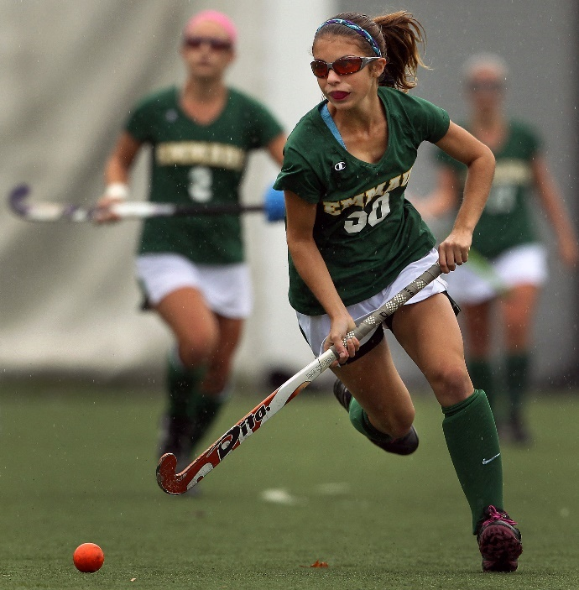
2016 NFHS Field hockey
POINTS OF EMPHASIS
Page: 61-63
PROPERLY MARKED PROTECTIVE EYEWEAR
ELIMINATION OF FACEMASK USE AS A PROTECTIVE DEVICE
25-YARD FREE HIT
SELF-PASS AND DELAY OF GAME
ROUGH AND DANGEROUS PLAY
GOOD SPORTING BEHAVIOR
Notes:
Comment on Slide:
The NFHS Field Hockey Rules Committee and the NFHS Board of Directors believe there are areas of the game of interscholastic field hockey that need to be addressed and given special attention. These areas of concern are often cyclical, some areas need more attention than others, and that is why they might appear in the rules book for consecutive editions. These concerns are identified as “Points of Emphasis.” For the 2016 high school field hockey season, attention is being called to: Properly marked protective eyewear, 25-yard free hit, self-pass and delay of game, rough and dangerous play, good sporting behavior. When a topic is included in the Points of Emphasis, these topics are important enough to reinforce and/or they are not being given the proper attention.
1. PROPERLY MARKED PROTECTIVE EYEWEAR
With the ASTM standards 2713-09, 2713-14 being in place since 2009 and 2014, respectively, the standardization of the performance of protective eyewear is more important now than ever before. It is incumbent upon the coaches and players to use the properly marked protective eyewear as it was manufactured. Combining various protective devices is potentially harmful and immediately voids any manufacturer’s warranty. By rule, required equipment shall not be modified and shall be worn as intended by the manufacturer. Manufacturers spend hundreds of hours researching and testing products before they are released to the public. They ensure that their products will perform at the highest level possible if it is worn properly. The NFHS makes a significant investment in time and resources to identify appropriate equipment for field hockey, for the sole purpose of minimizing risk. That is why there is a new rule requiring that all protective eyewear that meets the current ASTM standard be permanently labeled
effective January 1, 2019.
2. ELIMINATION OF FACEMASK USE AS A PROTECTIVE DEVICE
The masks do not meet any safety standard for ball or stick impact, nor do they offer any shatter resistance.
3. 25-YARD FREE HIT
The 25-yard free hit is a new rule change previously handled as a long hit. In an effort to improve the flow of play and standard of the game this rule has been implemented with emphasis on:
• Any 25-yard hit must follow the rules as outlined for any free hit within the 25-yard line.
• It is similar to taking a 16-yard hit, however, the attack has possession and places the ball on the 25-yard line, in line with where the ball went over the end line.
• All players shall be 5 yards away from the ball when the ball is put into play.
4. SELF-PASS AND DELAY OF GAME
The self-pass has been incorporated to improve the flow of the game. Delaying the game by any player should be avoided and coaches/officials should reinforce the following:
• Coaches should provide specific instruction regarding the 5-yard rule and how to defend it appropriately without inhibiting the flow of the game.
• Umpires should establish and communicate the 5-yard standard early in the game to support proper play and conduct of the players.
• A defender influencing or interfering with the self-pass before adhering to the 5-yard rule is a delay of game and should be penalized with the appropriate card progression to manage the game.
5. ROUGH AND DANGEROUS PLAY
Overly aggressive play and lack of regard for everyone’s safety is unacceptable in the sport of field hockey. In both practice and game play, coaches need to teach the safe use of the stick and good body control. Rough and dangerous play, such as deliberately/blindly hitting the ball into players who have been properly instructed and in good position to play defense, should be addressed by both coaches and officials. Players need to accept the possibility they could inflict serious injury. Officials must be able to recognize dangerous play and penalize it appropriately. Although it is recognized that the possibility of injury is inherent in field hockey, all participants have the obligation to minimize risk whenever possible.
6. GOOD SPORTING BEHAVIOR
Officials and coaches need to work together. Each contest is another opportunity for coaches and officials to teach not only field hockey, but also
model good sporting behavior. The positive values that are learned will serve the players long after their field hockey experience has concluded. Game situations typically provide a coach the opportunity to identify a teachable moment to reinforce good sporting behavior.

Slide 45
2016 nfhs
Field hockey information

Slide 46
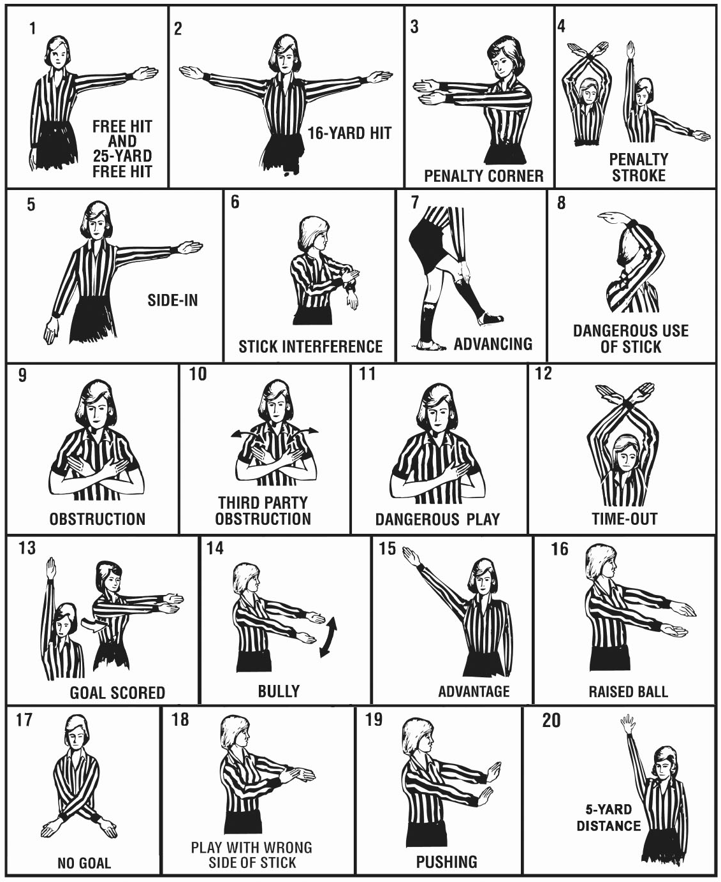
Official nfhs field hockey signals
Page: 87-88
1. Free Hit and 25-Yard Free Hit – Arm held to the side, slightly above
horizontal with the palm forward toward the field.
2. 16-Yard Hit – Umpire’s back is to the end line with arms held to the side,
slightly above horizontal, palms forward, pointing towards the center of
the field.
3. Penalty Corner – Extend both arms horizontally toward the goal.
4. Penalty Stroke – First signal time-out (arms crossed at the wrist above the
head), then extend the right arm overhead and the left arm toward the
penalty stroke line.
5. Side-In – For direction, arm extended to the side, slightly above horizontal,
palm forward toward the field with other arm down at the side.
6. Stick Interference – Hit forearm of one arm with other hand (chopping
action).
7. Advancing – Slightly raise one leg and touch it with the hand.
8. Dangerous Use of Stick – Raise bent arm forward and upward over the
head.
9. Obstruction – Arms crossed in front of chest with palms inward.
10. Third Party Obstruction – Arms crossed in front of chest, palms inward,
then move forearms in and out one time.
11. Dangerous Play – Place one forearm diagonally across the chest.
12. Time-out – Arms extended overhead, crossed at the wrist, palms forward
towards the field.
13. Goal Scored – One arm extended overhead, palm forward, then turn and
extend both arms horizontally towards the center of the field.
14. Bully – Move hands alternately up and down in front of body with palms
facing each other.
15. Advantage – Extend an arm high from the shoulder in the direction in
which the benefiting team is playing.
16. Raised Ball – Arms extended in front of body approximately 18 inches
apart, with palms held facing each other.
17. No Goal – Extend and cross arms in front of body with palms down.
18. Wrong Side of Stick – One arm extended in front of body, touch back of
hand with palm of free hand.
19. Pushing – Hands out in front of body with a pushing motion.
20. 5-Yard Distance – Extend one arm straight up in the air showing an open
hand with all fingers extended.
Notes:
1. Free Hit and 25-Yard Free Hit – Arm held to the side, slightly above
horizontal with the palm forward toward the field.
2. 16-Yard Hit – Umpire’s back is to the end line with arms held to the side,
slightly above horizontal, palms forward, pointing towards the center of
the field.
3. Penalty Corner – Extend both arms horizontally toward the goal.
4. Penalty Stroke – First signal time-out (arms crossed at the wrist above the
head), then extend the right arm overhead and the left arm toward the
penalty stroke line.
5. Side-In – For direction, arm extended to the side, slightly above horizontal,
palm forward toward the field with other arm down at the side.
6. Stick Interference – Hit forearm of one arm with other hand (chopping
action).
7. Advancing – Slightly raise one leg and touch it with the hand.
8. Dangerous Use of Stick – Raise bent arm forward and upward over the
head.
9. Obstruction – Arms crossed in front of chest with palms inward.
10. Third Party Obstruction – Arms crossed in front of chest, palms inward,
then move forearms in and out one time.
11. Dangerous Play – Place one forearm diagonally across the chest.
12. Time-out – Arms extended overhead, crossed at the wrist, palms forward
towards the field.
13. Goal Scored – One arm extended overhead, palm forward, then turn and
extend both arms horizontally towards the center of the field.
14. Bully – Move hands alternately up and down in front of body with palms
facing each other.
15. Advantage – Extend an arm high from the shoulder in the direction in
which the benefiting team is playing.
16. Raised Ball – Arms extended in front of body approximately 18 inches
apart, with palms held facing each other.
17. No Goal – Extend and cross arms in front of body with palms down.
18. Wrong Side of Stick – One arm extended in front of body, touch back of
hand with palm of free hand.
19. Pushing – Hands out in front of body with a pushing motion.
20. 5-Yard Distance – Extend one arm straight up in the air showing an open
hand with all fingers extended.

Slide 47

NFHS Rule Change Proposal System (RCPS) - Due: November 1, 2016
New Rule Change Proposal System (RCPS) is an online form to utilize for the submission of all proposed rules changes
Each state association shall determine from whom it will accept rule change proposals and process for distribution of access to link for the form
Proposals from coaches and officials must go through respective state association
Proposals from state association go directly to the NFHS
Proposals from the respective sport rules committee members go directly to the NFHS
Notes:
New this year is a new online system for the submission of rule change proposals.
The link to access the proposal form is under the control of each state association.
This ensures that all suggested changes from coaches and officials go to the respective state association for review for consideration to advance to the NFHS sport rules committee or not advance.
The state associations will utilize this same for to submit proposed changes directly to the NFHS.
This system allows the state to manage more efficiently all proposed changes.
If a member of a NFHS sport rules committee the same form is used and the proposed change goes directly to the NFHS and not through the state association office. This is the same process as in past years.

Slide 48
Standardized Open and Close Dates for NFHS Rule Change Proposal submission
Sport | Committee Meeting | Open Date for Proposals | Due Date for Proposals
Field Hockey | January | April 1 | November 1
Football | January | April 1 | November 1
Soccer | January | April 1 | November 1
Volleyball | January | April 1 | November 15
Spirit | March | June 1 | February 1
Swimming/Diving | March | June 1 | February 15
Basketball | March | June 1 | March 1
Wrestling | April | June 1 | March 1
Water Polo | April | June 1 | March 15
Ice Hockey | April | June 1 | April 1
Baseball | June | September 1 | May 1
Girls Lacrosse | June | September 1 | May 1
Softball | June | September 1 | May 1
Track & Field | June | September 1 | May 1
Boys Lacrosse | July | September 1 | June 1
Girls Gymnastics | October (2017)* | January 1, 2017* | September 15, 2017*
*These are standard annual open and close dates with the exception of girls gymnastics which will always occur during odd number year. (i.e. 2017, 2019, etc.)
Notes:
These are standard annual open and close dates with the exception of girls gymnastics which will always occur during odd number year. (i.e. 2017, 2019, etc.) due to this being an every other year rules book.
The Sport Schedule page lists the time periods in which each sport will be open to accept entries for rule change proposal(s).

Slide 49
NFHS Rule Change Proposal System (rcps)
The following links will be utilized to submit and manage rules proposals by the respective state association
Rule Change Proposal Form: http://www.nfhs.org/RuleChangeProposal
Proposal Management for State Association Staff: http://www.nfhs.org/RuleChangeProposal/Association
Notes:
This first link takes the individual to the actual rule change proposal form.
For the coach or official, the profile information such as name, email, state etc. must be completed.
For the state association staff member or committee member who is logged into the NFHS site, this profile information is automatically populated on the form.
The second link is for state association staff only and is the management side of the system to review, edit, approve or reject a submitted change.
For more information go to nfhs.org, login and go to My Groups to review a video and/or instruction documents on the RCPS.

Slide 50
Additional nfhs field hockey information
2016 NFHS Field Hockey Rules Online State Interpreters Meeting
  July 25, 2016 – 2:00 pm. (Eastern Time)
2017 NFHS Field Hockey Rule Change Proposal Form Due
  November 1, 2016
2017 NFHS Field Hockey Rules Committee Meeting
  January 11-13, 2017
  Indianapolis, Indiana
2017 NFHS Field Hockey Rules Online State Interpreters Meeting
  July 24, 2017 – 2:00 pm. (Eastern Time)
Notes:
NFHS REMINDER – Additional Information:
NFHS information with regards to field hockey.

Slide 51
NFHS Officials Association central hub

Slide 52
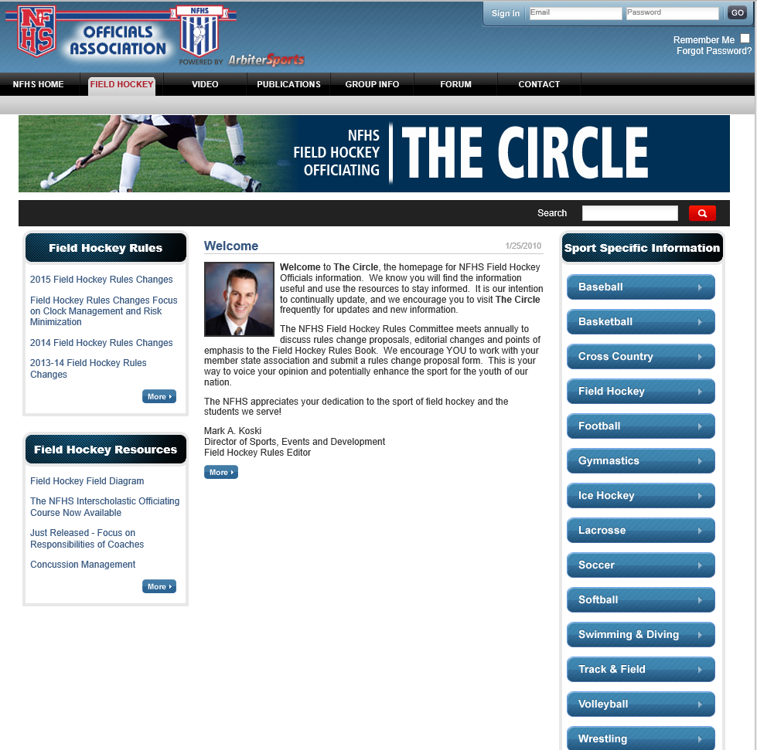
NFHS Officials Association Central Hub
https://nfhs-fieldhockey.arbitersports.com/front/105408/Site
Contains:
  Sport information
  Rules information
  Rules library
  Searchable rules book
  Video content on officiating sport, competition situations and interpretations
Notes:
Comment on Slide:
See comments on slide.

Slide 53
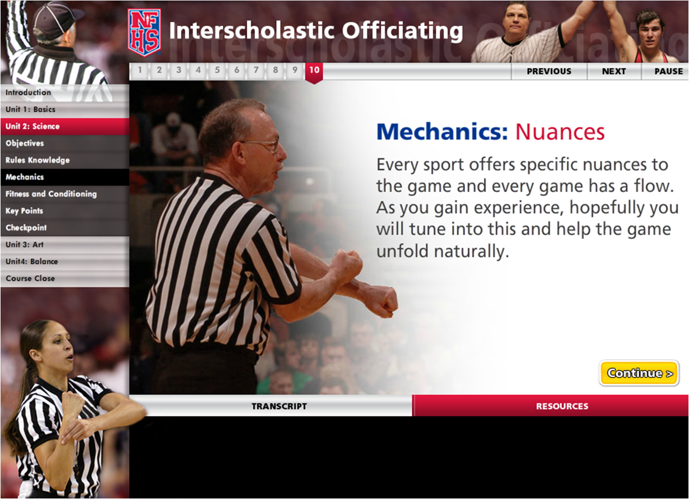
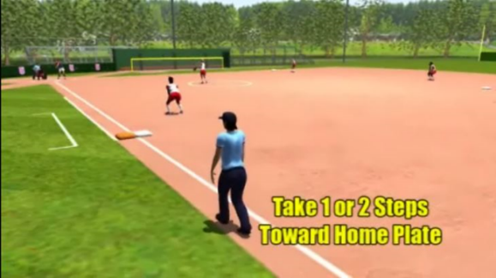
NFHS Officials education
Course and videos
Ideal for new officials or those in first few years of officiating
30-45 minutes to complete
Topics include: Basics of Becoming and Staying an Official, Science of Officiating, Art of Officiating
Course is FREE to NFHS Officials Association members, non-members fee is $20
NFHSLearn.com
Sports such as soccer, basketball and baseball offer direct illustrations of the rules book, including rules references and officials signals
Animated mechanics videos for softball and baseball umpires
Video interpretation of the NFHS Basketball Rules Book created through a partnership with the International Association of Approved Basketball Officials
Notes:
Comment on Slide:
See comments on slide.

Slide 54
NFHS Learning Center

Slide 55

The NFHS Learning Center
Mission: Provide ongoing professional development for Coaches, Administrators, Students, Parents and Officials on the role they play within interscholastic athletics and activities.
Notes:
Comment on Slide:
See comments on slide.

Slide 56

www.NFHSLearn.com
Register on
NFHSLearn.com and
receive the following
great benefits:
  Immediate access to all 18 NFHS free courses
  Opportunity to receive email updates on your sport, upcoming courses and much more
  Access coursework 24/7/365
  Access completion certificates 24/7/365
Notes:
Comment on Slide:
See comments on slide.

Slide 57






NFHS FREE Courses
Concussion in Sports
Coaching Pole Vault
NCAA Eligibility
Positive Sport Parenting
Sportsmanship
Sports Nutrition
Heat Illness Prevention
Introduction to Music Adjudication
Introduction to Pitch Smart
Learning Pro – Suite of 4 courses
Coaching Unified Sports
Creating a Safe and Respectful Environment
Engaging Effectively with Parents
Sudden Cardiac Arrest
Captains Course
Interscholastic Officiating
National Coach Certification Program
Notes:
Comment on Slide:
See comments on slide.

Slide 58


Concussion in Sports
Course Objectives
Units
■ Understand what concussions are & their impact on players
■ Recognize the complications associated with concussions
■ Recognize signs and symptoms of concussion
■ Know when additional medical attention is needed
■ Understand what your responsibilities are in concussion management
■ Understand the proper concussion management protocols
■ List the steps a player should use to return to active play safely
after a concussion
■ Concussion Overview
■ The Problem
■ Your Responsibility
More Information at nfhslearn.com!
Notes:
Comment on Slide:
About: The NFHS has teamed up with the Centers for Disease Control and Prevention (CDC) to educate coaches, officials, parents and students on the importance of proper concussion recognition and management in high school sports. This course highlights the impact of sports-related concussion on athletes, teaches how to recognize a suspected concussion, and provides protocols to manage a suspected concussion with steps to help players return to play safely after a concussion. Each state's requirements for concussion management are included as part of the course.
More:
■ Unlimited access to course & resources for 90 days from date of purchase
■ FREE Course
■ Required course for AIC and CIC certification
■ Approved by NFHS for 1 course clock hour

Slide 59
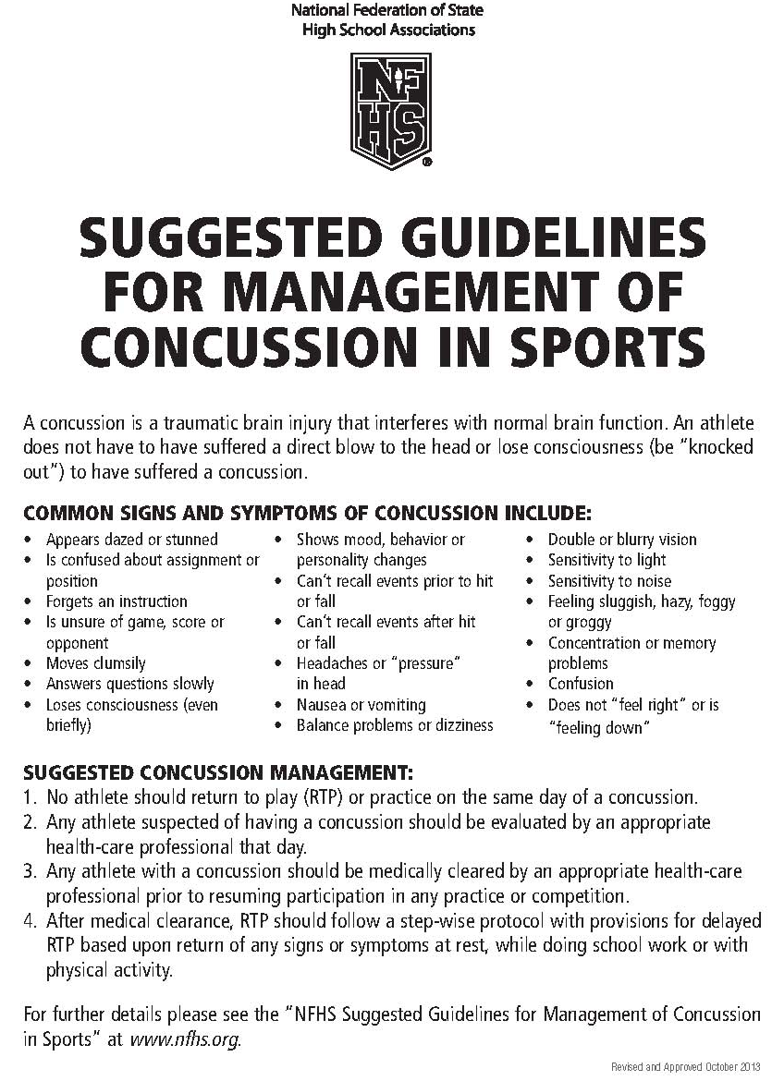
Nfhs suggested guidelines for management of concussion in sports
Page: 90
In the Appendix
in all 2016-17 NFHS
Rules Book
Notes:
Comment on Slide:
The “NFHS Suggested Guidelines for Management of Concussion” is in the Appendix in all 2016-17 NFHS Rules Books and was developed by the NFHS Sports Medicine Advisory Committee (SMAC).

Slide 60

Heat Illness
Prevention
Course Objectives
■ Recognize that Exertional Heatstroke (EHS) is the leading preventable cause of death among athletes
■ Know the importance of a formal pre-season heat acclimatization plan
■ Know the importance of having and implementing a specific hydration plan, keeping your athletes well-hydrated, and providing ample opportunities for, and encouraging, regular fluid replacement
■ Know the importance of appropriately modifying activities in relation to the environmental heat stress and contributing risk factors (e.g., illness, overweight) to keep your athletes safe and performing well
■ Know the importance for all staff to closely monitor all athletes during practice and training in the heat, and recognize the signs and symptoms of developing heat illness
■ Know the importance of, and resources for, establishing an Emergency Action Plan and promptly implementing it in case of suspected EHS or other medical emergency
Units
■ Fundamentals
1. Start Slow, Then Progress
2. Allow for Individual Conditioning
3. Adjust Intensity and Rest
4. Start Sessions Adequately Hydrated
5. Recognize Signs Early
6. Recognize More Serious Signs
7. Have an Emergency Action Plan
More Information at nfhslearn.com!
Notes:
Comment on Slide:
About: Exertional heat stroke is the leading cause of preventable death in high school athletics. Exertional heat stroke also results in thousands of emergency room visits and hospitalizations throughout the nation each year. This free course, brought to you by EAS Sports Nutrition, a division of Abbott Labs, is designed to give you the critical information you need to minimize the risk of exertional heat stroke among your athletes. The course presents seven fundamentals, which when followed, will minimize heat related illnesses of the students who participate.
More:
■ Unlimited access to course & resources for one year from date of purchase
■ FREE Course
■ Use as an elective to fulfill CIC certification requirements
■ Approved by NFHS for 1 course clock hour

Slide 61


Sudden Cardiac Arrest
Course Objectives
■ Understand what sudden cardiac arrest is
■ Recognize the warning signs and symptoms of sudden cardiac arrest
■ Learn what to do if a player collapses during physical activity
Units
■ Introduction
■ Sudden Cardiac Arrest
■ Post Test
More Information at nfhslearn.com!
Notes:
Comment on Slide:
About: Sudden Cardiac Arrest is the number one cause of death in student athletes during exercise across the United States. Caused by a structural or electrical problem associated with the heart, Sudden Cardiac Arrest happens when the heart unexpectedly stops beating and pumping blood. With content developed by Simon’s Fund, this course will help you learn and recognize the warning signs and symptoms of Sudden Cardiac Arrest. Also included are tips for what to do in the critical moments after an individual suddenly collapses in order to save their life.
More:
■ Unlimited access to course & resources for 90 days from order date
■ FREE Course
■ Use to fulfill CIC certification requirements
■ Approved by NFHS for 1 course clock hour

Slide 62

Sports
Nutrition
Course Objectives
■ Emphasize the importance of proper fueling for physical activity, pre- and post-workout
■ Provide real-world effective advice for helping your students to make better food decisions
■ Underscore male-and female-specific issues surrounding the topic of nutrition
■ Clarify the warning signs for eating disorders and disordered eating
■ To provide an overview about dietary supplements, how they are regulated and how to avoid use of contaminated dietary supplements
■ To highlight the risks to athletes who use performance-enhancing drugs, including anabolic-androgenic steroids
■ Reinforce the no-drug policy of interscholastic athletics
Units
■ Nutrition
■ Supplements
More Information at nfhslearn.com!
Notes:
Comment on Slide:
About: Proper nutrition can optimize athletic performance. This free course, brought to you by EAS Sports Nutrition, a division of Abbott Labs, can help your students perform at their peak. This course presents practical tips on how you can teach and model proper nutrition to your athletes.
More:
■ Unlimited access to course & resources for one year from date of purchase
■ FREE Course
■ Use as an elective to fulfill CIC certification requirements
■ Approved by NFHS for 3 course clock hours

Slide 63
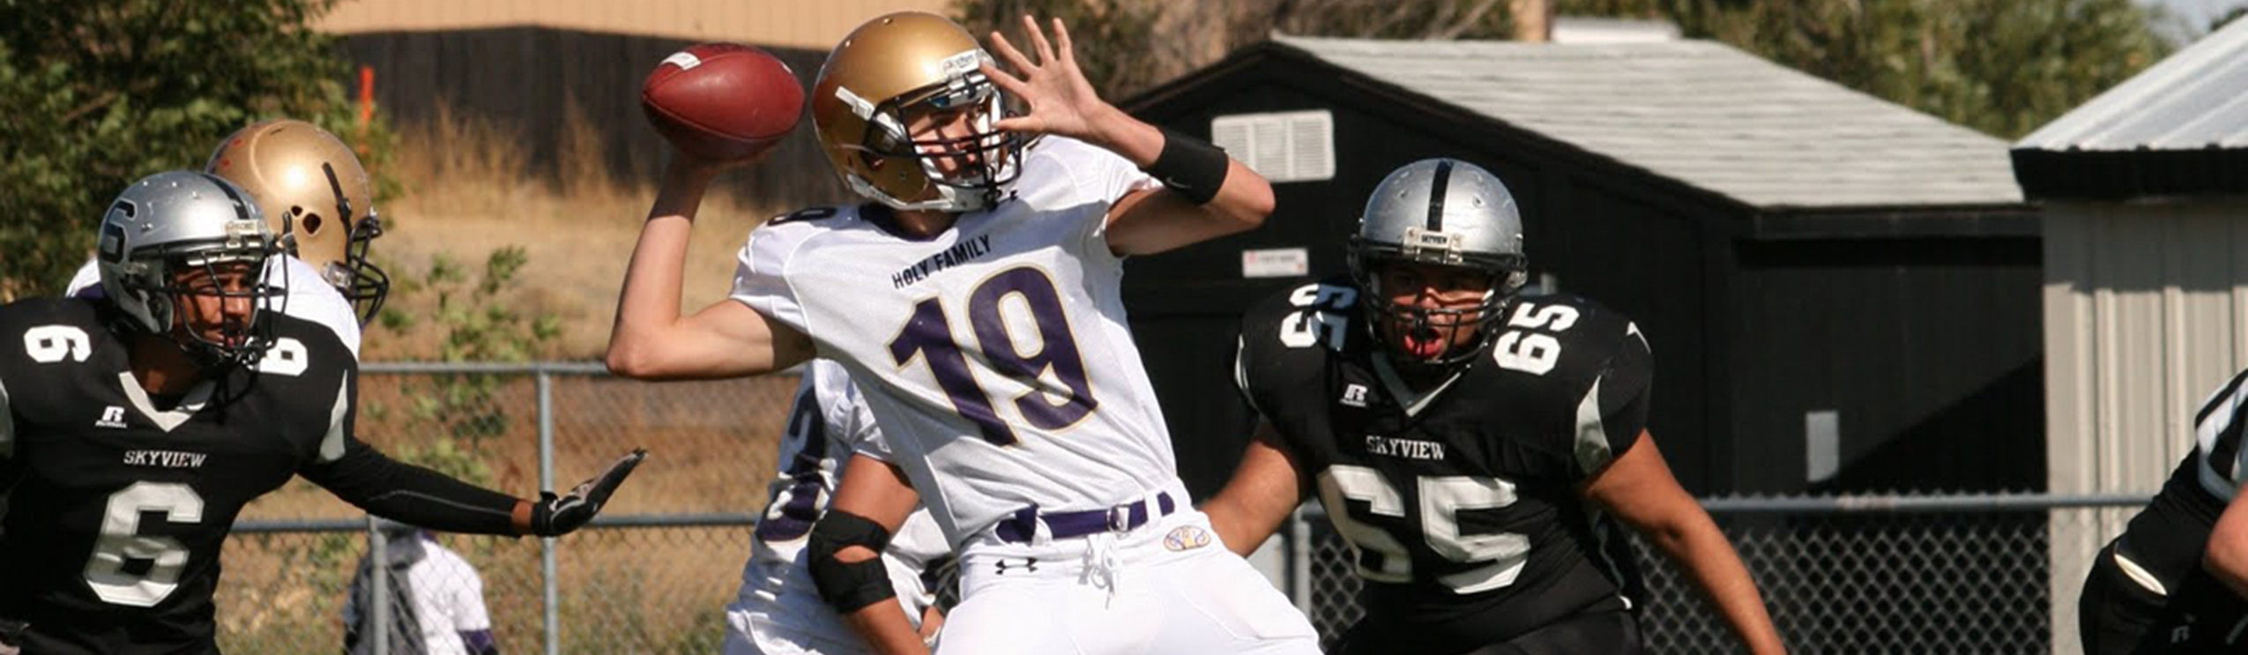
Coaching
Football
Course Objectives
■ Proper hand positioning for catching the ball
■ Identify drills for teaching safe tackling techniques
■ Teach fundamental Quarterback skills – proper stances, footwork, controlling the snap, securing the ball, drop back and passing
■ Teach fundamental Running Back skills – proper stances, taking the handoff, pass protection blocking, route running and receiving
■ Teach fundamental Wide Receiver and Tight End skills – proper stances, routes, running and blocking
■ Teach Tight End and Offensive Linemen blockings skills – drive block, combination block, double team block and pass rushing blocking
■ Teach fundamental Special Teams skills – kickoff technique, cover team, return specialist, extra point and punting
Units
■ All Player Skills
■ Offensive Team Skills
■ Defensive Team Skills
■ Special Teams
More Information at nfhslearn.com!
Notes:
Comment on Slide:
About: Coaching Football developed by USA Football in partnership with the NFHS, provides a student-centered curriculum in essential football coaching techniques and methods for interscholastic teacher/coaches. This course provides demonstration and teaching tips for each offensive and defensive position and shares practical methods for increasing student participation through effective feedback and stress reduction. Coaches who complete this course receive a one-year membership to USA Football that includes $1 million of general liability insurance.
More:
■ Unlimited access to course & resources for one year from date of purchase
■ Use to fulfill AIC or CIC certification requirements
■ Approved by NFHS for 5 course clock hours

Slide 64
NFHS Network

Slide 65

NFHS Network
By 2020, every high school sporting event in America will be streamed live.
The NFHS Network will be THE DESTINATION for fans to view these broadcasts.
Notes:
Comment on Slide:
See comments on slide.

Slide 66

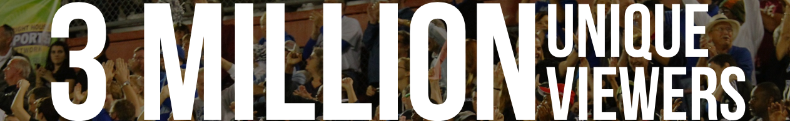
Notes:
Comment on Slide:
See comments on slide.

Slide 67
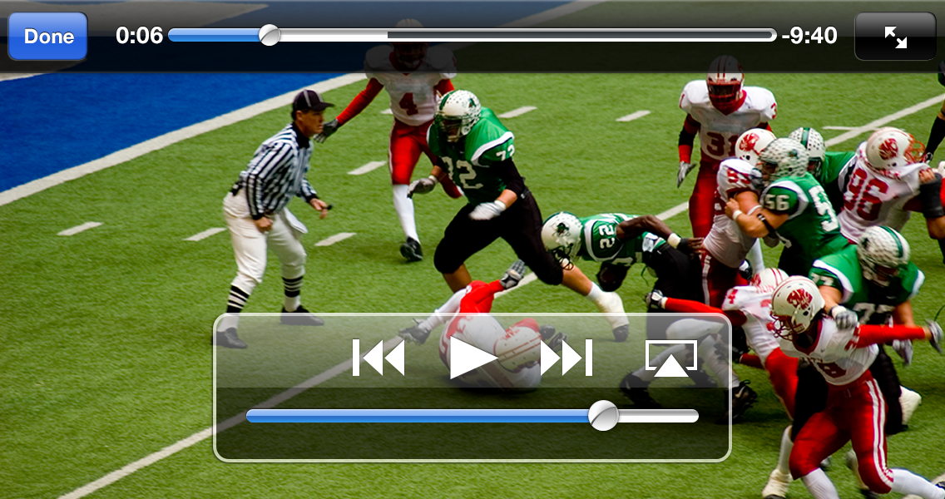
NFHS Network
View from mobile…
Notes:
Comment on Slide:
See comments on slide.

Slide 68
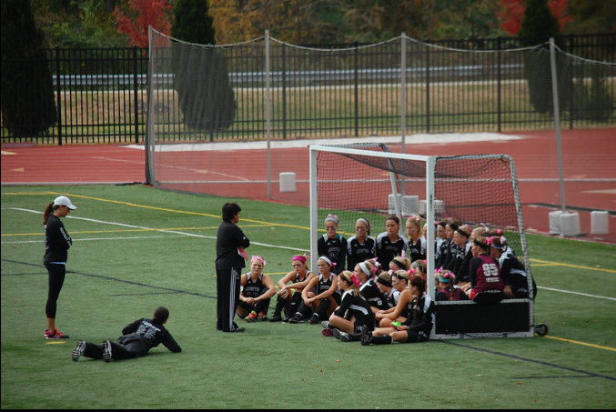
Thank You
National Federation of State High School Associations
PO Box 690 | Indianapolis, IN 46206
Phone: 317-972-6900 | Fax: 317.822.5700
www.nfhs.org | www.nfhslearn.com

